Slide 1
DEI Syllabus Statements
Department of Biomedical Informatics 08/08/2023

Slide 2
Purpose
To ensure all students are supported in their learning (Finley, 2021)
Helps students understand the importance and relevance of diversity and inclusion (Finley, 2021)
Signal to your students your commitment to creating an inclusive and supportive climate for all students (CMU, 2023)
Support a sense of belonging for your students by signaling care of the diversity of backgrounds and perspectives in class (Fuentes et al., 2020)
Signals that you value diversity and are committed to fostering an equitable, inclusive learning environment, …and may also articulate and model classroom behaviors you’d like students to practice as well (UWM, 2023)

Slide 3
Guidance (1)
Personalize your DEI syllabus statement specific to you and your course
Consider sharing your own social profile/locations (Fuentes et al., 2020)

Slide 4
Guidance (2)
Personalizing syllabus DEI statements (University of Iowa)
Inclusive Syllabi (University of Kansas)
Diversity & Inclusion Syllabus Statements (Brown University)
4 examples provided
Diversity & Inclusion Syllabus Statements (Clemson University)
Many examples; compiles information across multiple institutions
Diversity Statement on a Syllabus (Carnegie Mellon University)
5 examples provided

Slide 5
Things to consider including (University of Iowa)
Proclamation for the respect for diversity
An explicit valuing of diverse perspectives
Expectations with respect to the classroom climate and behavior
How micro- and macroaggressions will be addressed and used as teaching moments
Acknowledgment of inequities in society, education, or one’s field
Relevant student resources
Indication of ways that diversity enhances learning
Acknowledgment of how a diversity statement aligns with your teaching philosophy
Personalizing syllabus DEI statements (University of Iowa)

Slide 6
Things to consider including (Brown University)
What are your discipline's conventions and assumptions?
How might students with varying backgrounds respond to them?
What role does your respect for and engagement with diversity in the classroom play in your personal teaching philosophy?
What positive learning outcomes can come from respecting differences in the classroom? How can you highlight these?
What do you want your students to know about your expectations regarding creating and maintaining a classroom space where differences are respected and valued?
Is your statement inclusive of different types of diversity, including, but not limited to: race, gender, ethnicity, sexual orientation, age, socioeconomic status, religion, and disability?
Which campus resources would you like to direct your students to for further support?
What kind of classroom environment would your students like to see?
How might you include them in the conversation about standards for classroom civility?

Slide 7
Things to consider including (Carnegie Mellon University)
How do you, concretely, recognize and value diversity in your classroom?
How can diversity – as represented in your discipline, course content, and classroom – be an asset for learning?
How will issues related to diversity arise in your course and classroom? And, how will you handle them (ideally) when they do?
Do you seek input from your students on classroom climate (i.e., to what extent they feel included and how)?
Why being inclusive matters to you, specifically, and how that relates to your discipline, course, and desired classroom climate
What relevant resources exist on campus that could be useful to your students?
DBMI DEI has a feedback form that can be filled out anonymously: https://redcap.link/uamsdbmideisuggestions

Slide 8
Examples (1)
“Respect for Diversity: It is my intent that students from all diverse backgrounds and perspectives be well served by this course, that students’ learning needs be addressed both in and out of class, and that the diversity that students bring to this class be viewed as a resource, strength and benefit. It is my intent to present materials and activities that are respectful of diversity: gender, sexuality, disability, age, socioeconomic status, ethnicity, race, and culture. Your suggestions are encouraged and appreciated. Please let me know ways to improve the effectiveness of the course for you personally or for other students or student groups. In addition, if any of our class meetings conflict with your religious events, please let me know so that we can make arrangements for you.”
(Source)

Slide 9
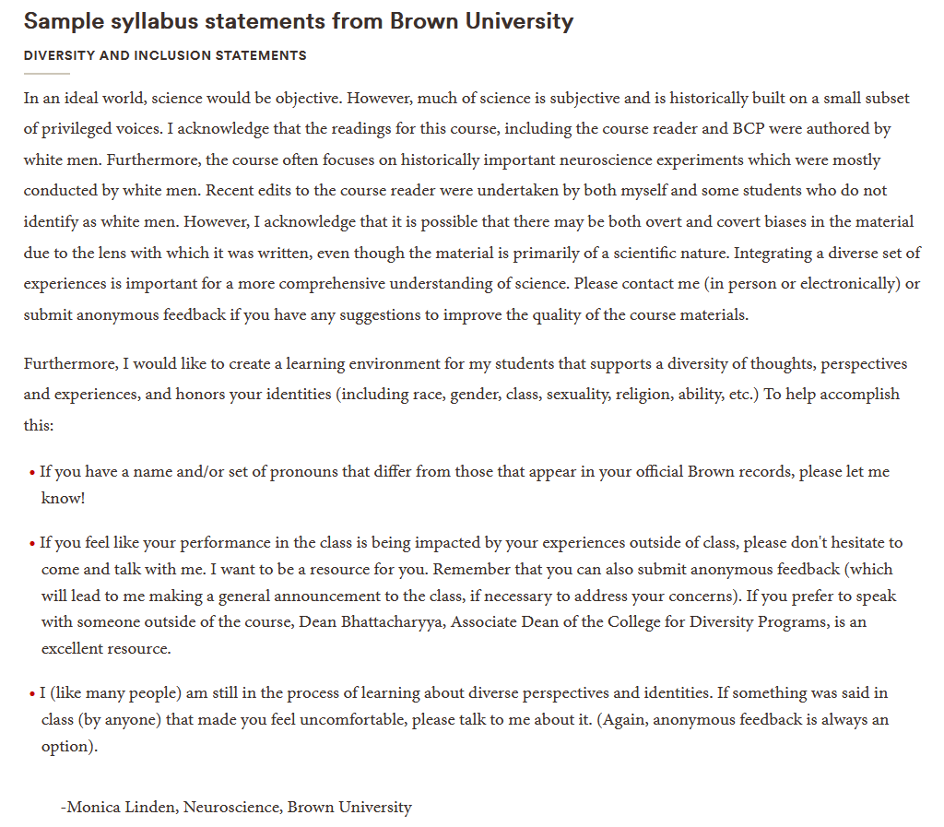
Examples (2)
(Source)

Slide 10
Examples (3)
Diversity and Inclusion Statement: Stonehill College embraces the diversity of students, faculty, and staff, honors the inherent dignity of each individual, and welcomes their unique cultural and religious experiences, beliefs, and perspectives. We all benefit from a diverse living and learning environment, and the sharing of differences in ideas, experiences, and beliefs help us shape our own perspectives. Course content and campus discussions will heighten your awareness to these differences. There are many resources for anyone seeking support or with questions about diversity and inclusion at [INSTITUTION]. Resources are infused throughout the Mission Division, Academic Affairs, and Student Affairs. If you’d like more information on how to get connected to resources, [INSERT CONTACT INFORMATION]. If you are a witness to or experience an act of bias at [INSTITUTION], you may submit a bias incident report [LINK HERE]. A personal note from your professor… If you ever have a concern about my behavior or that of another student in the class, please, please feel free to approach me in person, by email, or with an anonymous note under my door… whatever it takes so that I can continue to work on creating an inclusive classroom environment. Thank you.
(Source)

Slide 11
Examples (4)
“This is an Inclusive Classroom. At [INSTITUTION], administrators, faculty, and staff are committed to the creation and maintenance of “inclusive learning” spaces. These are classrooms, labs, and other places of learning where you will be treated with respect and dignity and where all individuals are provided equitable opportunity to participate, contribute, and succeed. In [our classroom/insert course here], all students are welcome regardless of race/ethnicity, gender identities, gender expressions, sexual orientation, socio-economic status, age, disabilities, religion, regional background, Veteran status, citizenship status, nationality and other diverse identities that we each bring to class. Your success at KU and beyond is enhanced by the innovation and creativity of thought that inclusive classrooms facilitate. The success of an inclusive classroom relies on the participation, support, and understanding of you and your peers. We encourage you to speak up and share your views, but also understand that you are doing so in a learning environment in which we all are expected to engage respectfully and with regard to the dignity of all others. Any student who has difficulty affording groceries or who lacks a safe and stable place to live and believes this may affect their performance in the course is urged to contact me or [LINK TO RESOURCE] for support. Other resources you may find helpful: [INCLUDE OTHER LINKS]. If you have any questions or concerns do not hesitate to raise them in class or with me directly.”
(Source)

Slide 12
Examples (5)
Cilia Zayas, MSF, MHA, DBMI Ph.D. Candidate and Instructor of Record Fall 2021
Course: HPMT 5134: Introduction to Health Systems Financial Management
“It is my intent that students from all diverse backgrounds and perspectives be well served by this course, that students’ learning needs be addressed both in and out of class, and that the diversity that students bring to this class be viewed as a resource, strength, and benefit. In this class we are establishing a working knowledge of fundamental accounting and financial management concepts, techniques, and vocabularies as they apply to the different perspectives, mission, and goals of healthcare organizations in the United States. Thus, diverse perspectives represent a great benefit to this course, and I appreciate you sharing your perspectives and experiences. It is my intent to present materials and activities that are respectful of diversity: gender, gender identity, gender expression, disability, age, socioeconomic status, ethnicity, race, nationality, religion, culture, and ability. Since our discussions and group work activities require interactively working with colleagues with different world views, I ask all participants to engage with care and respect for other members in the classroom. Your suggestions are encouraged and appreciated. Please let me know ways to improve the effectiveness of the course for you personally, or for other students or student groups. In addition, if any of our class meetings conflict with your religious events, please let me know so that we can make arrangements for you. I will gladly honor your request to be addressed by a different name or gender pronoun. Please let me know early in the semester if this is your desire so that I can make the necessary changes to my records.”
-Credit is given to Dr. Brochhausen for sharing DEI Syllabus Statement for GMS6805 used with modifications for HPMT 5134.

