Slide 1
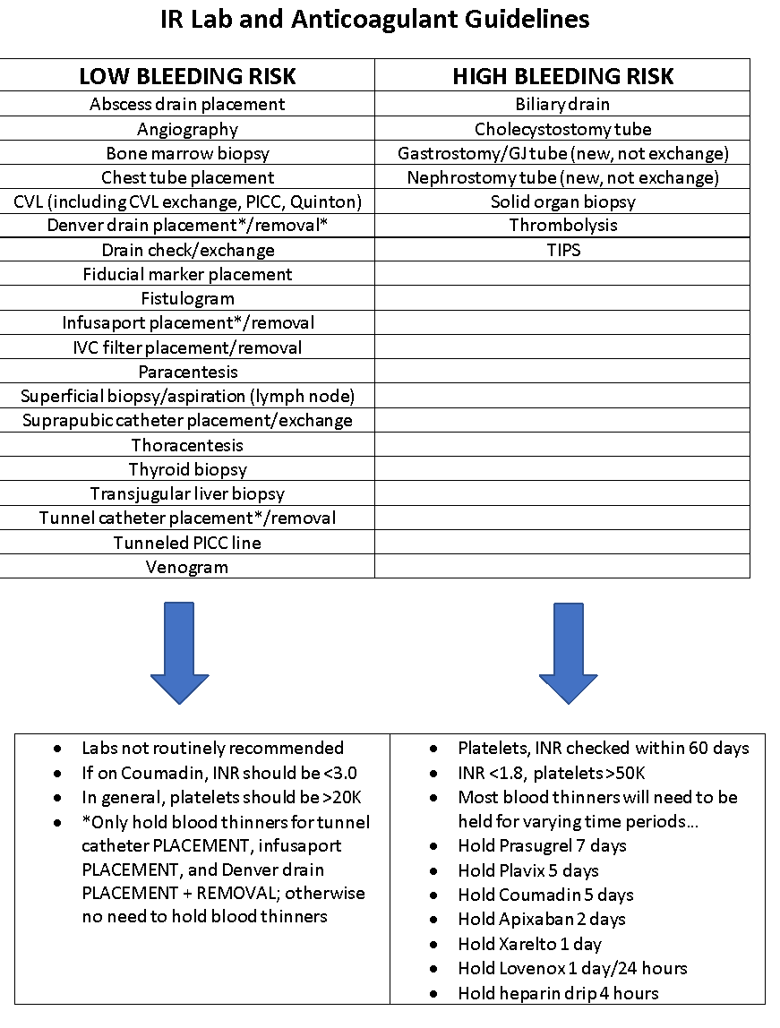
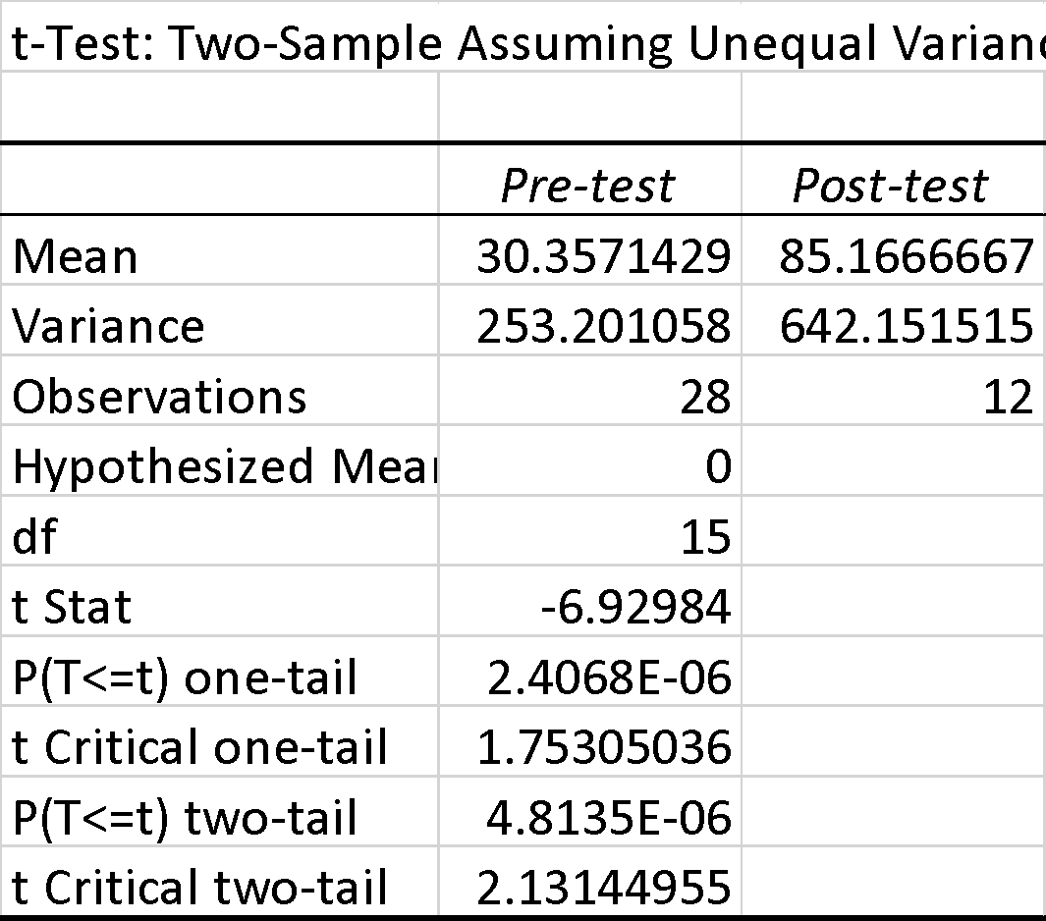
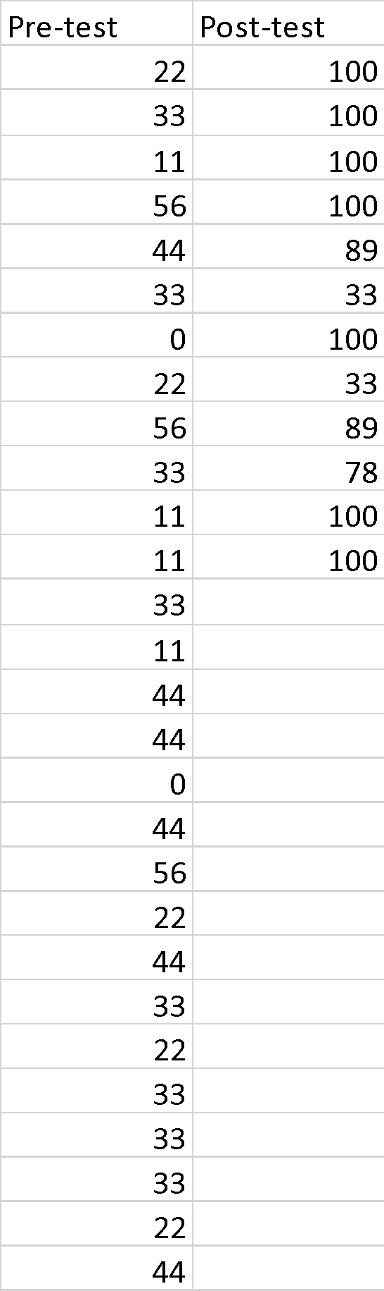



"Periprocedural guidelines for interventional radiology"
Resident Handout
Floyd, Sarah, MD, Kincaid, John, MD, Kaczenski, Alexander, MD, McAlister, Amanda M, MD, Peeples, Brooke, MD, Wood, Cole, MD, Dr Mollie Meek
Lack of education in current IR guidelines is a major barrier in obtaining efficient interventional services. We designed a graphic that improves Internal Medicine Residents’ knowledge of which procedures are high or low bleeding risk to better achieve recommended INR and platelet goals without delay in care. Our results show that this tool is effective in distributing this knowledge to residents with the eventual goal of reducing delays to the IR suite.
Introduction
Failure to recognize current IR guidelines has led to delay in care for some hospitalized patients. Using Society of IR consensus guidelines, we devised an easy-to-reference guide to laboratory thresholds and anticoagulant/antiplatelet administration for the most common IR procedures. We hypothesize that increased familiarity with these guidelines will result in fewer delays when coordinating interventions between Internal Medicine and IR.
Methodology
A two-page guide was prepared, dividing IR procedures into “Low Bleeding Risk” and “High Bleeding Risk” groups and their respective recommendations. A 10-question pre-test survey was disseminated to the Internal Medicine residents, followed by the guide and a post-test to assess for a difference in parameter knowledge.
Holding Blood Thinners for High Bleeding Risk Procedures
Blood Thinner | Duration
Advil/Naproxen | No hold
Aggrenox | 5 days
Apixaban/Eliquis | 2 days
Argatroban/Acova | 4 hours
Aspirin | No hold
Betrixaban/Bevyxxa | 3 days
Bivalirudin/Angiomax | 4 hours
Cilostazol/Pletal | No hold
Clopidogrel/Plavix | 5 days
Coumadin/Warfarin | 5 days
Dabigatran/Pradaxa | 2 days
Dalteparin/Fragmin | 24 hours
Edoxaban/Savaysa | 2 days
Enoxaparin/Lovenox | 24 hours
Eptifibatide/Integrillin | 4 hours
Fondaparinux/Arixtra | 2 days
Heparin IV drip | 4 hours
Heparin SQ injection | Hold AM dose
Prasugrel/Effient | 7 days
Rivaroxaban/Xarelto | 1 day
Ticagrelor/Brilinta | 5 days
Results
28 pre-tests were returned, with an average score of 31%. The post-test average of 12 respondents was 85%. This was found to be significant using a two-sample t-test assuming unequal variance (p<0.005)

