Slide 1
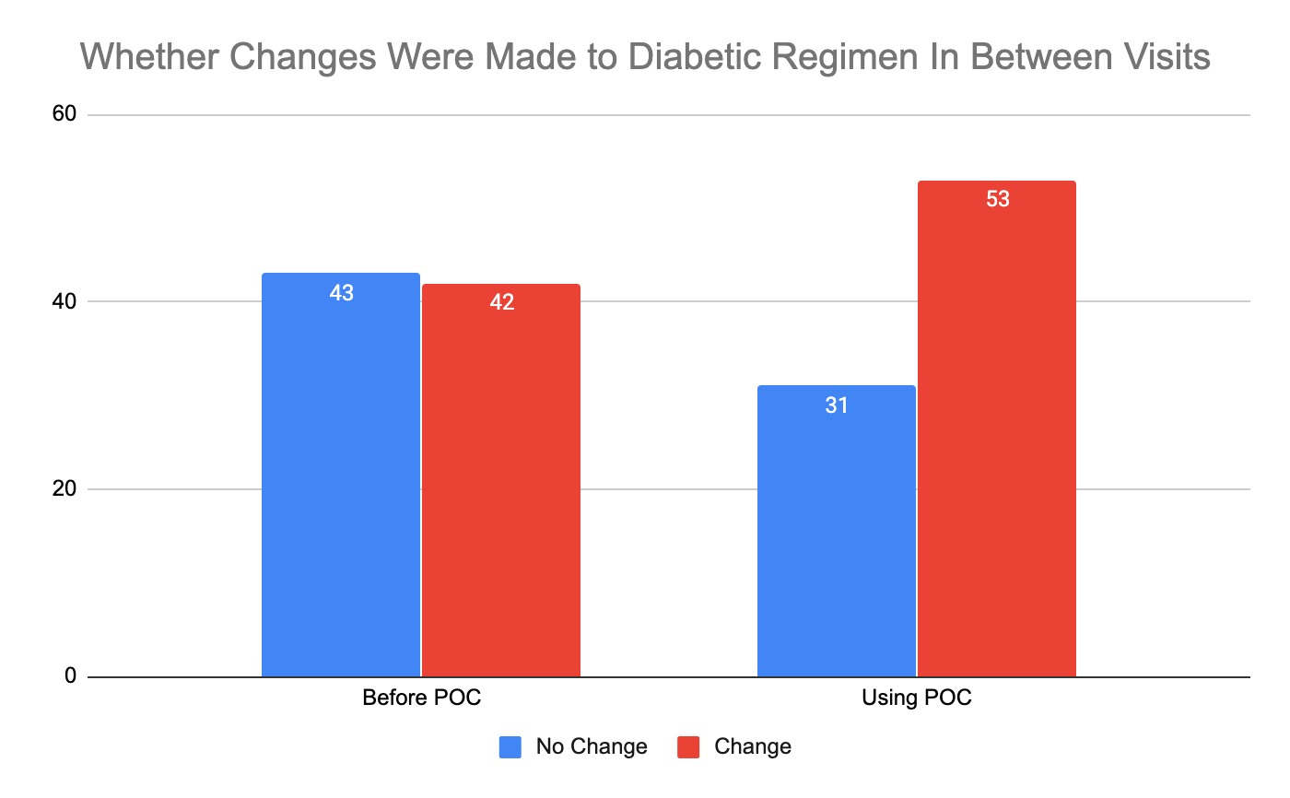
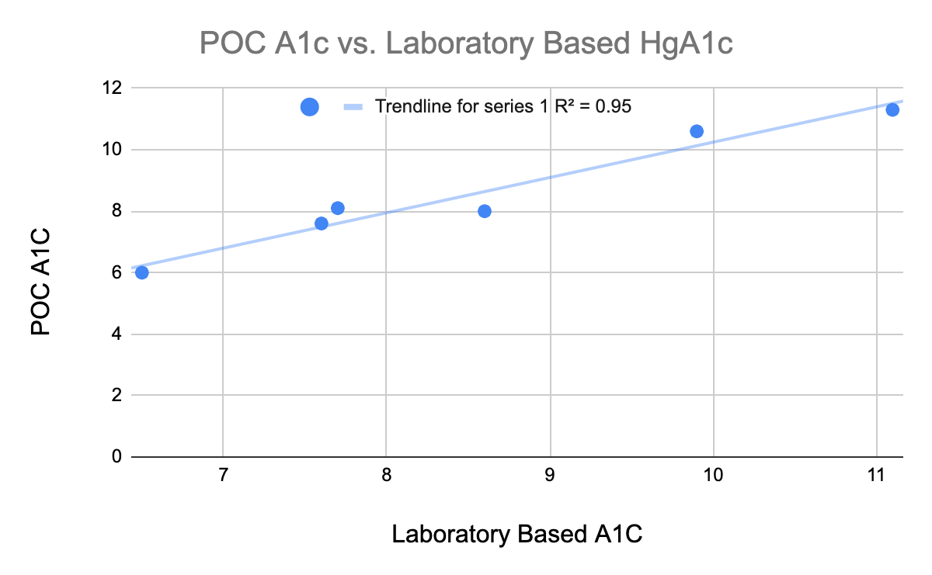

Use of point-of-care Hemoglobin A1C in the UAMS ambulatory setting
Arthur Slaton, MD, Caleb Peyton, MD & Alice Alexander MD
University of Arkansas for Medical Sciences Internal Medicine Program
Abstract
Methodology
Results
Resident/Attending Feedback
One of the challenges of working in the ambulatory setting is seeing patients with multiple co-morbidities, formulating a plan looking back at previous laboratory values, then contacting these patients at a later time to make changes (if any) to their medical regimens based on lab values collected after the in-person visit. With the development of and improvement in Point of Care (POC) technology, a lot of lab values can be tested in clinic with information coming back in minutes allowing for changes to be made prior to the patient leaving the office. The prototypical POC test is hemoglobin a1c (HgbA1c) that is routinely monitored on diabetics every 3 to 6 months with minor adjustments being made very frequently.
We sought out to answer the question of will having access to POC HgbA1c improve patient care and outcomes with regards to timely changes in medical regimens and improved glycemic control?
A prospective longitudinal observational study involving 171 patients with type II diabetes from the Internal Medicine Resident Clinic at UAMS were followed for a period of 1 year. At the beginning of the research period, patients’ POC HgbA1c was compared to previous lab collected HgbA1c and whether changes were made in the time period between visits.
From 01/14/19 to 04/22/19, we collected a group of 171 patients that are being followed in UAMS Internal Medicine Primary Care Clinic for diabetic management. Our clinic sent out a daily notice at the beginning of each clinic session to each provider with names of scheduled patients for that day that are due for an A1C test and this was used to gather the patients used for this study. These results were viewed retrospectively along with other aspects of the patients’ charts including what the patients’ previous A1C values were, if any changes to the medication regimen were made based off the obtained POC value, and if there were any comparable A1C values obtain during other healthcare visits (for accuracy purposes). This group of patients was then followed over the next six months and POC A1C values were collected during follow-up visits and these were compared with the initial value to assess if the changes to medication regimen (or lack thereof) based on the POC test were efficient in better diabetic management. Of the 171 patients, we excluded patients who were type 1, being managed by endocrine, or had well controlled diabetes as defined by HgbA1c that was < 8.0 and would not warrant a change in diabetic regimen according to the goal hemoglobin A1c as established by the American College of Physicians¹.
With our secondary goal being to help validate the accuracy of the POC A1c machines, we also chart reviewed patients to see if a laboratory HgA1c had been drawn on the same day as any of the POC A1c. There were 8 cases throughout the study period where a laboratory hemoglobin A1c was drawn on the same day that a POC A1c was used in the clinic, these are reflected in the results section.
After applying our exculsion criteria, 85 of the 171 patients met criteria in the visit prior to implementing the POC A1C testing in the clinic. Of the 85 patients, only 42 patients (49.41%) had a change made to their diabetic regimen after their lab was drawn and the next visit. At the next visit when POC A1C was used, 84 of the 171 patients met criteria. 53 of the 84 patients (63.10%) had a change made to their diabetic regimen before their next scheduled follow up (Figure 1).
We sent out a five-question survey to 32 UAMS clinic physicians regarding different aspects of the POC A1C test. All levels of training, from PGY-1 to attending level, participated in the survey.
90.63% thought that having access to POC A1C machines improved the overall management of their respective diabetic patients.
90.63% thought that the POC test allowed for quicker, more efficient adjustments to diabetic regimens.
64.52% believed the POC test results to be fully accurate.
75% did not think that integrating the POC test slowed the pace of clinic in any noticeable way.
93.75% felt that having the POC A1C test allows for improved diabetic education with their patients.
Conclusions
By comparing what percentage of patients had a change to their diabetic regimen we showed that having POC A1C had a drastic impact on the amount of patients that had changes made to their diabetic regimen before their next appointment. We decided not to study whether implementing POC A1C had an impact on glycemic control and improved HgbA1C values because of the many different factors that go in to a patient improving their control. Of the majority of patients that met criteria for having a change made that did not have any changes, the main reason for no changes being made to their regimen seemed to be non-compliance. In these instances, the previous regimen was prescribed without any changes.
Although a limited number of lab A1C values were drawn to directly compare with the POC A1C values, when they were available it appears that they correlate very closesly with the lab values which is consistent with previous studies results.
Another concern was whether adding another data point to review in the course of a normal clinic visit would have the providers feel more stressed with time. When we polled both residents and attendings not only did the overwheliming majority think that POC A1C improved their ability to care for diabetic patients, but 75% did not believe that it slowed the pace of clinic in any noticeable way.
There are several limitations in our study. It was a small study group performed in a very difficult patient population. These included but aren’t limited to patients’ compliance with medication regimen, residents/attendings not ordering the POC test during visits, and patients being lost to follow up. In the future, studies could be designed with larger patient populations and could focus on whether glycemic control is affected by having POC technology available in clinic.
Introduction
As primary care Internal Medicine physicians, one disease process we encounter arguably more than any other is diabetes. Management can be difficult as so many aspects comprise care other than medication changes. We sought to find a more efficient way to at least mitigate the delay of appropriate medication adjustments.
Early in our residency careers, we saw first-hand how diabetic medication management could suffer delays in care. Prior to integration of POC (point of care) A1C machines, we would meet with diabetic patients, review recorded home glucose readings, and make changes based on previous lab results. We would then send them to the lab to have a current A1C drawn. The lab would take about a day to result and then we would call the patient and explain any further changes we would like to make. This method presents a number of challenges including relying on patients to bring their glucose logs, being able to successfully contact patients after they have left clinic, patients not presenting for their lab draws and not having a multidisciplinary team (nursing, pharmacy, dietician, etc) available to meet with patients in person. Many times, if glycemic control had worsened and patients were to start an insulin regimen, this would need to schedule another provider visit to ensure adequate counseling and instruction.
We hypothesized that using the POC A1C machines would alleviate a lot of the aforementioned problems with the assumption that the POC A1C is accurate when compared to lab drawn HgA1C. There have been several studies showing a tight correlation between the POC tests and lab values¹.
Our goal with this quality improvement project was to both assess whether changes to diabetic regimen were made quicker with POC technology with a secondary goal of further validating the accuracy of the POC A1C machines we are currently using in clinic.
Figure 1. Whether Changes Were Made to Diabetic Regimen In Between Visits
During the course of the study, there were 8 times when patients happened to have a lab drawn A1C on the same day that they had POC A1C collected during their clinic visit. Two of the patient’s POC A1C value read as >14 with their lab values being 14.1 and 13.5. The remaining 6 were graphed below with linear regression and R² value shown (Figure 2).
Figure 2. POC A1C% vs Laboratory Based A1C. N=6.
Acknowledgements and References
A special thanks to our faculty mentor, Dr. Alice Alexander, for her assistance and guidance for completion of this project.
Nathan DM, et al. Accuracy of a Point-Of-Care Hemoglobin A1c Assay. J Diabetes Sci Technol. 2019 Nov;13(6):1149-1153. doi: 10.1177/1932296819836101. Epub 2019 Apr 3.
Qaseem A, Wilt TJ, Kansagara D, et al, for the Clinical Guidelines Committee of the American College of Physicians. Hemoglobin A1c Targets for Glycemic Control With Pharmacologic Therapy for Nonpregnant Adults With Type 2 Diabetes Mellitus: A Guidance Statement Update From the American College of Physicians. Ann Intern Med. 2018;168:569–576. [Epub ahead of print 6 March 2018]. doi: https://doi.org/10.7326/M17-0939

