Slide 1

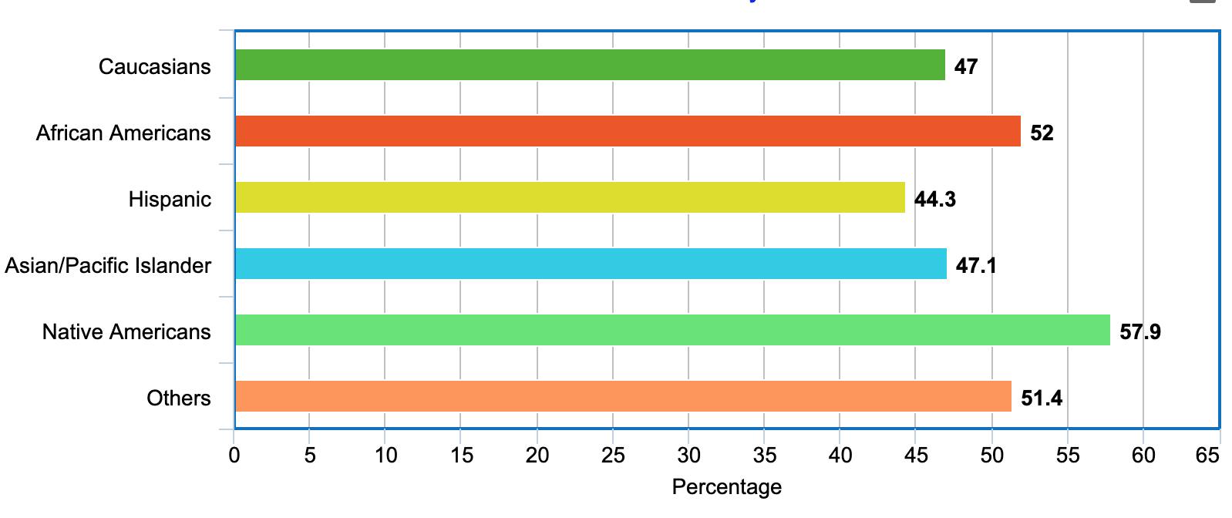

Factors Affecting Mortality of Hospitalized Patients with Disseminated Intravascular Coagulation in the United States
Arya Mariam Roy, MD¹; Manojna Konda, MD¹; Akshay Goel, MD¹; Appalanaidu Sasapu, MD²; Nikhil Meena, MD³
Departments of Internal Medicine¹ , Division of Hematology and Oncology²; Division of Pulmonary and Critical Care³
University of Arkansas for Medical Sciences, Little Rock, AR
INTRODUCTION
RESULTS
Association of Race in Mortality of DIC
Disseminated Intravascular Coagulation (DIC) is a systemic coagulopathy which leads to widespread thrombosis and hemorrhage and ultimately results in multiorgan dysfunction. DIC usually occurs as a complication of illnesses like severe sepsis, malignancies, trauma, acute pancreatitis, burns, and obstetrical complications. The prognosis and mortality of DIC depend on the etiology, however, the mortality of DIC is known to be on the higher side. The aim of the study is to analyze if gender, race, regional differences have any association with the mortality of hospitalized patients with DIC.
A total of 8704 admissions were identified with a diagnosis of DIC during the year 2016. The mean age for admission was found to be 56.48± 0.22. The percentage of admissions in females and males did not have a notable difference (50.57% vs 49.43%). The disease specific MR for DIC was 47.7%. Admission during weekend vs weekdays did not carry a statistically significant difference in terms of MR. Females with DIC were less likely to die in the hospital when compared to males with DIC (OR= 0.906, CI 0.82 - 0.99, p= 0.031). Interestingly, African Americans (AA) with DIC admissions were found to have 24% more risk of dying when compared to Caucasians admitted with DIC (OR= 1.24, CI 1.10 - 1.39, P= 0.00), Native Americans (NA) has 67% more risk of dying when compared to Caucasians (OR= 1.67, CI 1.03 - 2.69, p= 0.035). The mortality rate of NA, AA, Caucasians with DIC was found to be 58%, 52%, 47% respectively. The MR was found to be highest in hospitals of the northeast region (52%), then hospitals in the south (47%), followed by west and mid-west (46%), p= 0.000. Patients admitted to west and mid-west were 24% less likely to die when compared to patients admitted to northeast region hospitals (OR= 0.76, p= 0.001). The average length of stay and cost of stay were also less in west and mid-west regions when compared to north east. The difference in outcomes persisted after adjusting for age, gender, race, hospital division, co-morbid conditions.
Basilar artery
METHOD
The National Inpatient Sample Database from the Healthcare Cost and Utilization Project (HCUP) by the Agency for Healthcare Research and Quality (AHRQ) for the year 2016 was queried for the data. We identified hospital admissions for DIC with the International Classification of Diseases, Tenth Revision, Clinical Modification diagnosis code D65. We studied the characteristics of all such hospitalizations for the year 2016 and the factors associated with the in-hospital mortality rate (MR) of DIC. We used length of stay, cost of stay as an outcome to determine if gender, race, and location play a role in the mortality.
Statistical analysis : Sampling weights were used throughout all calculations, facilitating appropriate national projections. Percentages in all tables and figures reflect national estimates. Data analysis was performed using STATA 16.0. For univariate analysis, Chi-square test and Student’s t-test were used. Multivariable logistic regression analyses was done to determine the association of each factors to the MR.
REFERENCES
CONCLUSION
Our study demonstrated that African Americans and Native Americans admitted with Disseminated Intravascular Coagulation have high risk of dying in the hospital. Also, there exists a difference between the mortality rate, length and cost of stay among different regions in the United States. More research is needed to elucidate the factors that might be impacting the location-based variation in mortality.
Hossain, N., & Paidas, M. J. (2018). Disseminated intravascular coagulation. In Critical Care Obstetrics (pp. 479–486). wiley.
Saito, S., Uchino, S., et.al. (2019). Epidemiology of Intravascular Coagulation in sepsis and validation of scoring systems. Journal of Critical Care (vol: 50. pp 22-30)

