Slide 1
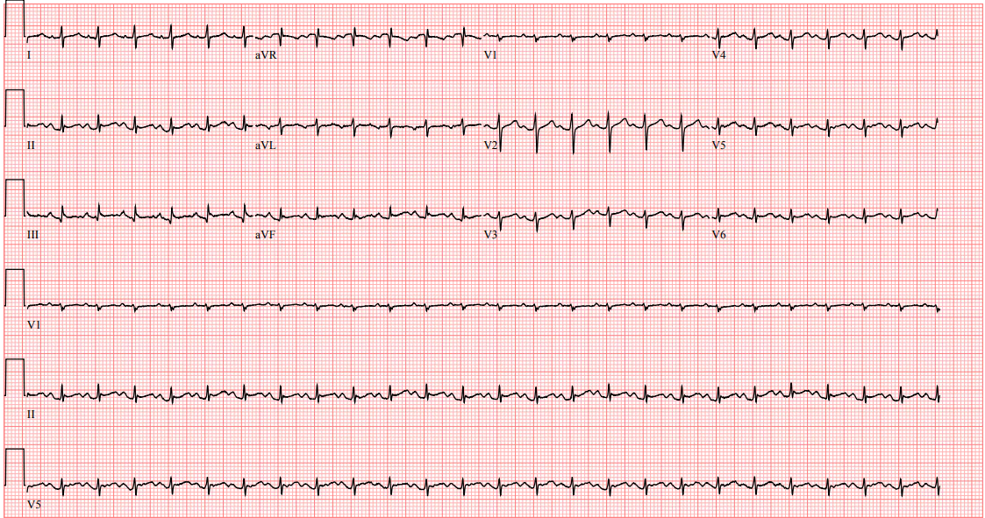

Cardiac Tamponade Presenting As Sepsis
Husam Salah, Harmeen Goraya
Department of Internal Medicine, University of Arkansas for Medical Sciences
Introduction
On arrival, Her mean arterial pressure (MAP) was in the 30s, requiring a gradual addition of dobutamine, norepinephrine, and vasopressin drips to maintain a MAP more than 65.
Physical examination was remarkable for diminished breath sounds at the lung bases.
Labs were remarkable for a white blood cell count of 20.17K/ul with neutrophilic level of 8.1 mmol/L, troponin level of 0.06 ng/mL, B-type natriuretic peptide of 73 pg/mL and procalcitonin level of 2.22 ng/mL.
Chest x-ray did not show any acute cardiopulmonary processes. Electrocardiography was normal sinus rhythm with low voltage.
Bedside ultrasound revealed large pericardial fluid. Emergent pericardiocentesis was performed. All of the patient’s symptoms immediately improved and her vital signs normalized.
Discussion
  Tamponade a clinical syndrome that results from the accumulation of fluid in the pericardial space.
  It can initially be asymptomatic; however, as it progresses, it can present with shortness of breath, chest pain, tachycardia, pulses paradoxus.
  Beck’s triad (hypotension, muffled heart sound, and distended neck vain), and in severe cases with a cardiogenic shock.
  Tamponade is typically diagnosed using echocardiogram.
Clinical presentation (e.g., shortness of breath, tachycardia, hypotension) is nonspecific and can be similar to other conditions, such as sepsis.³
Stolaz et al retrospectively analyzed 153 patients who had presented to the emergency department and had been found to have pericardial effusion. 37.5% of the patients did not have any historical features suggestive of pericardial effusion. 0% of these patients had all of the components of Beck’s triad.⁴
Our case report shows that tamponade can be easily misdiagnosed as sepsis. As a timely diagnosis of tamponade is crucial, we believe that point-of-care ultrasound (POCUS) should be performed in all critically ill patients to avoid delay in treatment.
This, in turn, requires more POCUS training of the medical staff, including residents.
1
1
1
2
Case Presentation
A 54-year-old lady with asthma, paroxysmal atrial fibrillation, and hypertension was admitted to our intensive care unit (ICU) from another hospital with 3-day history of cough, tachycardia and hypotension.
She was started on broad-spectrum antibiotics for presumed sepsis. Her blood pressure continued to drop, requiring a phenylephrine drip.
She was then transferred to our ICU for higher level of care.
References
1- Appleton C, Gillam L, Koulogiannis K. Cardiac Tamponade. Cardiol Clin. 2017;35(4):525-537.
2- Bodson L, Bouferrache K, Vieillard-baron A. Cardiac tamponade. Curr Opin Crit Care. 2011;17(5):416-24.
3- Azim A, Rao PB, Srivastav P, Singh P. Cardiac tamponade mimicking septic shock diagnosed by early echocardiography. J Emerg Trauma Shock. 2010;3(3):306.
4- Stolz L, Valenzuela J, Situ-lacasse E, et al. Clinical and historical features of emergency department patients with pericardial effusions. World J Emerg Med. 2017;8(1):29-33.

