Slide 1
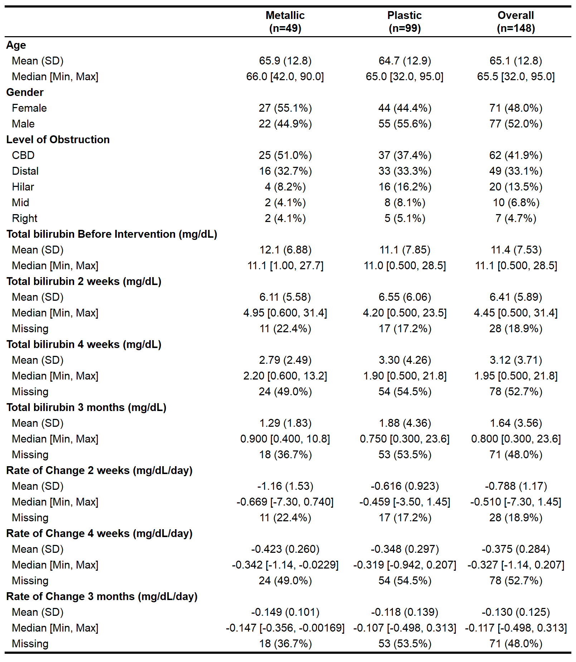
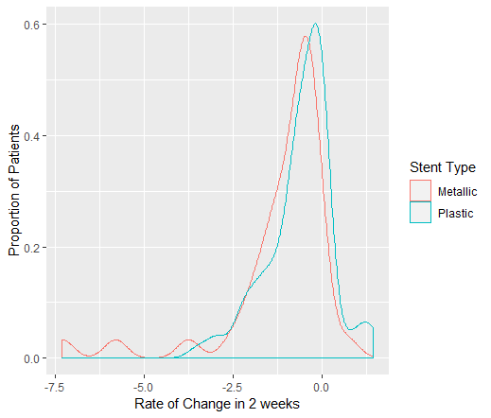
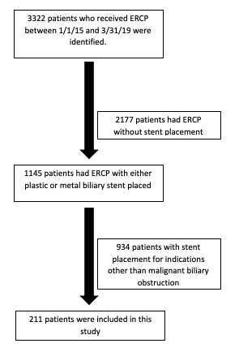
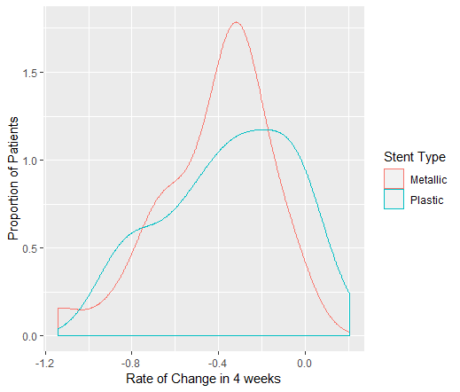
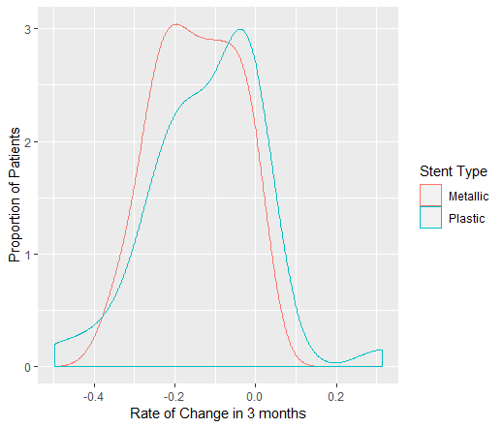

Efficacy of Plastic Versus Metal Biliary Stents on Bilirubin Regression in Malignant Obstructive Jaundice: A Retrospective Analysis
Jesse J. Xie, Zhongning Chen, Natalie B. Peeples, Charles Lavender, Quinton D. Palmer, Arya M. Roy, Benjamin Tharian, Shashank Garg, Sumant Inamdar
Abstract
Demographics
Results
Conclusion
Background: Malignant obstruction of the biliary tree often confers a worse outcome and poorer quality of life due to hyperbilirubinemia reducing the efficacy of chemotherapy and causing uncomfortable symptoms, respectively. Though we understand the difference in length of patency between plastic stents (PS) and self-expanding metal stents (SEMS), we lack evidence that one has increased efficacy in bilirubin regression over the other.
Methods: We retrospectively compared 211 patients with either PS or SEMS placement for hyperbilirubinemia secondary to malignant biliary obstruction to analyze each stent’s impact on rate of bilirubin regression.
Results: We found no difference in rate of bilirubin regression between PS and SEMS at 2 weeks, 4 weeks, and 3 months when analyzing all interventions, however there was a statistically significant faster rate of regression in metal stents in initial intervention at 2 weeks, but no difference at 4 weeks or 3 months. There was a significan decrease in bilirubin at each level of obstruction with both types of stent placement.
Conclusion: Both PS and SEMS placement are effective in palliation of malignant hyperbilirubinemia regardless of the level of biliary obstruction. Though SEMS have a longer duration of patency compared to PS, it does not confer a faster level of bilirubin regression over the long term.
211 patients were included in the study.
There is a statistically significant difference in rate of biliary regression favoring metal stents at the 2 week mark (p = 0.05).
There is no difference at the 4 week or 12 week time point.
There was no statistical significance in overall bilirubin drop between the two types of stents with p-value 0.30, 0.71, 0.74 at 2, 4, 12 weeks respectively.
ERCP with placement of a PS or SEMS is the most common method for biliary drainage.
Despite evidence of longer duration of patency in SEMS compared to PS, there is a lack of large sample size comparing the efficacy between the two in rate of bilirubin regression.
In this study, there was a statistically significant difference between PS and SEMS following initial placement (n = 148) favoring SEMS at 2 weeks but no difference at 4 or 12 weeks. When analyzing all procedures (n = 211) there was no statistical significant difference in the rate of bilirubin regression following the placement of PS versus SEMS.
Placement of PS and SEMS both individually showed statistically significant decrease in bilirubin.
The type of stent placed does not necessarily lead a clinically meaningful rapid decline.
Patient tolerance of repeat procedures, life expectancy, patient comfort, and cost must all be considered prior to choosing a stent material.
Rate of change in total bilirubin | PS | SEMS
2 weeks | -1.16 (1.53) | -0.616 (0.923)
4 weeks | -0.423 (0.260) | -0.348 (0.297)
12 weeks | -0.149 (0.101) | -0.118 (0.139)
Methodology
Age 18 and 95 who underwent ERCP at the University of Arkansas for Medical Sciences (UAMS) for the purpose of palliation of malignant biliary obstruction and obstructive jaundice between 1/1/15 to 3/31/19 were included in this study.
Patients were identified using ICD-10 and CPT codes; raw data collection from the electronic medical records system was done by the UAMS technology team.
Data was then analyzed by members of the research team; all patients who had biliary stent placement for indications other than malignant obstruction were excluded.
Future Directions
Introduction
A larger sample size is needed to determine whether re-intervention with a different stent type following initial stent placement increases rate of bilirubin regression.
Separate metal stent population into fully covered stents, partially covered stents, and uncovered stents.
Include multiple centers to allow for results that are more applicable to all populations.
Malignancies of the liver, pancreas, and gallbladder commonly cause obstructive jaundice.
Since patients rarely present with early symptoms, they often present at an advanced stage and typically poor candidates for surgical intervention.
Endoscopic retrograde cholangiopancreatography (ERCP) for biliary tree decompression is the primary method for not only bile drainage prior to the chemotherapy initiation but also for the palliation of symptoms related to obstructive jaundice.
Biliary stents are divided into two major categories: plastic stents (PS) and self-expanding metal stents (SEMS).
SEMS are associated with a longer duration of patency when compared to PS.
There are limited studies with large sample sizes to show a difference in rate of normalizing hyperbilirubinemia between the two.
There is significant cost difference and follow-up care differences between SEMS and PS.
Acknowledgements
Weston BR, Ross WA, Wolff RA, Evans D, et al. Rate of bilirubin regression after stenting in malignant biliary obstruction for the initiation of chemotherapy: how soon should we repeat endoscopic retrograde cholangiopancreatography? Cancer. 2008 Jun;112(11):2417-23
Raju RP, Jaganmohan SR, Ross WA, et al. Optimum Palliation of Inoperable Hilar Cholangiocarcinoma: Comparative Assessment of the Efficacy of Plastic and Self-Expanding Metal Stents. Dig Dis Sci. 2011 May;56(5):1557-64
Bernon MM, Shaw J, Burmeister S, Chinnery G, et al. Distal malignant biliary obstruction: a prospective randomised trial comparing plastic and uncovered self-expanding metal stents in the palliation of symptomatic jaundice. S Afr J Surg. 2018 Mar;56(1):30-4
Unconjugated hyperbilirubinemia: practice essentials, background, pathyophysiology. Medscape reference. March 2019.
Mescher AL. "The Circulatory System." Junquiera's Basic Histology. 12th Ed. New York: McGraw-Hill, 2010. Print. 197.
Chapter 13. Bilirubin Formation and Excretion by the Liver. In: Barrett KE. Barrett K.E. Ed. Kim E. Barrett.eds. Gastrointestinal Physiology, 2e New York, NY: McGraw-Hill; 2014. http://accessmedicine.mhmedical.com/content.aspx?bookid=691&sectionid=45431414. Accessed July 07, 2019.
Bill JG, Mullady DK. Stenting for Benign and Malignant Biliary Strictures. Gastrointest Endosc Clin N Am. 2019 Apr; 29(2): 215-235

