Slide 1

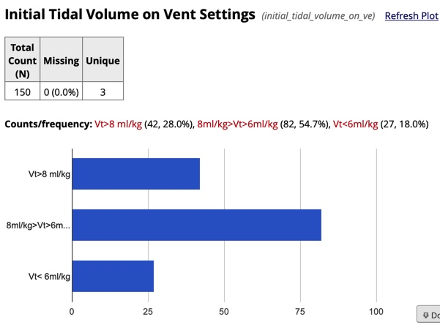
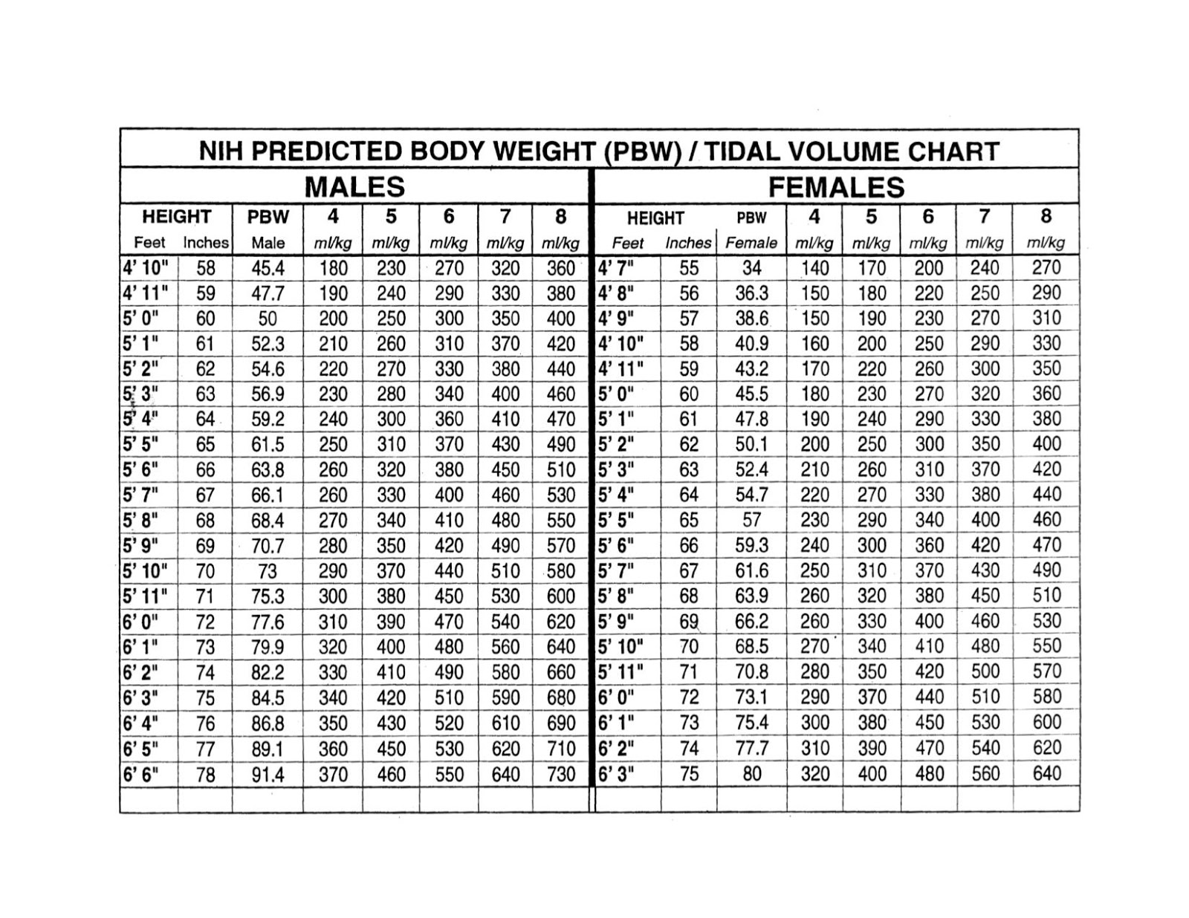
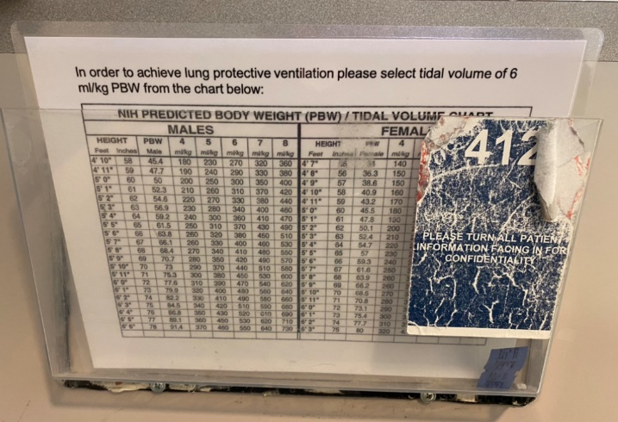
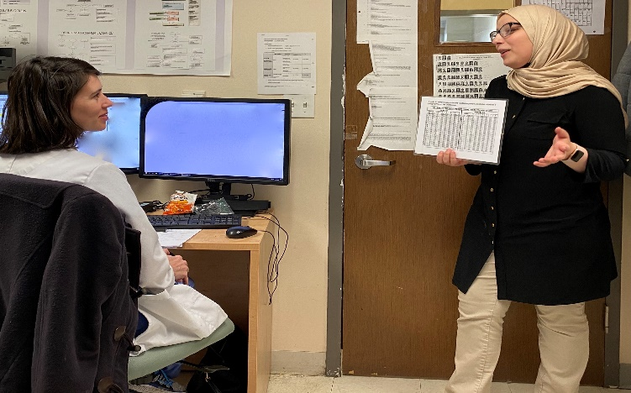

Lung Protective Ventilation in Patients at-Risk For ARDS: A Quality Improvement Initiative
Arwa Albashaireh¹, Nicholas Ibanez¹, Amy James³, Steven Ko^{2,} Andrew Prince², Ahmad Tarwaneh², Nikhil Meena^{1,2}
¹Department of Medicine, University of Arkansas for Medical Sciences (UAMS), Little Rock, AR
²Division of Pulmonary and Critical Care, University of Arkansas for Medical Sciences (UAMS), Little Rock, AR
College of Medicine, University of Arkansas for medical Sciences, Little Rock, AR³
Background
Adult Respiratory Distress Syndrome (ARDS) is an acute, diffuse, inflammatory form of lung injury that is associated with a variety of etiologies¹. In 2000 a study called “Ventilation with Lower Tidal Volumes as Compared with Traditional Tidal Volumes for Acute Lung Injury and the Acute Respiratory Distress Syndrome” was published in the New England Journal Of Medicine (NEJM) which concluded that lower tidal volume than traditionally used resulted in decreased mortality and increase number of days off the ventilator.
The recommendations were to use Lung protective ventilation (LPV) with tidal volume of 6 – 8 ml/kg of predicted body weight (PBW) or ideal body weight (IBW).
28% received >8ml/kg, 54.7% received 6- 8 ml/kg, and 18% received <6 ml/kg. Vt: Tidal Volume. Fig.1
Laminated cards were made and distributed to all ICU beds in E4. Fig.2
Interventions
Interventions to improve adherence to appropriate LPV in patients at-risk for ARDS (as of 1/27/2020) include:
Laminated cards outside patients’ rooms: a table with Height/PBW/Recommended TV. Please see Figures 2 - 3
Investigation
Laminated cards placed outside patient’s room in the chart holder. Fig.3
Educating residents on importance of LPV and showing them how to use the cards. Fig.4
The aim of our project was to measure adherence of UAMS trainees and intensive care unit staff with the use of protective lung volumes.
We retrospectively reviewed 151 intubated patients at UAMS who were at-risk for ARDS (including patients with pneumonia, sepsis, trauma and surgeries) and found that 82 (54.7%) patients received LPV (6 - 8 ml/kg PBW). 42 (28%) did not receive LPV (> 8 ml/kg PBW). 27 (18%) received very low tidal volumes (< 6 ml/kg PBW).
Data was collected and analyzed using Research Electronic Data Capture (RedCap) and figures were generated through the application.
Our adherence to LPV can be improved by utilizing proposed interventions. EPIC order set is being developed. Post intervention data is pending. Incoming interns, residents and critical care fellows will continue measuring outcomes of this project’s interventions.
Further interventions currently undergoing evaluation include an ICU ventilator order set bundle on EPIC which will:
Calculate a tidal volume of 6 ml/kg PBW.
Calculate a respiratory rate based on that tidal volume to ensure an adequate minimum minute ventilation.
Order an ABG to be obtained in one hour to evaluate appropriateness of the initial settings.
References
https://www.uptodate.com/contents/acute-respiratory-distress-syndrome-clinical-features-diagnosis-and-complication
Bellani G, Laffey JG, Pham T, et al. Epidemiology, patterns of care, and mortality for patients with acute respiratory distress syndrome in intensive care units in 50 countries. JAMA 2016;315:788-800
The Acute Respiratory Distress Syndrome Network. Ventilation with lower tidal volumes as compared with traditional tidal volumes for acute lung injury and the acute respiratory distress syndrome. N Engl J Med 2000;342:1301-1308
Serpa Neto A1, Cardoso SO, Manetta JA, Pereira VG, Espósito DC, Pasqualucci Mde O, Damasceno MC, Schultz MJ. Association between use of lung-protective ventilation with lower tidal volumes and clinical outcomes among patients without acute respiratory distress syndrome: a meta-analysis. JAMA. 2012 Oct 24;308(16):1651-9. doi: 10.1001/jama.2012.13730.
Notes:
Our QI project is LPV in patients at risk for ARDS: a QI intitiative.
ARDS is an acute diffuse inflammatory form of lung injury that is associated with various etiologies.
In the year 2000, a big study was published in the NEJM. Called “ …..” this study has changed how mechanical ventilation was practiced. In the past initial TV of 12 ml/kg PBW was used. After this study the recommendations were changed to initial TV is 6 – 8 ml/kg PBW as the study resulted in decreased mortality and increased days off the ventilator.
Our QI aimed to measure adherence of UAMS trainees and ICU staff with the use of protective lung volumes.
We retrospectively reviewed 151 intubated patients at UAMS who were at risk of ARDS (pneumonia, sepsis, trauma).
As seen in figure 1, we found that 28% received > 8 ml/kg, 54.7% received 6 – 8ml/kg, 18% received < 6ml/kg.
Our interventions to improve adherence as of 1/27/2020.
We made laminated cards that had NIH predicated body weight/ tidal volume chart based on patient height in inches. Those were placed outside patients rooms in the chart holders as an easy access to residents and RT’s once a patient is needing intubation as shown in figures 2 and 3. residents were educated on how to use the cards.
Further interventions currently being evaluated include an ICU ventilator order set on EPIC that will calculate TV of 6ml/kg PBW, it will also calculate RR based on that TV and will automatically place an order for ABG 1 hour after intubation to evaluate appropriateness of initial settings.

