Slide 1

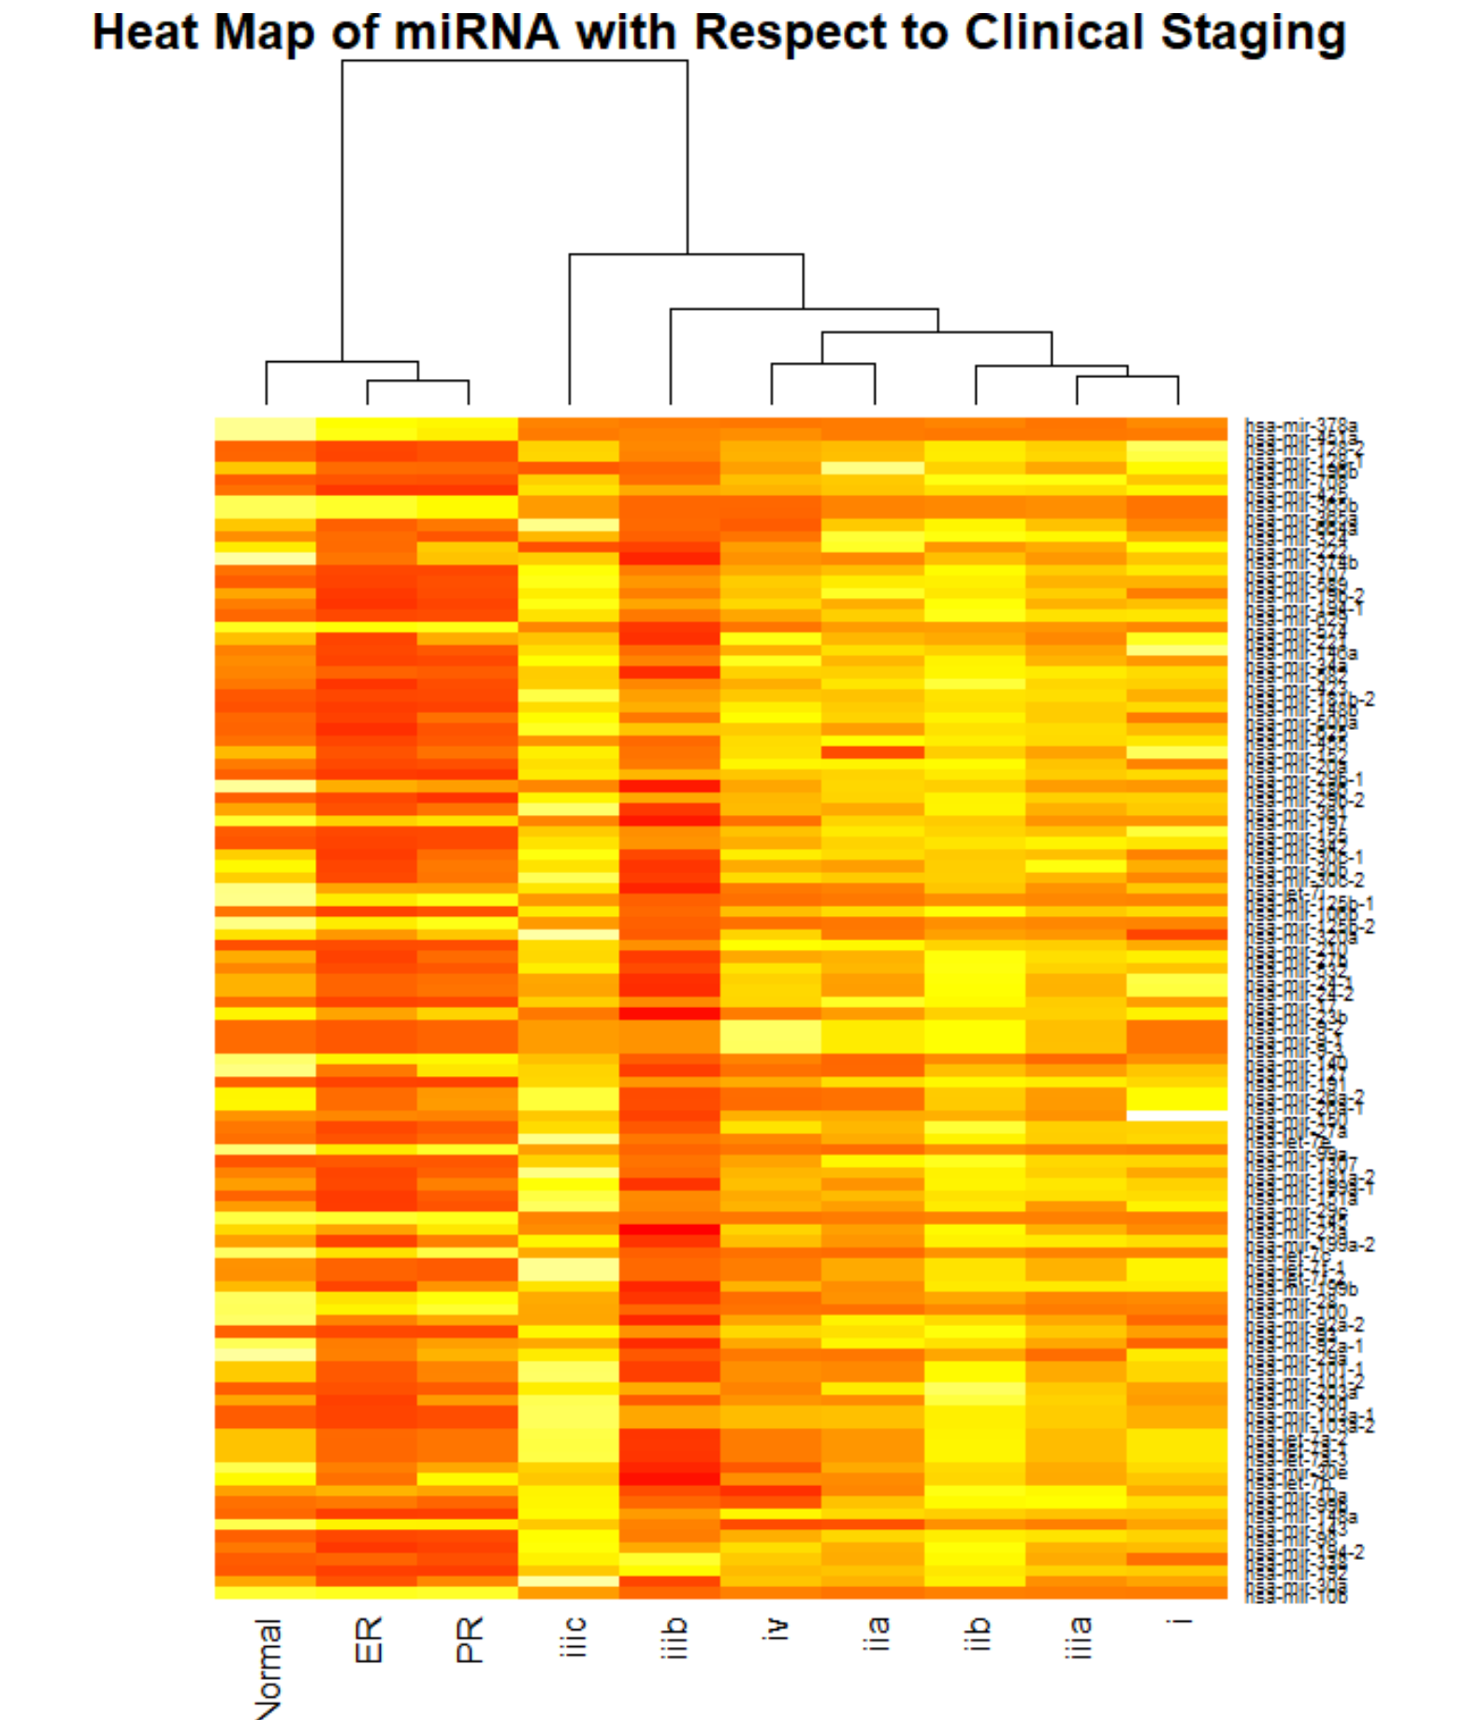

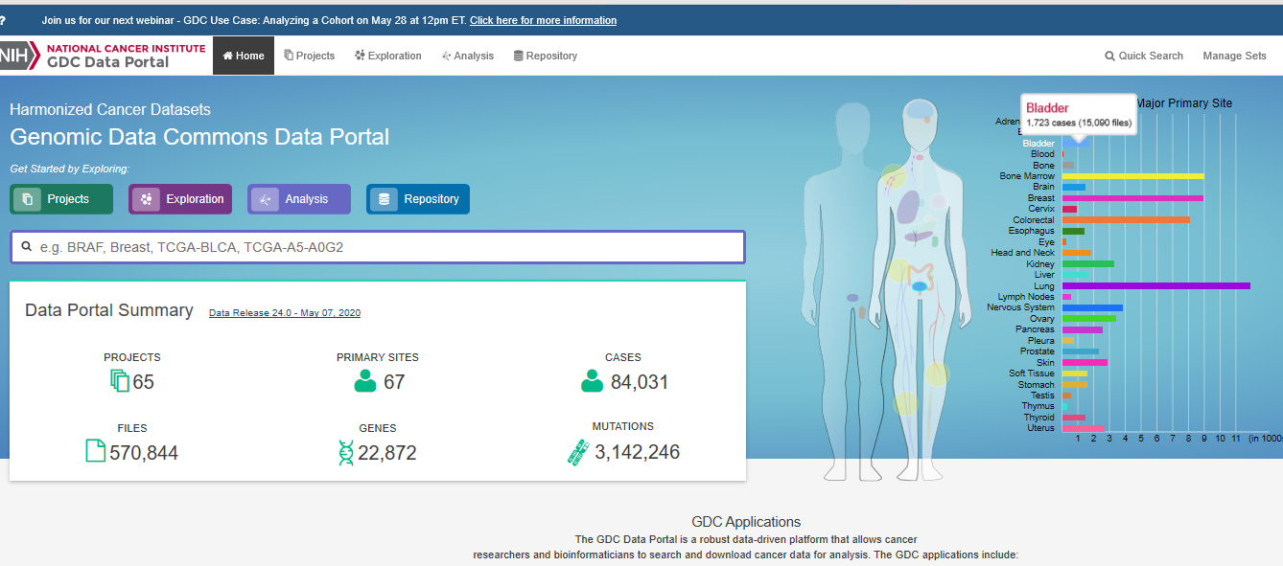
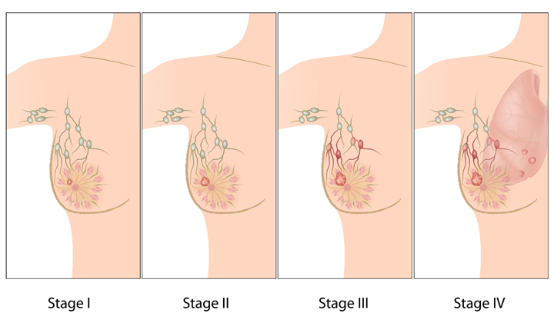
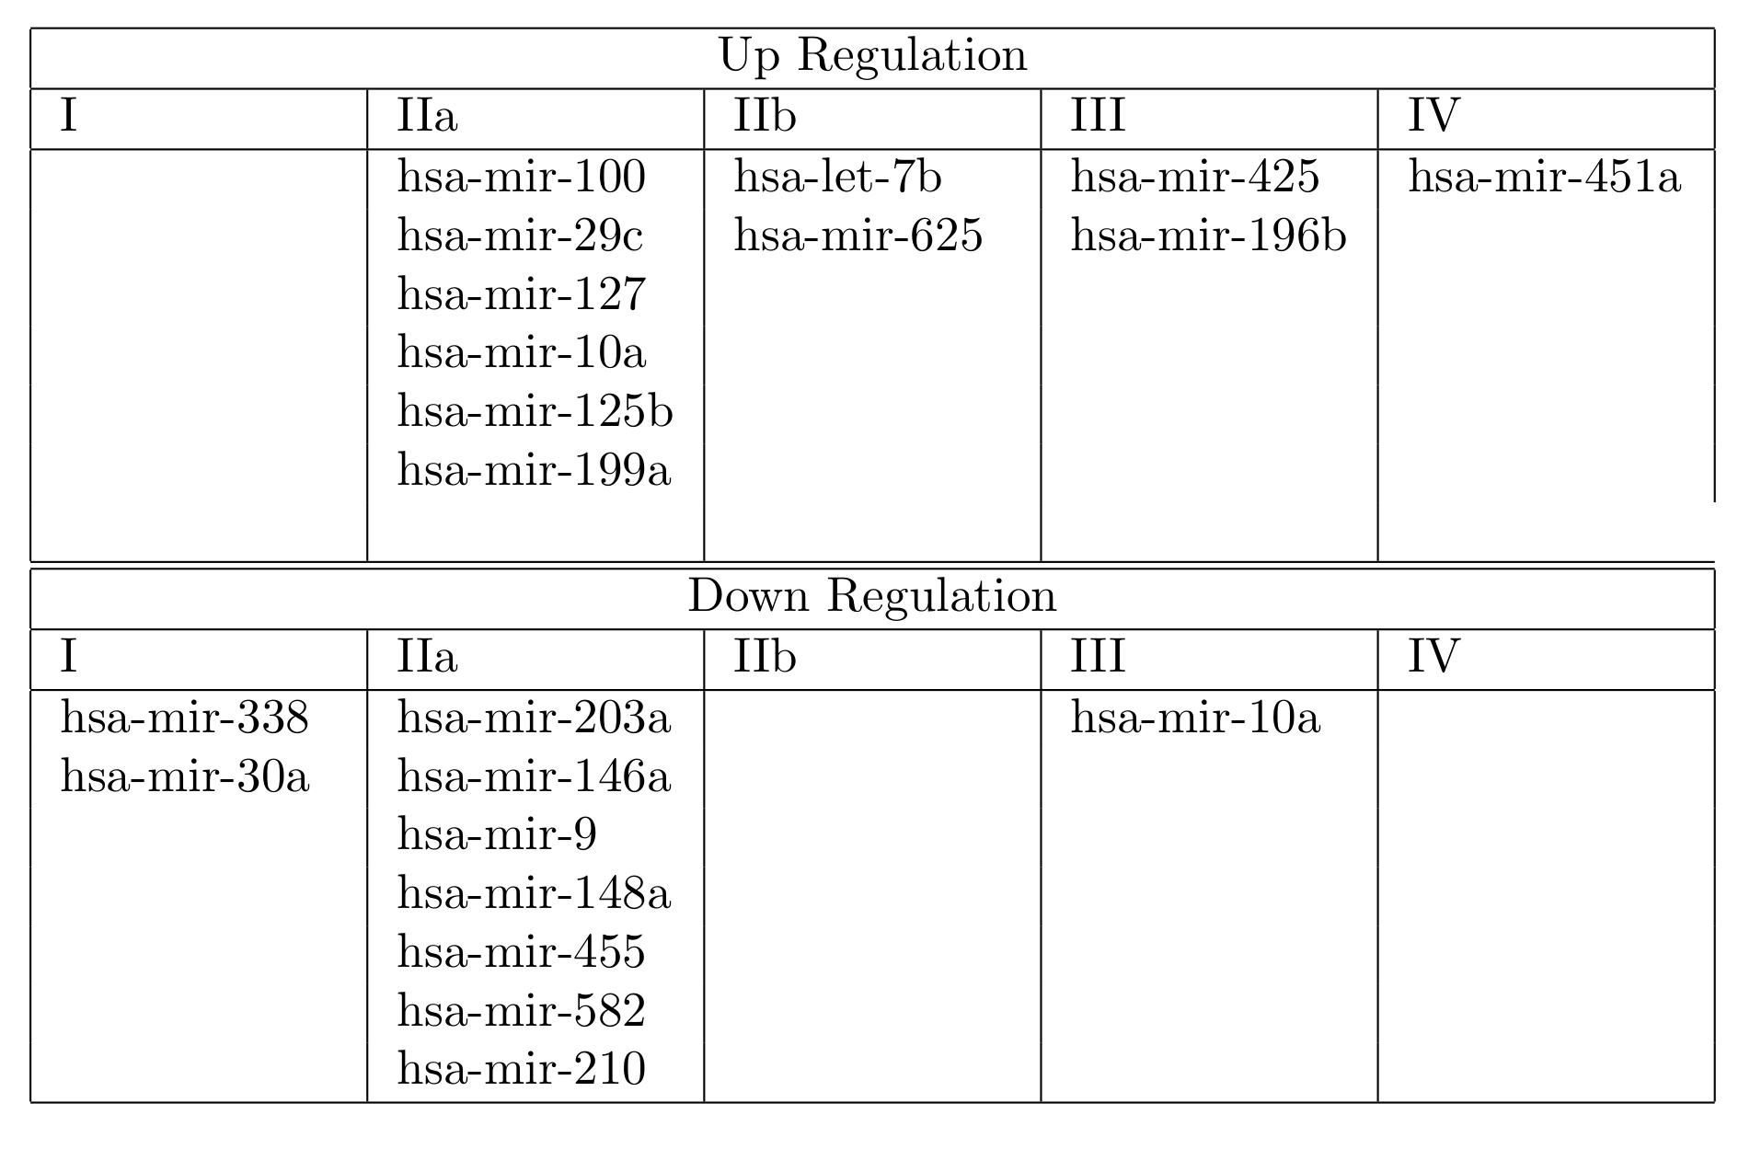
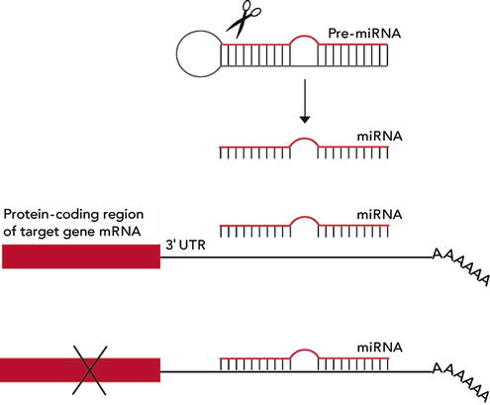

Micro RNA (miRNA) Expression Profile of Various Stage of Breast Cancer
Jim Zhongning Chen, MD¹, Horacio Gomez-Acevedo, PhD²
¹Deparment of internal medicine, ²Department of Biomedical Informatics
Purpose
Materials
Results
Hormone Status
In the setting of breast cancer, clinical staging and expression of hormone receptors are very import for both prognosis and treatment. Radiographic imaging may sometimes be unreliable and invasive testing can both be finically burdensome and puts patients at risk. Peripheral blood testing may help physicians make better clinical decisions. The focus of this study is to isolate specific miRNA that are differentially expressed at various stages of breast cancer.
The Cancer Genome Atlas (TCGA) is an online database. miRNA count data and TNM staging data were collected. Analysis was done in R using package EdgeR.
.
Conclusion
Unique Expression profiles can be useful in identifying stages of breast cancer without tissue diagnosis. Identifying these uniquely expressed miRNA in later stages may be useful in identifying mechanisms of disease progression.
Methodology
Patient data were mined from the TCGA-BRCA project. Inclusion criteria include: 1. ductal neoplasms of the breast. 2. Each sample needed to have miRNA-seq data available, 3. Patients are female, 4. patient must have use AJCC clinical staging data available.
A total 1039 set of samples were included in the analysis. From the original 1881 is narrowed down to requiring miRNA count > 10. The samples are separated based on clinical staging as well as hormonal staging. The differential expression is compared against normal tissue applying a |log Fold Change| > 2, and false discovery rate cut off of 10⁻⁵.
.
Clinical Staging
.
Further Studies
Statistically significant Log Fold Changes more than 2
Uniquely expressed miRNA in later stages may be potential targets for therapy and prognostic factors for treatment failure. These miRNA should can be used as biomarkers for treatment response.
Micro RNA (miRNA)
.
.

