Slide 1
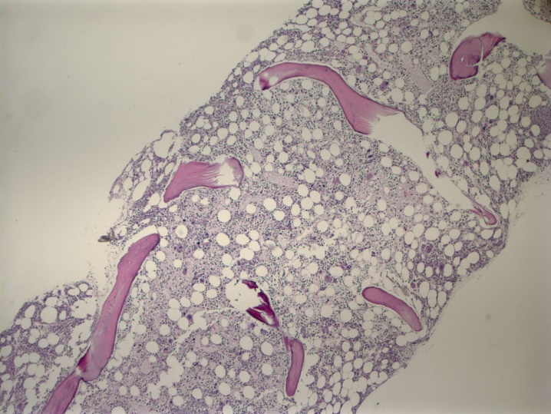
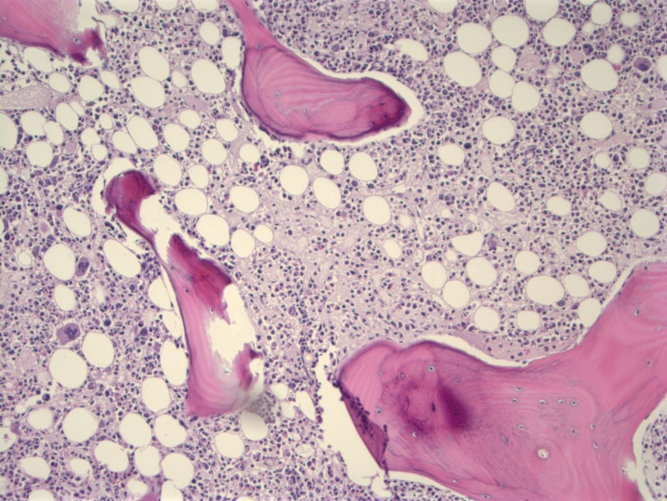
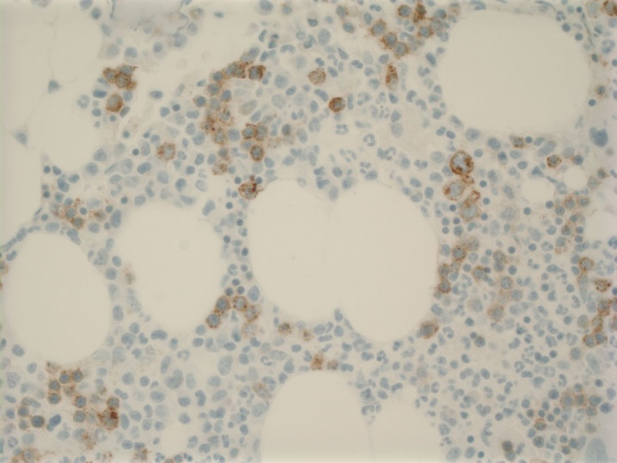
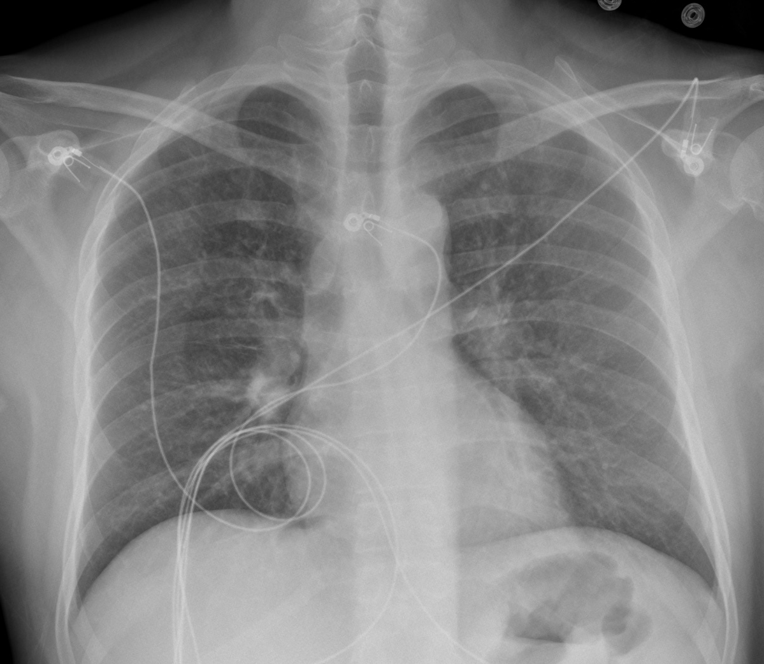
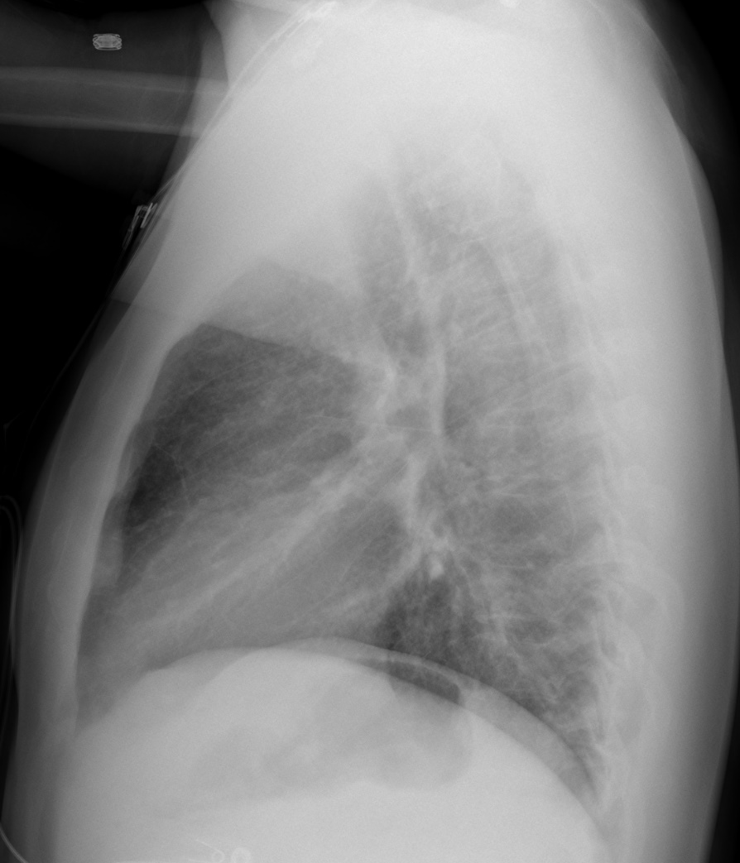
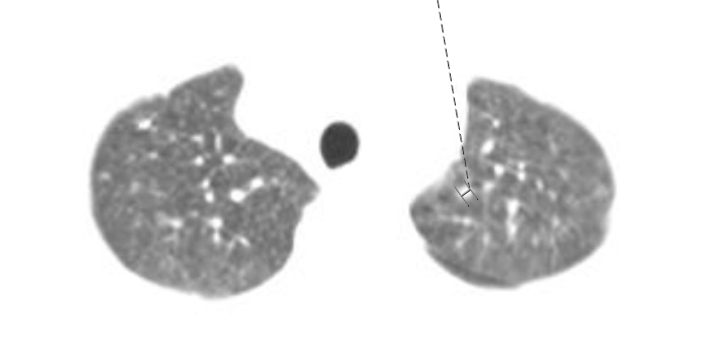
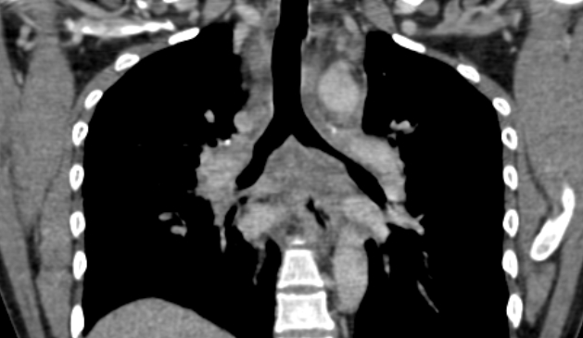

A Curious Case of Anemia
Michael Cross, M.D., Courtney Bundrick, M.D., Keyur Vyas, M.D.
Department of Internal Medicine, University of Arkansas for Medical Sciences, Little Rock, Arkansas
INTRODUCTION
Anemia is commonly encountered in the outpatient setting with a prevalence of roughly 15 million cases in the United States.
Though internists frequently encounter iron deficiency anemia, we must remain vigilant to accurately diagnose more complex cases.
LABORATORY EVALUATION
BONE MARROW EXAM
1.65
6.8
120
130
101
6
114
3.3
22
0.6
T.Bili 0.6
ALP 60
AST 85
ALT 66
LDH 402
GGT 79
Lipase 31
INR 1.2
Ferritin 290
Serum Fe 138
TIBC 227
Fe sat 61%
Transferrin 162
Retic 0.33% (absolute 0.2)
Retic index 0.08
HIV +
HCV Ab +
Histo Ag +
A
B
C
D
HISTORY OF PRESENT ILLNESS
A 33-year-old Hispanic man presented to the ED from his primary care clinic for further evaluation of anemia. He was told he had iron deficiency anemia and had been started on ferrous sulfate.
He reported daily nausea, vomiting, non-bloody diarrhea, and fatigue for the past month or so.
His trial of Bismuth subsalicylate did not provide relief. He related a 35-lb unintentional weight loss over the same time.
Additionally, he reported non-productive cough and intermittent 5-minute episodes of aching, non-radiating, peri-prandial chest pain present for one month.
He had also been diagnosed with H. pylori and started on triple therapy.
CHEST RADIOGRAPH
E
Parvovirus B19 Serum qPCR > 1.38E+10
CT CHEST
CONCLUSIONS
The patient was diagnosed with
HIV/AIDS
HCV
Disseminated Histoplasmosis
Parvovirus B19 Infection
Aplastic crisis
Norovirus gastroenteritis
PHYSICAL EXAM
T 99.9F BP 110/68 HR 106 RR 25 SpO2 100% RA
Appears thin, bitemporal wasting
Pale conjunctivae
No oral ulcers
Cardiopulmonary and abdominal exam normal
CLINICAL COURSE
The patient was treated liposomal amphotericin B, itraconazole, IVIG, anti-retroviral therapy and clinically improved. Despite ART, he developed recurrent aplastic crises and has required prolonged IVIG.
DISCLOSURES
The authors have nothing to disclose.

