Slide 1

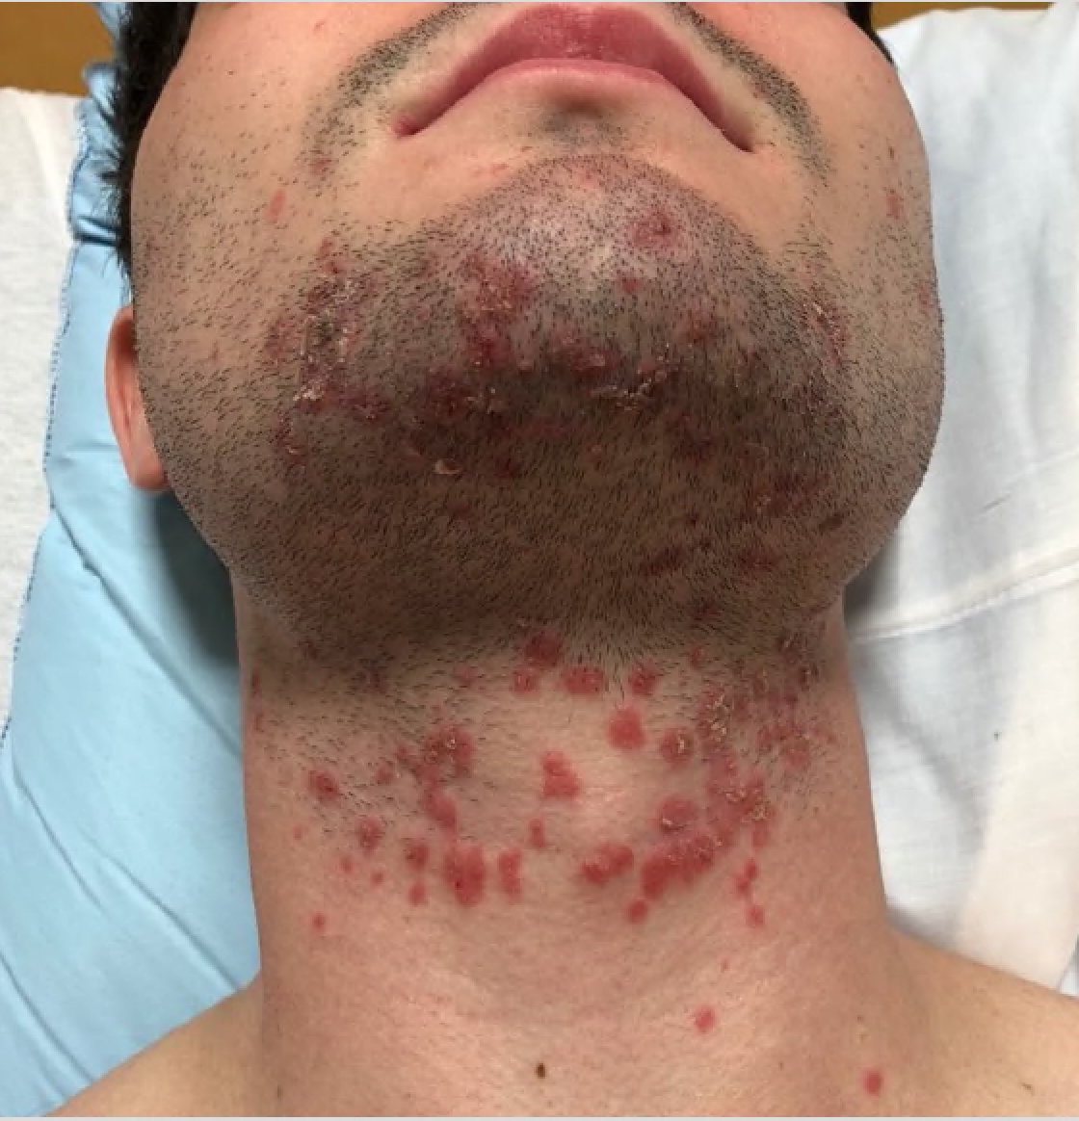
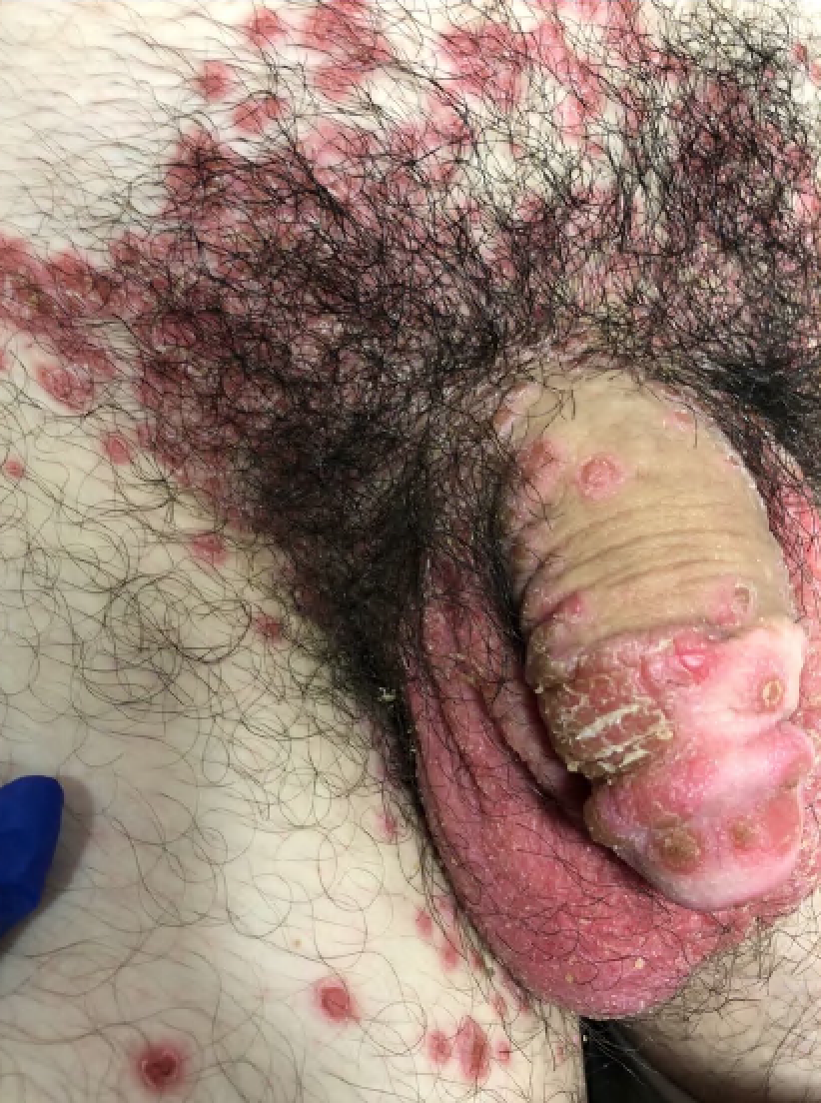

Can’t See, Can’t Pee, Can’t Climb a Tree: Interesting case of polyarthritis and rash in a young male.
Ryan K. James, MD¹; Gayathri Krishnan, MD¹, Keyur Vyas, MD¹
1 Department of Internal Medicine, University of Arkansas for Medical Science, Little Rock, Arkansas
INTRODUCTION
PHYSICAL EXAM
DISCUSSION
Reactive arthritis is a relatively rare rheumatologic condition with an incidence of 0.6 to 27 and prevalence of 30 to 40 per 100,000 adults globally. Here we present a case of reactive arthritis with axial and peripheral involvement in a young male triggered by chlamydia infection.
HEENT: Normal sclera and conjunctiva, moist mucous membranes, diffuse erythematous maculopapular discrete lesions along the hard palate and posterior pharyngeal wall.
Neck: Purple/red maculopapular non-tender rash, some with crusting, no vesicles, supple, no lymphadenopathy (A)
Chest: Normal bilateral expansion, normal work of breathing, similar rash over bilateral axilla
MSK: Moves all extremities, right knee is swollen and tender, motion is mildly limited by pain, some erythematous lesions over the LE which are non tender, left ankle is warm, swollen and erythematous. Tenderness to palpate in the lower part of spine and bilateral SI joints.
GU: Erythema at tip of penis and diffusely over bilateral scrotum, few healing lesions over the shaft, with very localized maculopapular erythematous rash surrounding the groin. No inguinal lymphadenopathy. (B)
Reactive arthritis is an inflammatory spondyloarthropathy generally triggered days to weeks after a gastrointestinal or genitourinary infection.
Common associated preceding infections include Chlamydia, Campylobacter, Yersinia, E. coli, Salmonella, Shigella, and Gonorrhea.
Associated symptoms include oligoarthropathy, conjunctivitis/scleritis and urethritis/cervicitis hence the mnemonic “can’t see, can’t pee, can’t climb a tree”.
Treatment initially begins with control of the underlying infection.
Additional treatment options include NSAIDs in the acute phase, sulfasalazine or methotrexate in severe cases and TNF-alpha inhibitors in refractory cases.
Patients with presence of HLA-B27 haplotype have a high risk of recurrence and warrant close follow up with a rheumatologist.
This patient remained on a combination of methotrexate (with folic acid supplementation), sulfasalazine and adalimumab. At 4-month follow up patient reported complete resolution of joint pain and significant improvement of rash.
CASE DESCRIPTION
A
20-year-old Caucasian male in overall general good health presented with swollen painful joints and rash.
Patient had a long-standing history of chronic low back pain with stiffness.
Symptoms started four months prior with pain and swelling of the right hip, progressing to involve the right knee, left ankle and both wrists along with an erythematous maculopapular rash.
Two episodes of fever at home, up to 101.2 F
Outpatient STI screening revealed urine NAAT positive chlamydia infection which was appropriately treated with ceftriaxone and azithromycin.
Symptoms persisted despite antibiotic therapy to the point he was unable to walk due to severe pain which prompted this presentation.
Family history included a grandfather with an unknown spine problem that resulted in his grandfather having significant spinal deformity and chronic pain.
B
LABS
15.5
134
94
22
ESR – 50
CRP – 221.4
HIV – Non-reactive
RPR – Non--reactive
ANA – Negative
HLA B-27 – Detected
17.4
505
3.5
25
0.9
148
Radiology
REFERENCES
C
Hannu, Timo (06/2011). "Reactive arthritis.". Best practice & research. Clinical rheumatology.
C. MR imaging displaying asymmetric bilateral sacroiliitis more pronounced on the right than the left without significant joint effusion.

