Slide 1

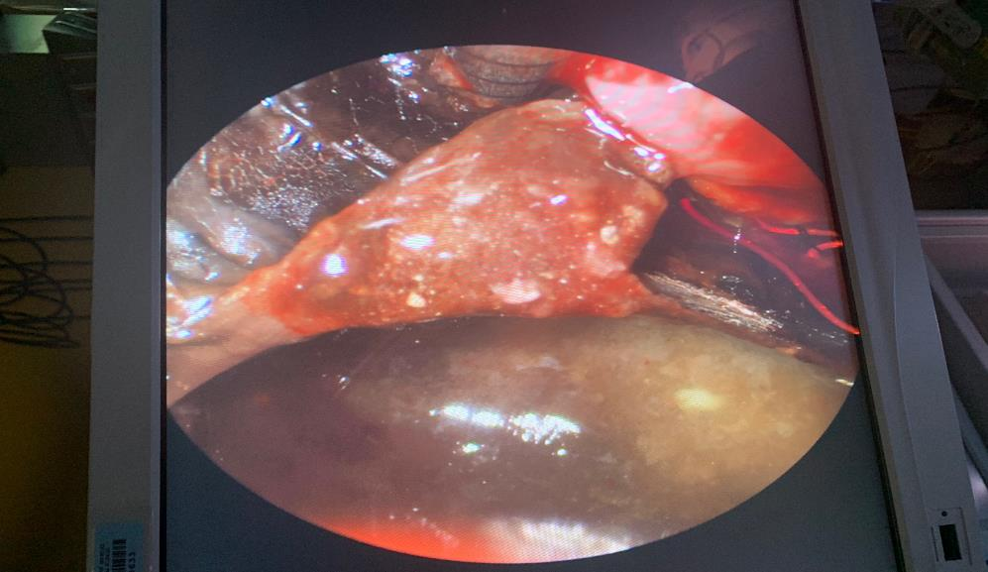
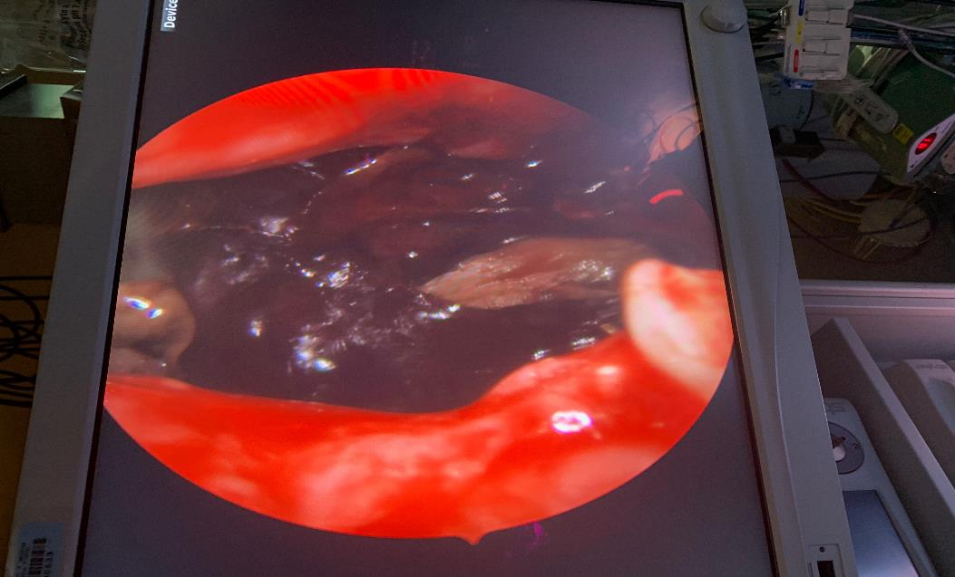
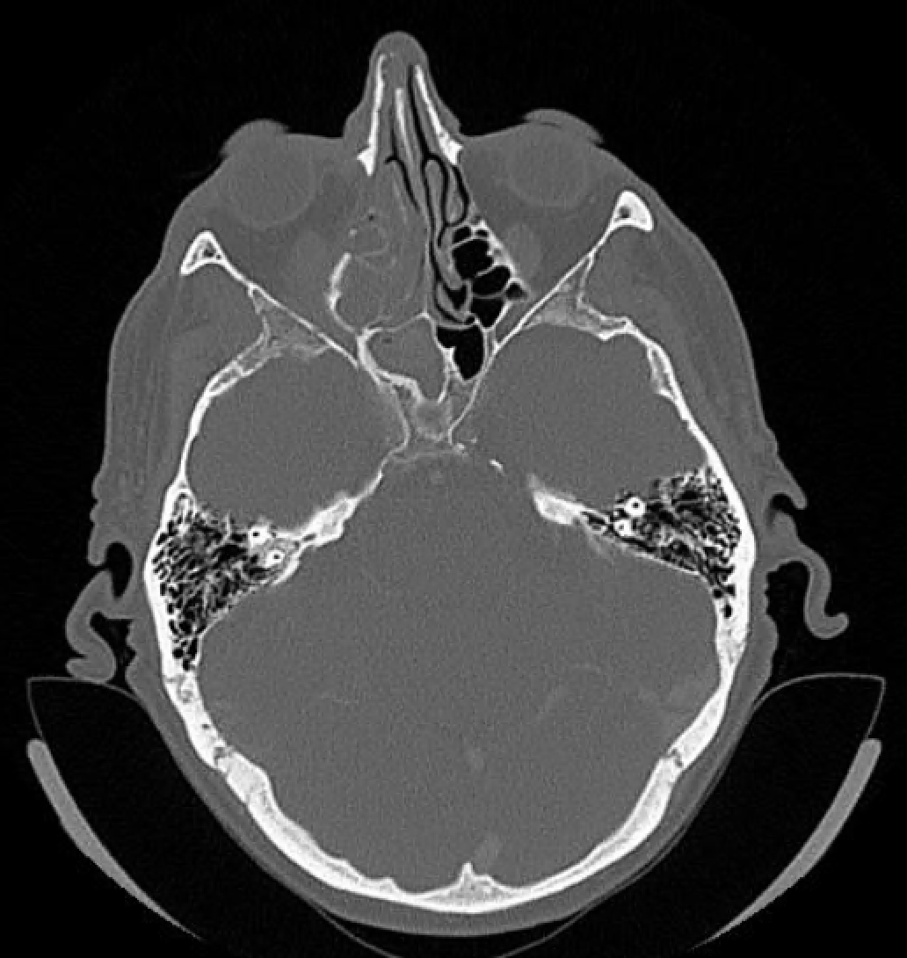
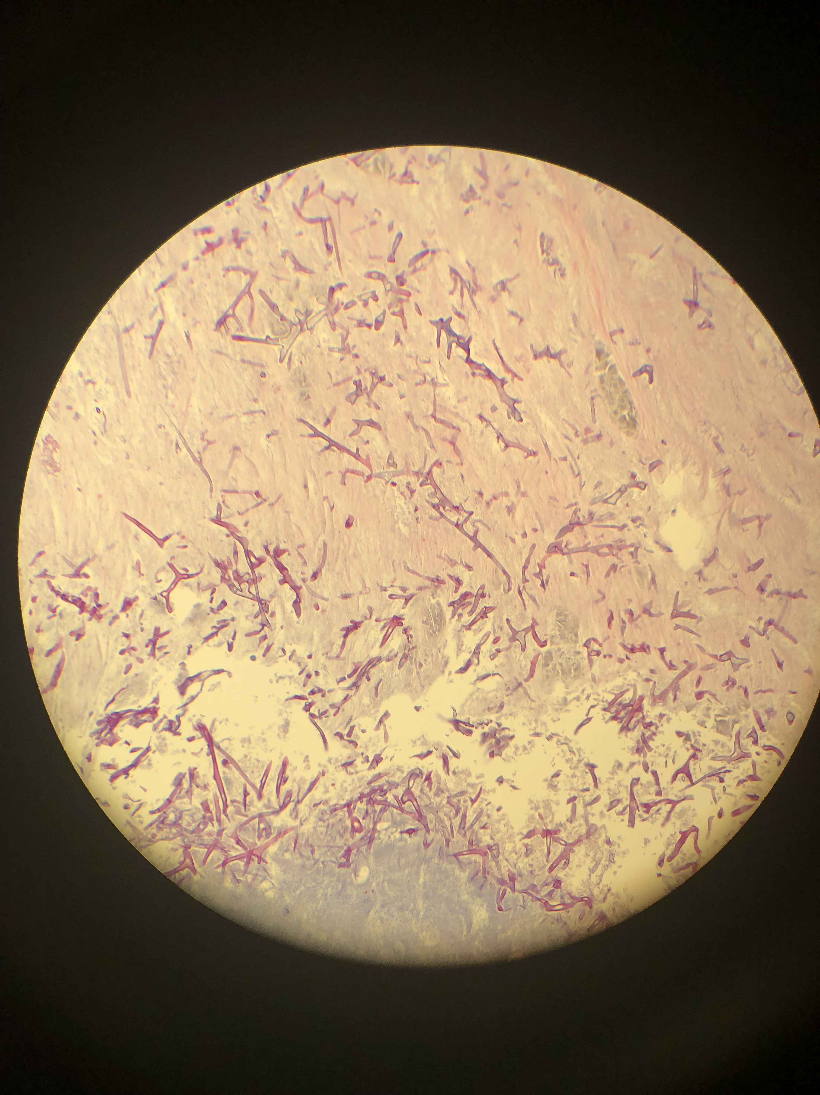
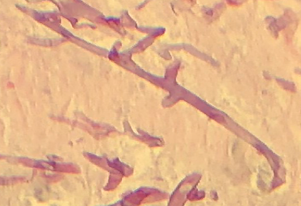
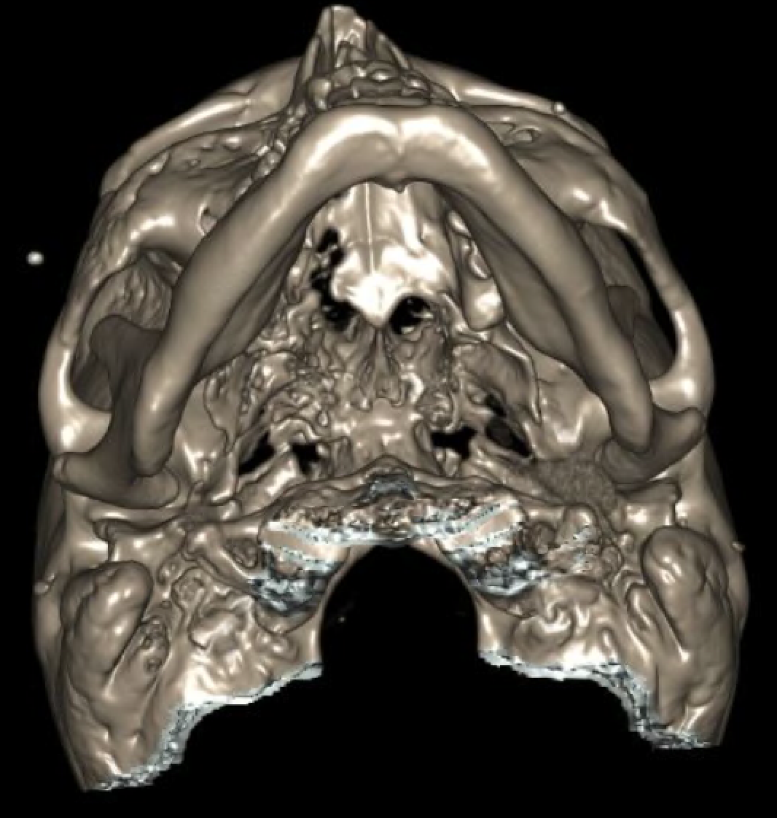
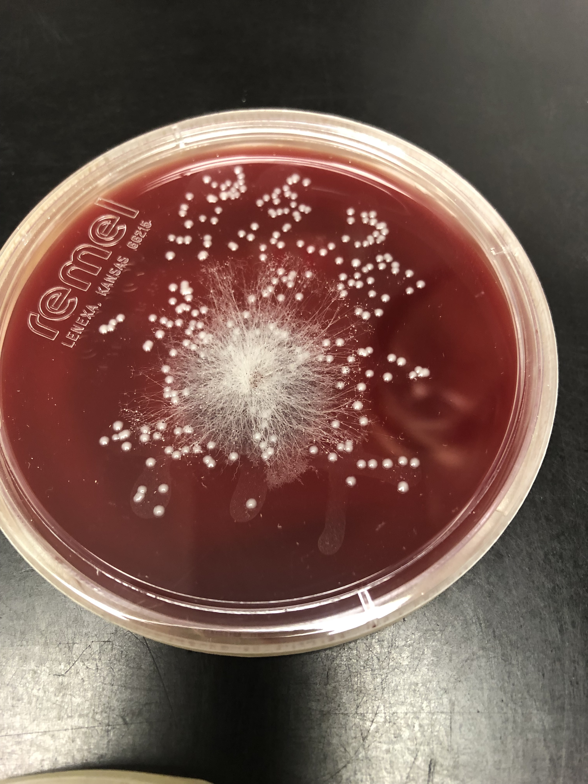
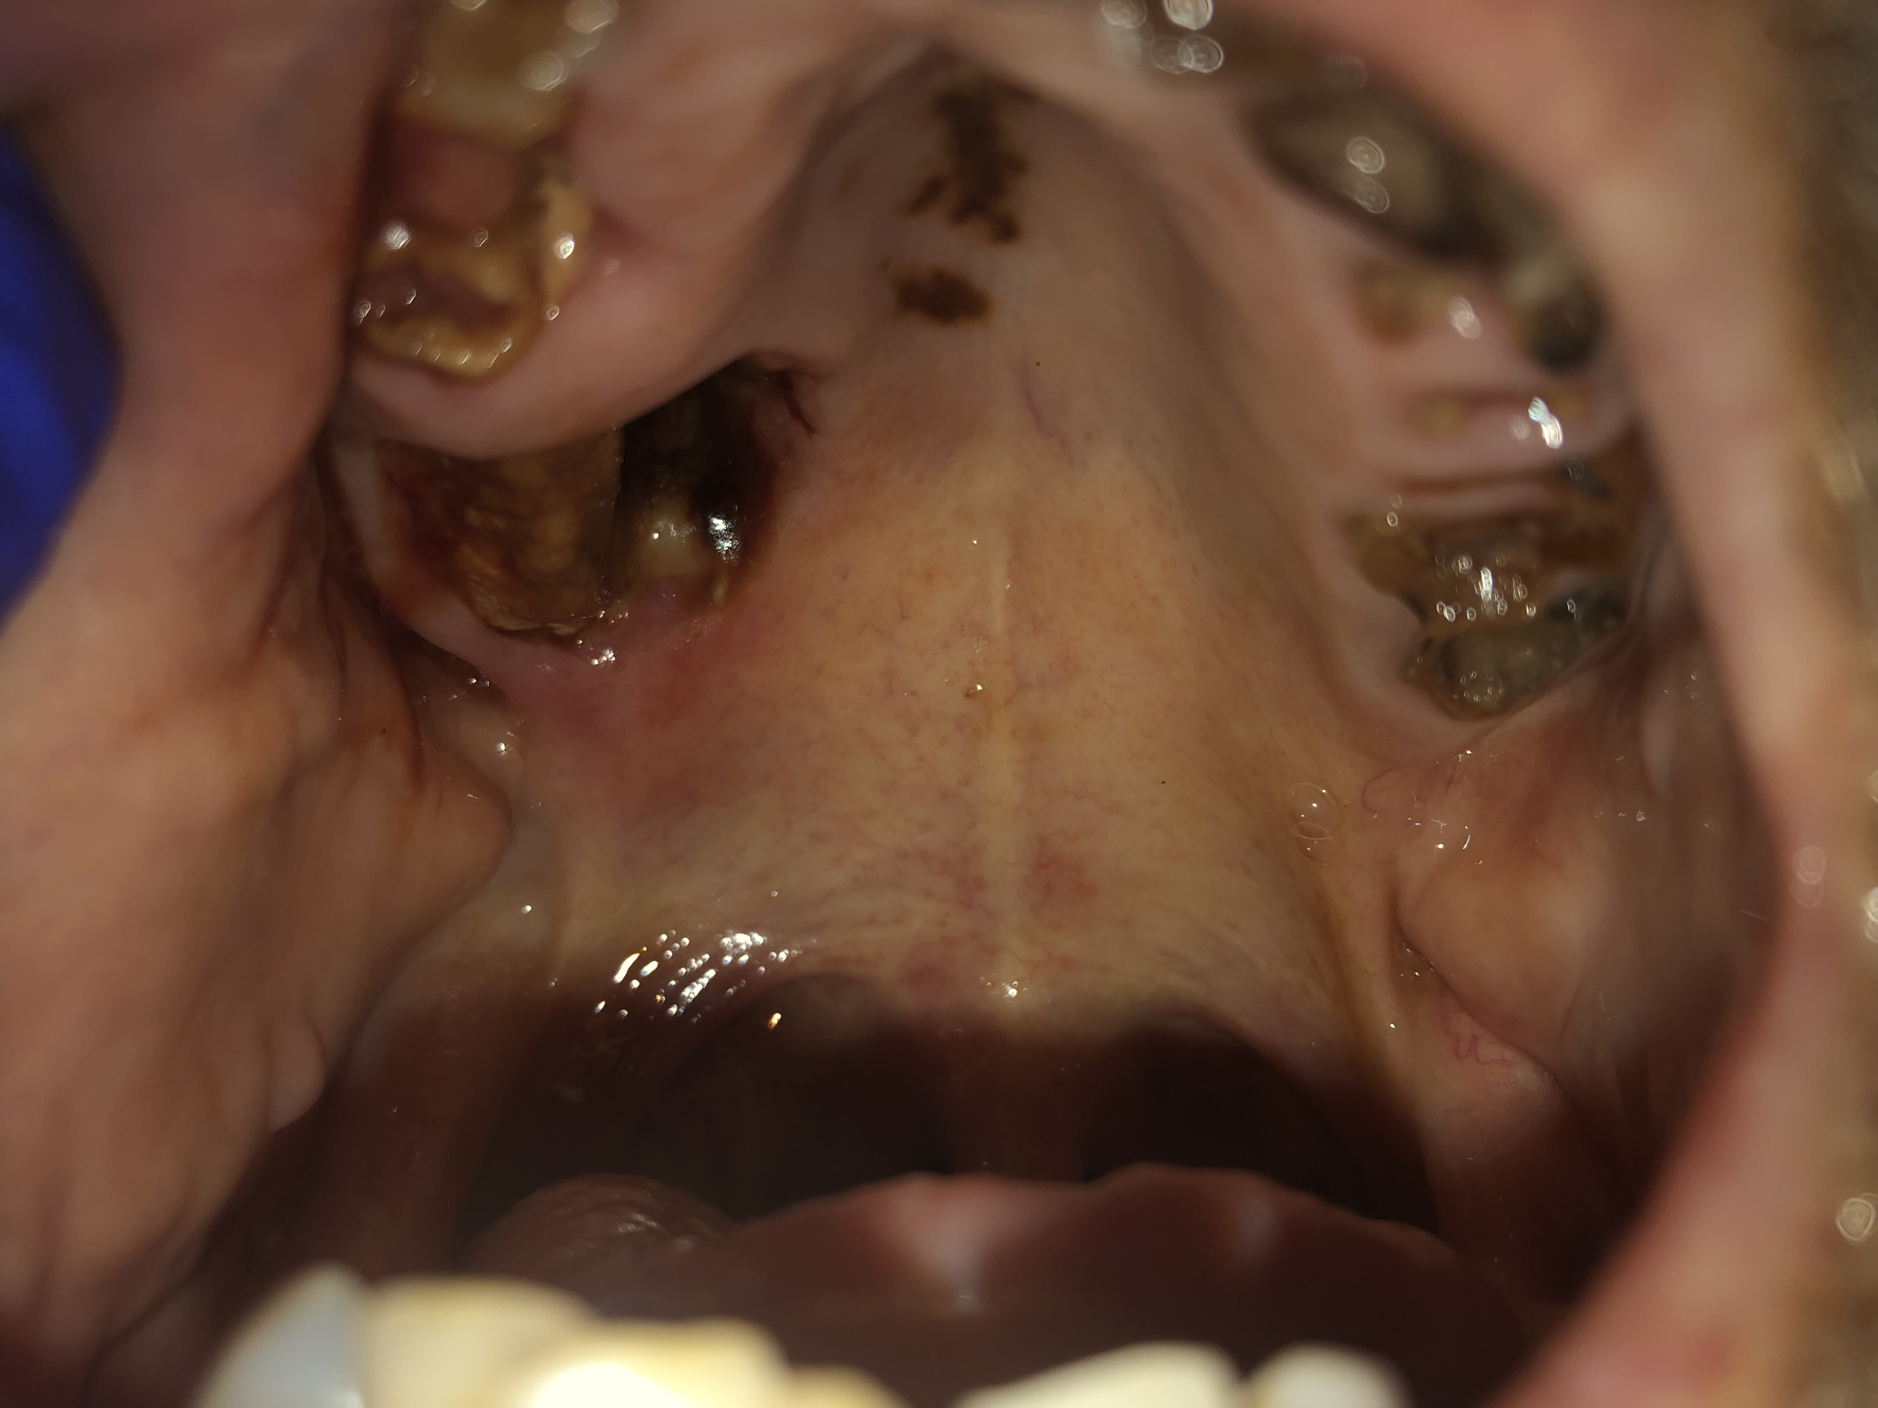
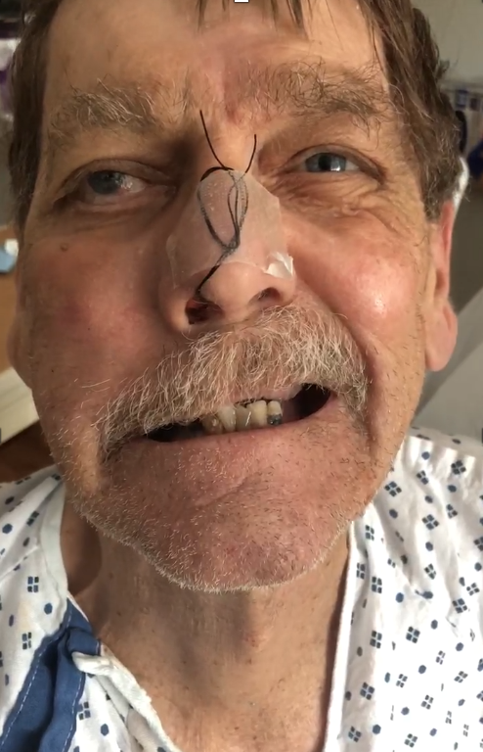
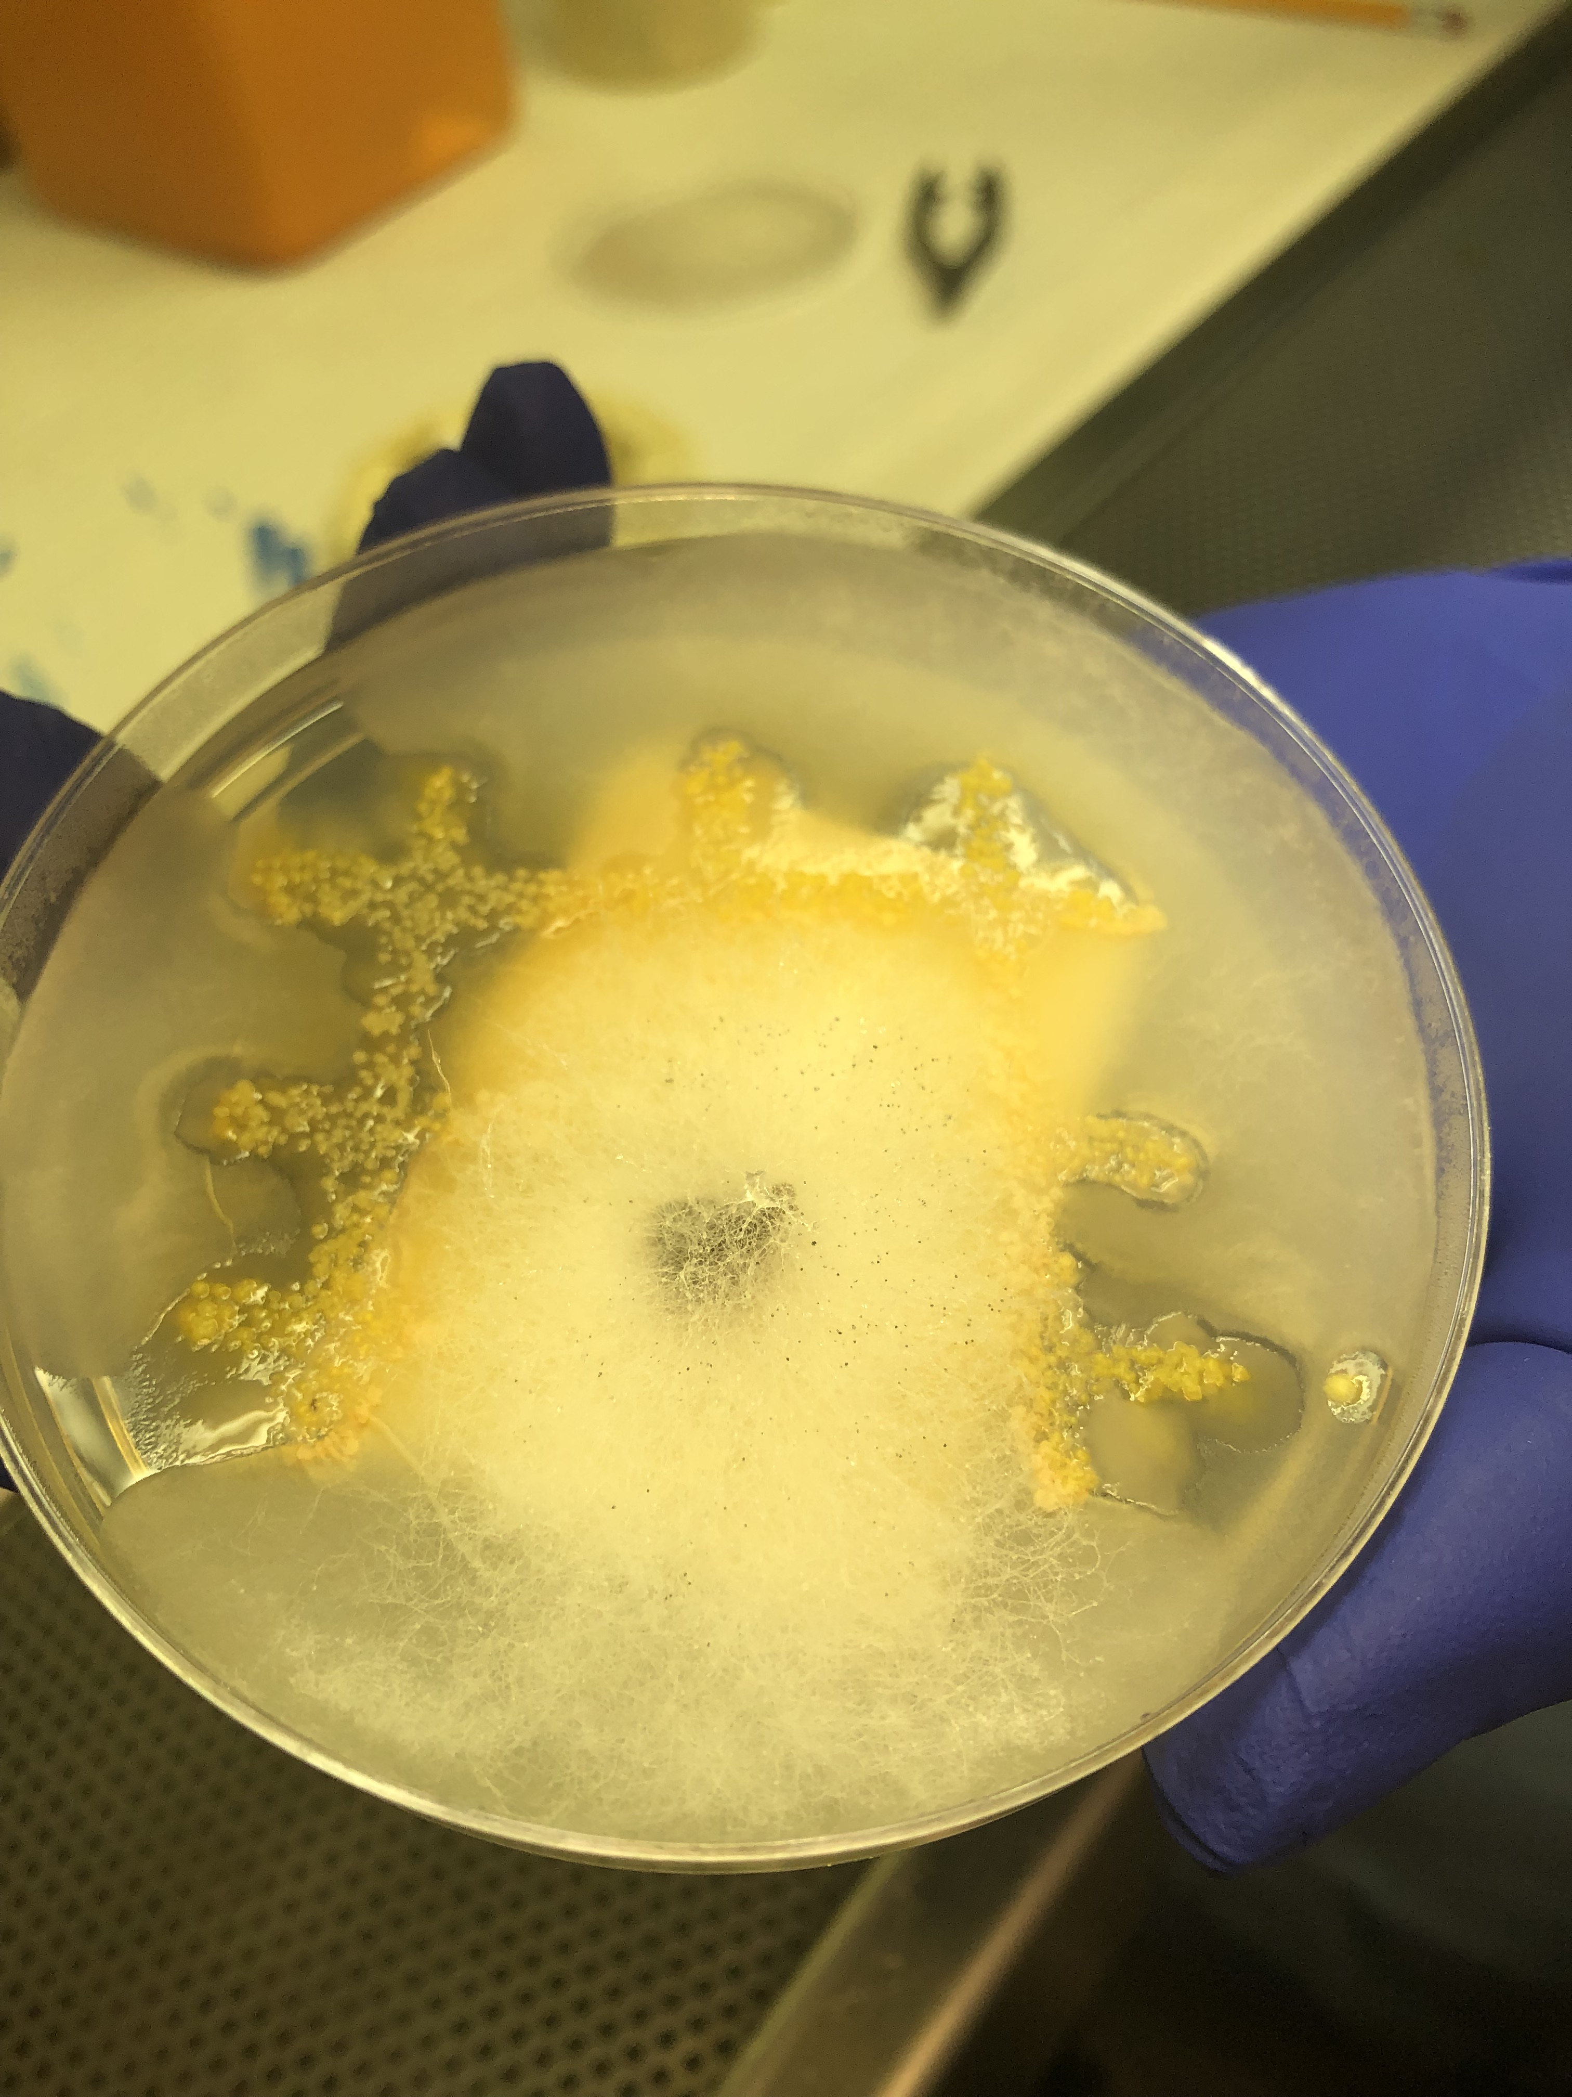
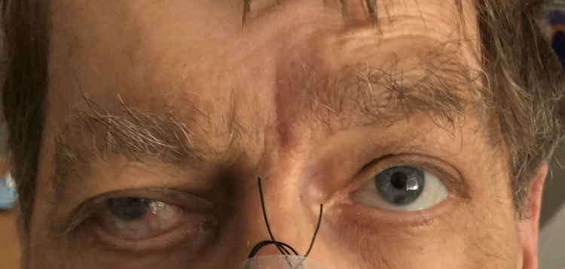

Sweet Tooth: A case of opportunistic infection in an immunocompromised host. Ryan K. James, MD¹; Mary Burgess, MD¹ 1 Department of Internal Medicine, University of Arkansas for Medical Science, Little Rock, Arkansas
INTRODUCTION
LABS
GROSS PATHOLOGY
MANAGEMENT
Immunocompromised patients require a broad differential at the time of presentation due to risks of a host of opportunistic infections. Infections range from bacterial to viral and fungal organisms all with varying degrees of morbidity and mortality. Progression of these diseases can be indolent, taking years to show systemic findings, or aggressive with mortality days to weeks from the time of diagnosis.
7.5
10.1
313
138
105
11
148
HbA1c: 10.8
HIV: negative
B-glucan: 144
F
G
Management is a 4-step approach:
Early diagnosis: Usually beginning with computed tomography which lacks sensitivity, follow-up magnetic resonance imaging is highly suggested. CT imaging is highly relied on for pulmonary involvement which often shows a reverse halo sign early in the disease course.
Reversal of predisposing risk factors: In this patient prompt, aggressive glycemic control was initiated to better aid in prognosis. If patients are immunosuppressed secondary to chronic steroid use therapy must be stopped.
Surgical debridement: This provides a more favorable outcome than patients who do not undergo surgery and reduces mortality, consultation with a Head and Neck surgeon early is essential.
Antifungal therapy: Liposomal amphotericin starting at 5.0 – 7.5mg/kg/day along with isavuconazole for salvage therapy
3.8
22
0.7
PT/INR: 13.2/1.2
CRP: 24.4
ESR: 54
Galactomannan: negative
Resp Culture: Moderate pseudomonas
CASE DESCRIPTION
RADIOLOGY
68yo M with type 2 diabetes (metformin only), COPD, CAD (s/p CABG) and tobacco abuse (40 pack years) presents initially to PCP with tooth pain of one week duration with subsequent extraction the following day. Evening following extraction he felt a “pop” with sudden vision loss and right-sided facial weakness. Patient saw an ophthalmologist and was told he had an “infarct” and would not regain vision in his right eye. Presented to PCP four days later with SOB and non-productive cough, diagnosed with pneumonia and sent home on 10-d course of amoxicillin Pt presented again to PCP two weeks later for worsening symptoms, admitted for CAP and started on vancomycin and piperacillin-tazobactam.
D
F/G. Images from nasal endoscopy showing extensive necrosis of the right maxillary sinus, inferior turbinate and pterygopalatine fossa
HISTOPATHOLOGY
DISCUSSION
H
Head and Neck surgery were notified on admission with surgery scheduled early the following morning. With fungal elements seen on frozen culture liposomal amphotericin B 5mg/kg was started immediately along with isavuconazole due to concerns of intracranial extension on HD 2. After discussion with surgical specialists and neuro-radiology intracranial extension of infection was highly likely. Options were discussed with the patient and family who ultimately elected to pursue home hospice and was discharged on HD 5.
Invasive mold infections such as mucormycosis and aspergillus are uncommon findings in the general population however immunocompromised groups are at high risk for these aggressive and often fatal diseases. Sinusitis is much more common in uncontrolled diabetes rather than pulmonary Beta-glucan is absent from the cell wall of mucor which helps to differentiate it from aspergillus. In this patient an elevated B-glucan level was observed however previous case reports have observed elevated levels as well which could be explained by a mixed infection with Aspergillus or Fusarium species, this patient also had moderate levels of Aspergillus on fungal culture. Histopathology is also required for definitive diagnosis which shows aseptate hyphae as opposed to septate hyphae characteristic of aspergillus. Branching angles are also differentiating factors, mucor often shows branching at 90º angles as opposed to more acute branching seen in aspergillus. Comment on branching angles must be differed to microbiology due to the steps necessary to prepare tissue to be fixed for staining. Despite early diagnosis and treatment prognosis remains poor in patients with invasive fungal sinusitis
PHYSICAL EXAM
Pertinent positives
General: Chronically ill appearing, cachectic
HEENT: Bilateral temporal wasting. Right periorbital swelling. Multiple missing teeth and very poor dentition, 2cm area of necrosis of the hard palate with exposed maxillary bone (A). Tender nodule over right temporal region. No palpable parotid lesion.
Resp: Coarse breath sounds in b/l upper lobes
Neuro: Right pupil non-reactive to light with ptosis and lateral gaze palsy. Right-sided peripheral CN7 palsy. V1 palsy. (B/C)
E
H. H&E stain showing branching aseptate hyphae with extensive necrosis and focal angioinvasion suggestive of Zygomycetes species
MICROBIOLOGY
A
C
I
J
B
REFERENCES
D. CT max/face with contrast showing extensive inflammation involving the right sphenoid sinus, ethmoid air cells, and maxillary sinus along with osteomyelitis of the right maxilla, body of the sphenoid, and right pterygoid. Deep facial abscesses within the right face surrounding the right maxilla, involving the right pterygopalatine fossa. E 3D reconstruction showing erosion of the hard palate
Zygomycetes in Human Disease
Julie A. Ribes, Carolyn L. Vanover-Sams, Doris J. Baker
Clinical Microbiology Reviews Apr 2000, 13 (2) 236-301
Practice Guidelines for the Diagnosis and Management of Skin and Soft Tissue Infections: 2014 Update by the Infectious Diseases Society of America, Clinical Infectious Diseases, Volume 59, Issue 2, 15 July 2014, Pages e10–e52
I/J. Fungal elements on supportive media and blood agar, respectively.
Notes:
Still need to insert UAMS logo at top L hand corner!!!!

