Slide 1
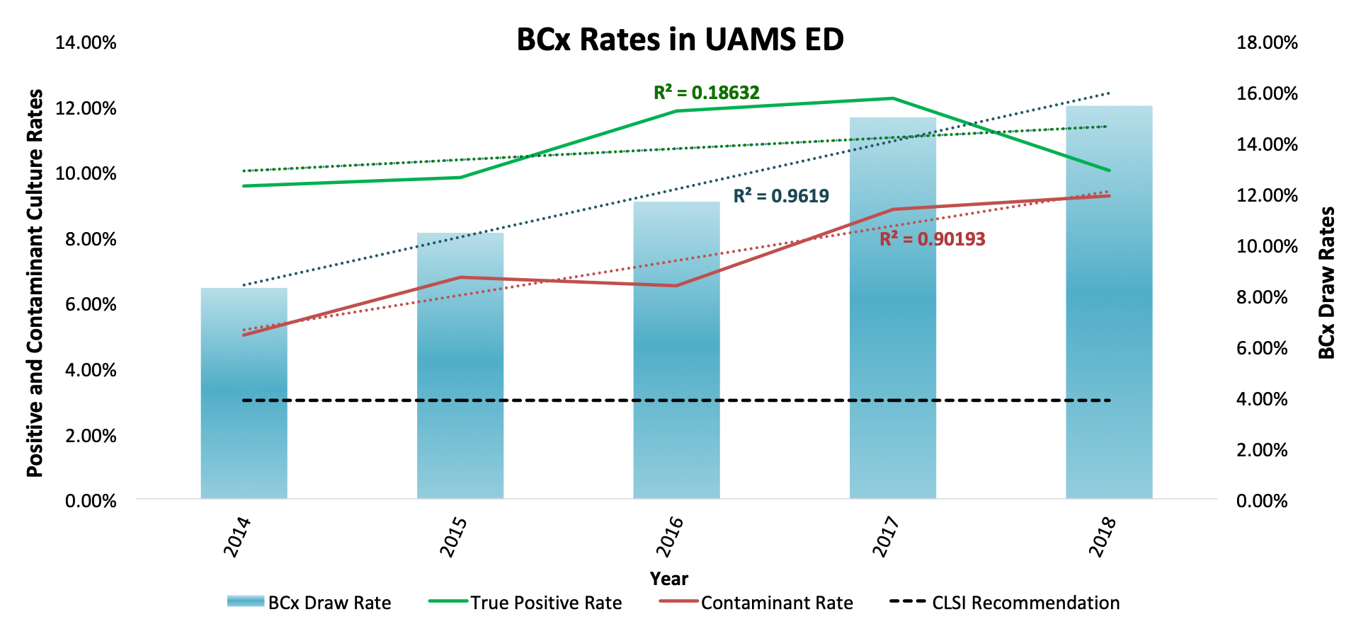
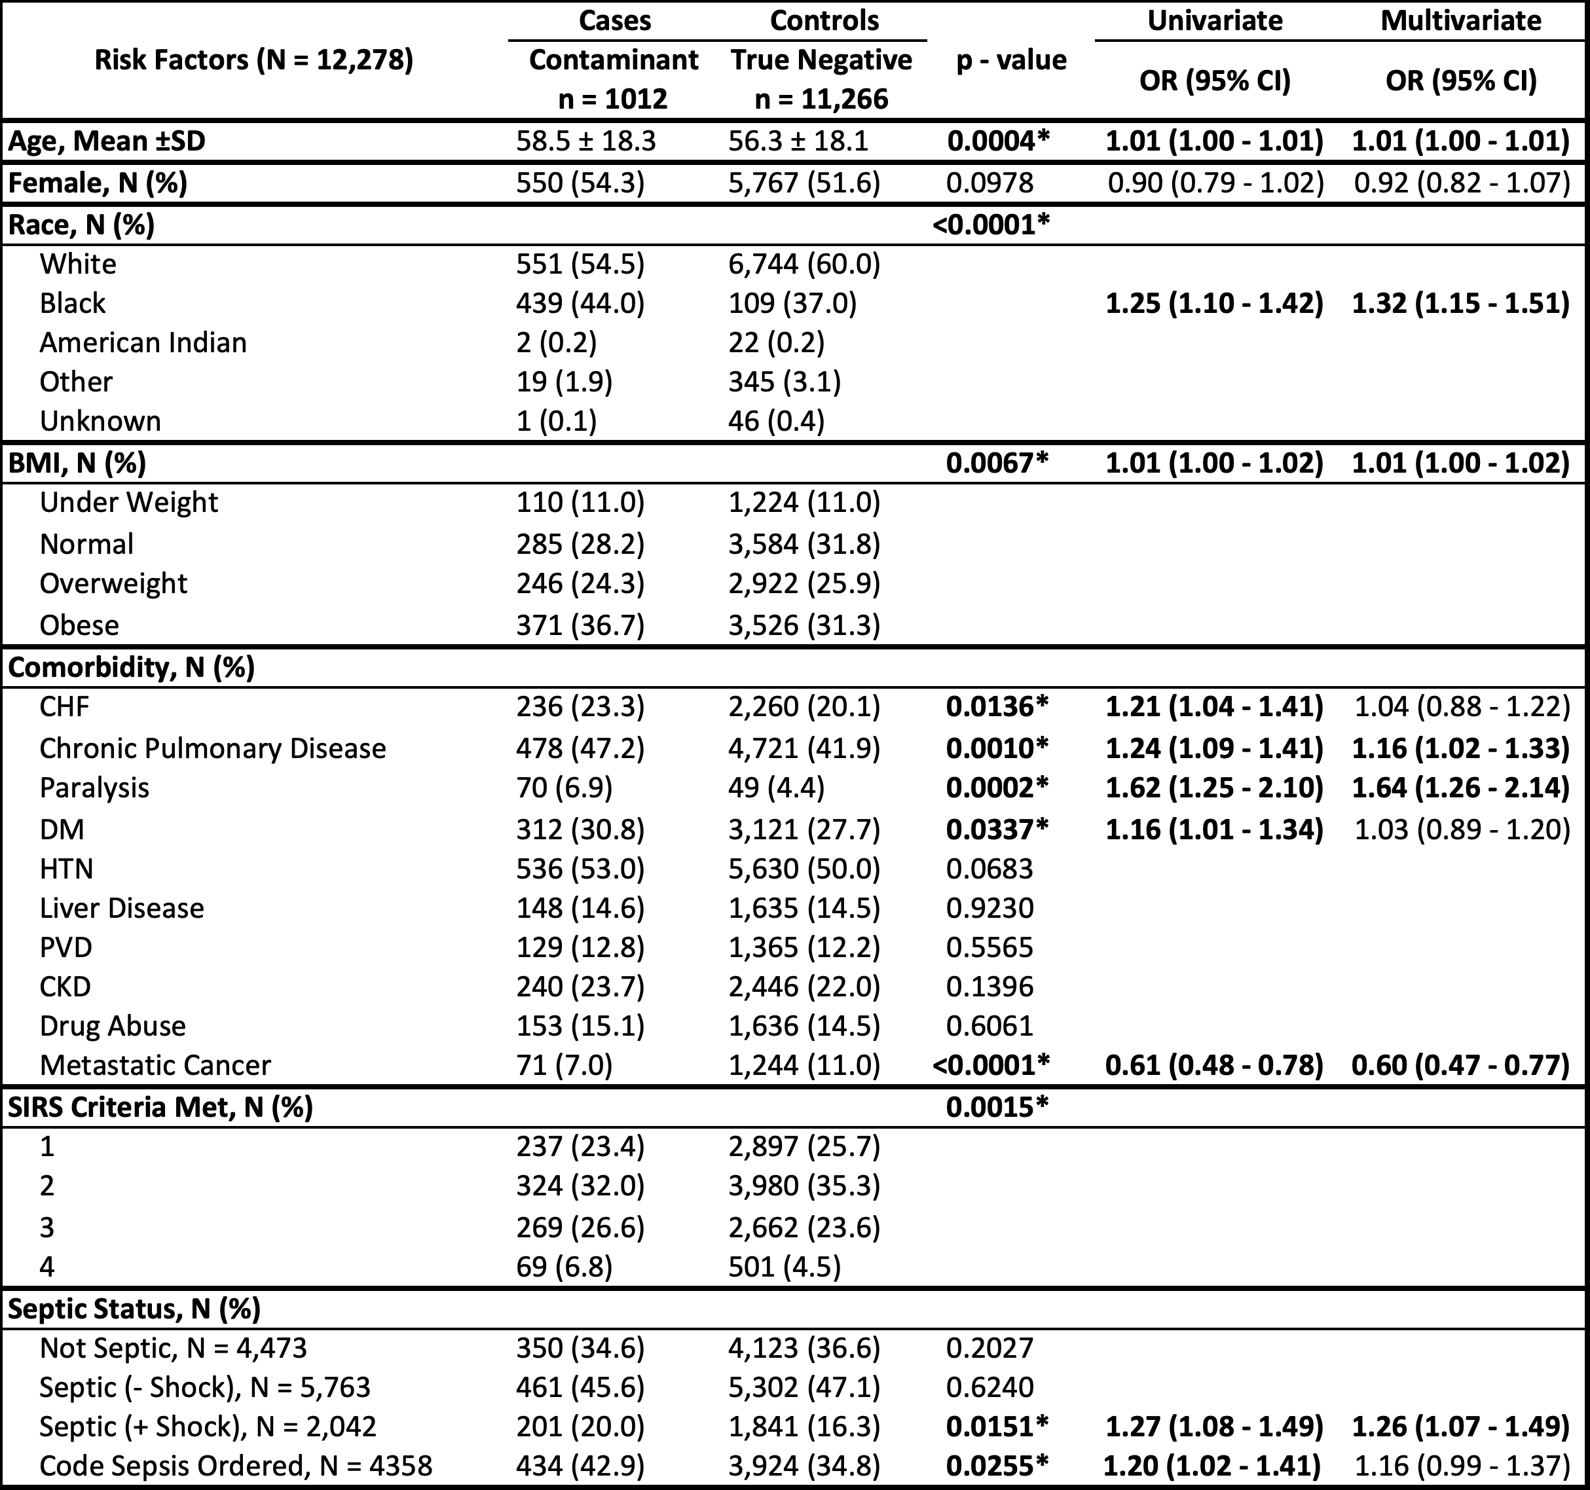
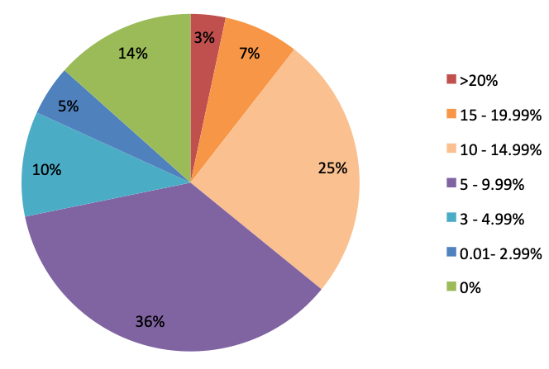
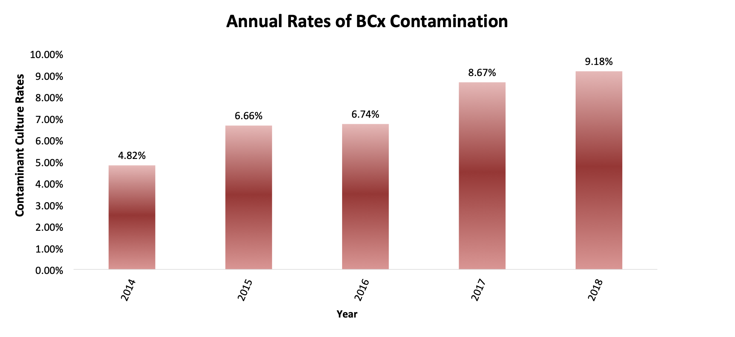

Blood Culture Contamination in the Emergency Department: A Risk Factor Analysis
Justin Klucher, BS¹ Mrinmayee Lakkad, MS² Jacob Painter, PhD² Ryan Dare, MD³
University of Arkansas for Medical Sciences, Little Rock, AR
College of Medicine¹, Division of Pharmaceutical Evaluation and Policy² Division of Infectious Diseases³
BACKGROUND
METHODS
Blood Cultures (BCx) are used to guide treatment in bacteremic patients, but are susceptible to contamination by patient skin flora, environmental pathogens, or collector flora¹
Contaminated BCx impact patient care through increased costs, increased hospitalization and inappropriate antibiotics¹
Clinical Laboratory Standards Institute (CLSI) recommends BCx contamination rates < 3%, our institution’s Emergency Department (ED) is currently more than double this during this study
Efforts should be made to discern the cause of this rise in order to improve practice and patient care
Since 2016, “Code Sepsis” has been used as an ED code for potentially septic patients when 2 or more of the following are abnormal: Temperature, Blood Pressure, Heart Rate, and Respiratory Rate. “Code Sepsis” enhances the urgency of care for these patients
We hypothesized that implementation of “Code Sepsis”, while decreasing sepsis related mortality, increases risk of contamination due to the added urgency resulting in collection errors
Retrospective case-control risk factor analysis of patients with BCx drawn in our institution’s ED between June 2014 and March 2018
Patients with false positive (contaminated) BCx, identified per American Society for Microbiology guidelines†, were considered cases. While patients with true negative cultures were considered controls. True positive cultures were not included in analysis
Demographics and clinical characteristics were collected from generated reports from our electronic medical record and included in this risk factor analysis. Comorbidity data was obtained from a query with support from our institution’s translational research institute (TRI)
Sepsis was defined as meeting two or more systemic inflammatory response syndrome (SIRS) criteria without hypotension. Septic shock was defined as meeting two or more SIRS criteria with hypotension. Not septic was defined as meeting one or less SIRS criteria without hypotension. By nature of BCx being drawn it was assumed there was suspicion for infection.
For categorical data, statistical analysis was performed using Pearson’s chi squared test, while continuous data was analyzed with student t-tests, binomial proportion tests, or Pearson’s correlation coefficient. All statistical analysis was performed using STATA 14.2 software (College Station, TX) and SAS (Cary, NC)
RESULTS
Contamination Rates by Collector
Figure 1: Yearly BCx rates from UAMS ED from 2014 to 2018. The left axis shows true and false positive BCx collection rates (green and red respectively). The right axis shows monthly BCx draw rates. CSLI accepted BCx contamination rate is <3% (dashed). Pearson’s correlation coefficient is shown for approximate linear regressions of the data sets.
*
*
Figure 3: Contamination rates for each collector during study period. Collectors with less than 10 BCx draws were excluded. (N=209)
Figure 2: Annual contamination rates at UAMS ED from 2014 to 2018 at the patient encounter level (rate a patient had a contaminant during their stay). Binomial proportion tests were used to compare consecutive yearly rates.
* = Year intervals with statistically significant difference (p value <0.05.)
Table 1: Risk factors associated with BCx contamination (False Positives). Analysis was performed with chi squared tests. Odds Ratios (OR) performed for variables with p value < 0.1 and entered into multivariate analysis and adjusted for other factors.
* statistical significance (p < 0.05)
CONCLUSIONS
The ED BCx contamination rate is not only higher than the acceptable rate (3%) but is rising with the increase in overall BCx collections despite a relatively constant rate of truly positive BCx.
BCx contamination rates significantly increased between 2014-2015 and again between 2016-2017. Of note, “Code Sepsis” was implemented in the ED 03/2016.
Older age, obesity, African American race, and having specific comorbidities (congestive heart failure, chronic pulmonary disease, diabetes mellitus, paralysis, etc) increased contaminant risk
Presentation with septic shock are more likely to have contaminated BCx
The severity of SIRS presentation appears to increase risk of contamination
“Code Sepsis” appears to have significantly increased contamination rates, but is no longer significant when accounted for other variables (possibly Septic Shock)
The data suggests patients who present as a more “difficult stick” (dark, fragile skin; hypotensive) are more likely to develop contaminated BCx.
Collector contamination rates varied widely. Only 38 (19%) of 209 collectors with more than 10 draws had contamination rates below the accepted rate of 3%. Of that 3%, the majority had no contaminated BCx. One in ten collectors had contamination rates >15%.
Limitations of this study include the retrospective single center study design. This limits risk factor analysis primarily to patient specific factors. Given the cohort size, generated clinical and patient data reports were utilized for data extraction and detailed chart review was not pursued. Unfortunately, collection technique could not be assessed in this study.
A multidisciplinary ED BCx contamination prevention committee aimed at developing interventions to minimize contamination are utilizing the results of this study in an effort to reduce contamination in the at-risk populations . Clinical outcome analysis of this cohort of patients was also performed and is presented as poster #2014 here at IDWeek.
This is a crisis requiring culture change regarding proper sterile technique for obtaining BCx. Interventions proposed include dedicated phlebotomists, venipuncture vs catheter draws, use of sterile BCx kit, and teaching and enforcing full sterile technique for blood draws at all times^{1,2}
ACKNOWLEGEMENTS
REFERENCES
APPENDIX
Funding through University of Arkansas College of Medicine Honors Research program
We thank Nicole Emery, Brett Bailey, and the Translational Research Institutes for their aid in selecting and acquiring patient data used in this study
Dawson S. Blood culture contaminants. J Hosp Infect. 2014; 87:1-10.
Self WH, Mickanin J, Grijalva CG, et al. Reducing blood culture contamination in community hospital emergency departments: a multicenter evaulation of a quality improvement intervention. Acad Emerg Med. 2014; 21(3): 274-82.
†American Society for Microbiology Guidelines for Contamination:
  CNS (one or two bottles) of one set is considered a contaminant
  2+ sets of same CNS species within 5 days is considered a positive culture
  Diptherioids/Corynebacteria/Micrococcus/Lactobacillus/Rothia/Kocuria/Acitinobacter/Select Bacillus are contaminants
  Propionibacterium acnes, select Actinomyces, and select flora are considered positive on a patient to patient basis

