Slide 1
Department of Pediatrics Onboarding Day 1
August 28, 2024

Slide 2
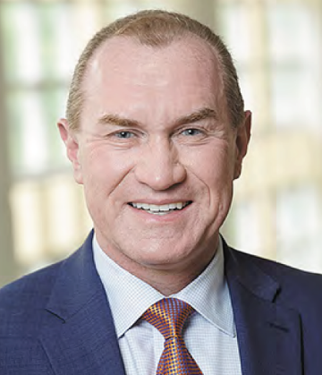
William J. “Bill” Steinbach, MD
Robert H. Fiser, Jr. Endowed Chair in Pediatrics
Chair, Department of Pediatrics
Associate Dean for Child Health
Pediatrician-in-Chief, Arkansas Children’s
501.364.5262
WSteinbach@uams.edu

Slide 3
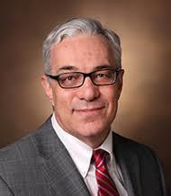
Steven Webber, MBChB (Hons), MRCP
Executive Vice Chancellor
Dean, College of Medicine
Professor, Pediatrics
Section, Cardiology

Slide 4
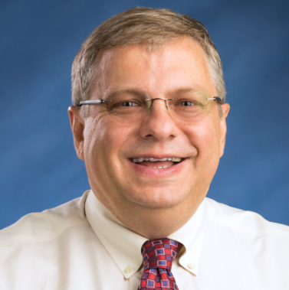
Steve Schexnayder, MD
Executive Vice Chair
Professor, Division of Critical Care
SchexnayderSM@uams.edu

Slide 5
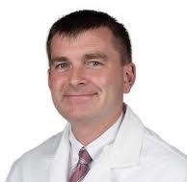
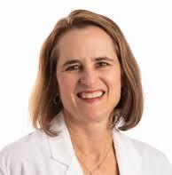
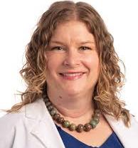
Department of Pediatrics Vice Chairs
Kelly Curran, MD
Vice Chair, Education (Residency)
Assoc. Professor, Adolescent Medicine
KCurran@uams.edu
Brian Varisco, MD
Vice Chair, Research
Professor, Critical Care
BVarisco@uams.edu
Jill Fussell, MD
Vice Chair, Education (Fellowship)
Professor, Developmental & Behavioral Pediatrics
FussellJillJ@uams.edu

Slide 6
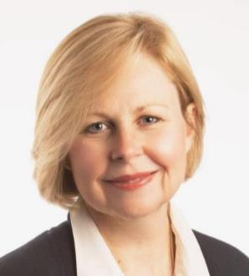
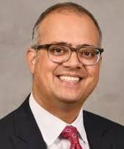
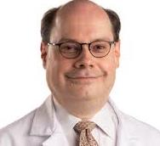
Department of Pediatrics Vice Chairs
Eddie Ochoa, MD
Vice Chair, Partnerships & Child
Health Equity
Professor, Community Pediatrics
OchoaEduardoR@uams.edu
Renee Bornemeier, MD
Vice Chair, Faculty Affairs
Associate Dean, FAD, COM
Professor, Cardiology
BornemeierReneeA@uams.edu
Prateek Wali, MD
Vice Chair, Clinical Strategy
Professor, Gastroenterology
Joining October 2024

Slide 7
Where are we headed?
Next 5 Years:
Expanding UAMS DOP and Arkansas Children’s Excellence
and Growing our National Reputation
• Massive facility expansion on two campuses ($318M)
• Hiring 150-200 more faculty in DOP and non-DOP Sections across both campuses
• Developing new clinical Centers and new Programs
• Significantly expanding the number of pediatric fellowships and innovating residency education
• Substantially increasing research footprint and research integration

Slide 8
UAMS Department of Pediatrics
Overall Mission and Vision Statements
Department Mission
Provide exceptional, family-centered care driven by scientific discovery and evidence-based medicine as we train the next generation of pediatricians and leaders in pediatric health.
Department Vision
The UAMS Department of Pediatrics will be a national leader in clinical care, research, education, and advocacy.

Slide 9
UAMS Department of Pediatrics
Academic Mission Goals
Clinical
Deliver compassionate, collaborative, and equitable care that propels us to regional and national prominence.
Research
Conduct multi-disciplinary, cutting-edge research across the translational spectrum to stimulate innovation and improve health outcomes for children.
Education
Educate and cultivate the next generation of pediatric physicians and healthcare providers as clinicians, educators, and investigators.

Slide 10
Department of Pediatrics Growth
*FY25 only started 23 days ago…

Slide 11
FY25 Department of Pediatrics Faculty Leadership
Chair
Associate Dean for Child Health
William J. Steinbach, MD
Vice Chairs (9+2)
Clinical Sections (24)
Clinical Programs (5)
Executive Vice Chair
Steve Schexnayder, MD
Vice Chair, Faculty Affairs
Renee Bornemeier, MD
Adolescent Medicine
Kelly Curran, MD
Developmental Pediatrics
Maya Lopez, MD
Infectious Diseases
Matthew Kelly, MD
Dennis Developmental Center (DDC)
Jamie Flor, MD
Vice Chair, Clinical Strategy
Prateek Wali, MD
Vice Chair, Partnerships & Health Equity
Eddie Ochoa, MD
Allergy & Immunology
Tamara Perry, MD
Emergency Medicine
David Spiro, MD MPH
Neonatology
Ashley Ross, MD
Family Treatment
Liza Murray, MD
Vice Chair, Education (Fellowship)
Jill Fussell, MD
Cardiology
Paul Seib, MD
Endocrinology
Jon Oden, MD
Nephrology
Richard Blaszak, MD
Vice Chair, ACNW
TBD
Head Start
Eddie Ochoa, MD
Children At Risk
Liza Murray, MD
Gastroenterology
Jennifer Dotson, MD
Neurology
Erin Willis, MD
Vice Chair, Education
(Med Student/Residency)
Kelluy Curran, MD
Vice Chair, Research
Brian Varisco, MD
Kids First
Angie Scott, MD
Clinical Informatics
Pele Yu, MD
General Pediatrics
Sowmya Patil, MD
PM&R
Laura Hobart-Porter, DO
Associate Vice Chair Basic & Translational Research
Josh Kennedy, MD
Vice Chair, Quality Improvement & Innovation
TBD
Schmieding Developmental Center (SDC)
TBD
Community Pediatrics
Chenia Eubanks, MD MPH
Genetics
Elizabeth Sellars, MD
Psychology
Brandi Whitaker, PhD
Associate Vice Chair
Clinical Research
TBD
Critical Care
Ron Sanders, MD
Hematology & Oncology
David Becton, MD
Pulmonary & Sleep Medicine
Jennifer Guimbellot, MD PhD
Developmental Nutrition
Mario Ferruzzi, PhD
Hospital Medicine
Rebecca Cantu, MD MPH
Rheumatology
Stacie Jones, MD (interim)

Slide 12
FY25 Administrative Leadership
Assistant Dean for Child Health Administration
Tiffany Edwards, CMPE
Finance Director
Afif Kamal
Associate Administrator for
Patient Care-Inpatient
Dir. of Clinical Operations & Strategy
Jeremy Ruff
Research Administrator
Mark Mosby
Executive
Administrative
Support
Dir. Of Pediatric Nursing
Advanced Practice
April Carpenter
Accounting Manager
Rashonda Williams
Executive Assistant for Chair
Stacy Cornwell
Assistant Administrator for Patient Care-Primary Care
Ryan Choate
Director of Operations ACNC
Michelle Perry
APRN Coordinators
340B Program Manager
Maha Ramzan
Admin Coordinator
for Vice Chairs
Leah Burns
Headstart
Tyra Larkin
Assistant Administrator for Patient Care-Outpatient/Inpatient
TBD
Clinical Research Finance Director ACNC
Jackie Yabrough
Physician Recruitment/
Onboarding Manager
Meghan Baser
Senior Grants Manager
TBD
Assistant Administrator for Patient Care-Outpatient/Inpatient
TBD
Director of Research Administration COBRE
TBD
Assistant Administrator for Patient Care-Outpatient/Consult
Mariah Camp
Senior Communications Writer
Michael Taggard
Assistant Administrator for Patient Care-Behavioral Health
Brian Carpenter
ACNW Office Manager
Erika Lopez
ACNW Admin Coordinator
Brittani Monk
Administrative Coordinator
Faculty Affairs
Jenny Kubacak

Slide 13
FY25 Office of Education
Vice Chair of Education – Residents/Students
TBD
Vice Chair of Education - Fellows
Jill Fussell, MD
DEI Director
Carla Brown, MD
Advocacy Director
Becca Perrin, MD
Assistant Administrator
Ryan Choate
Fellowship Program Directors (13)
Medical Student Leadership
Pediatric Residency Leadership
Allergy/Immunology
Robbie Pesek, MD
Office of Education
Staff Director
Amanda Dozier
Cardiology
Joshua Daily, MD
Endocrine
Shipra Bansal, MD
Student Clerkship Director
Jacob Filipek, MD
Clerkship
Coordinator
TBD
Hematology/Oncology
Joanna Mack, MD
Dave Douglass, MD
AI/Pulm Fellowship Coordinator
Lauren Rogers
Residency Program Director
Ori Kas-Osoka, MD
Child Abuse
Liza Murray, MD
Associate Student Clerkship Director
Carla Brown, MD
Associate Peds Program Director
Paul Drake, MD
Prim. Residency Program Manager
Leigh Austin
Clinical Informatics
Feliciano Yu, MD
Hospital Medicine
Rebecca Cantu, MD
Card. Fellowship Coordinator
(0.5 FTE)
Bren Bradley
Surgery/Hem-Onc Coordinator
Jill Hare
Associate Peds Program Director
Rachel Millner, MD
Residency Program Coordinator/Office Manager
Lori Miloni
Critical Care
Katherine Irby, MD
Matt Malone, MD
Neonatology
Jessica Jakubowicz, MD
Emerg Med/Child Abuse and Endo Coordinator
Stephanie Veach
Associate Peds Program Director
Shruti Tewar, MD
Developmental Pediatrics
Jill Fussell, MD
Psychology
Brandi Whitaker, PhD
Damon Lipinski, PhD
Neonatology Coordinator
Tracy Richardson
Administrative Coordinator
Allison Huckey
Coaching Director
Richard Blaszak, MD
Neurology
Critical Care Coordinator
Malinda Scott
Hospital Med Coordinator
(0.5 FTE)
Maia Ghosh
Emergency Medicine
Nick Hobart-Porter, MD
Amber Morse, MD
Pulmonary
Erhan Ararat, MD
Zina Ghazala, MD
Coaching Director
Caroline Crocker, MD
Continuity Clinic Director
Debbie Becton, MD
Dev Peds Coordinator
(0.5 FTE)
Tori McDonald
Child Neurology Residency Program
Kapil Arya, MD
Coordinator: Malinda Scott

Slide 14
Roadmap 2028 Final Report
Completed by 12/31/23 on schedule after 18 mo
1,164 pages
24 Academic Sections
5 Academic Missions
For each of 29 areas:
  Goal Expansion
  Measures & Targets
  External Reviewer(s) Summary
  External Chairs’ Report
  Compilation of 233 proposed initiatives from Departmental Leadership Retreat
  Collated 221 confidential survey comments about department needs and direction

Slide 15
Our Goal: Nationally Present with a High-Energy,
Growth-Minded Tripartite Mission Approach
Departmental ethos to be nationally recognized
  Achieve excellence in all missions
  Maintain and accelerate academic atmosphere and production
  Support an exciting culture of curiosity
Educational innovation
  Become a training destination for multiple programs
  Find ways to reward mentoring and collaboration and equally value all missions
Future Department size of approximately 500 primary physician/PhD faculty
  Constantly rethinking structure and organization for a department of this size
  Find the very best talent in a massive wave of recruiting
Recruiting top quality nationally-known pediatric faculty of all types
  Continually improve research and quality improvement infrastructure and support
  Complement our strong clinical presence with discovery

Slide 16
Multiple Existing Strategic Plans
>85% of each Strategic Plan is SYNERGISTIC
UAMS 10-Year Plan (2029)
AC 5-Year Plan (2025)
ACRI 3-Year Plan (2025)
Key to success is leveraging our partners and facilitating their success as well
DOP 5-Year Plan (2028)
All of these are the first-ever formal strategic plans

Slide 17
Inflection Point in Time:
Future Integrated 2030 Strategic Plan
Align 5 Strategic Plans:
Arkansas Children’s Hospital
Arkansas Children’s Northwest
Arkansas Children’s Research Institute
Arkansas Children’s Foundation
UAMS Department of Pediatrics
Develop one harmonized, partnership plan to
guide us all further than we have ever been

Slide 18
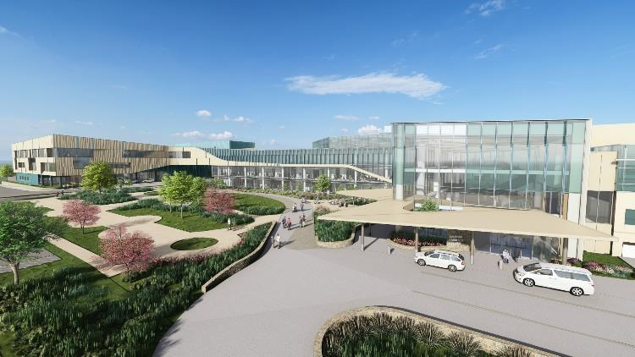
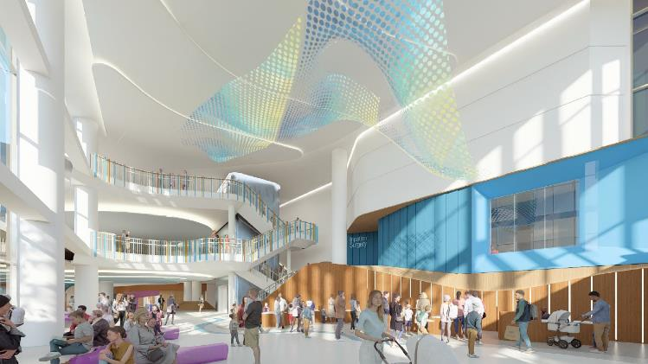
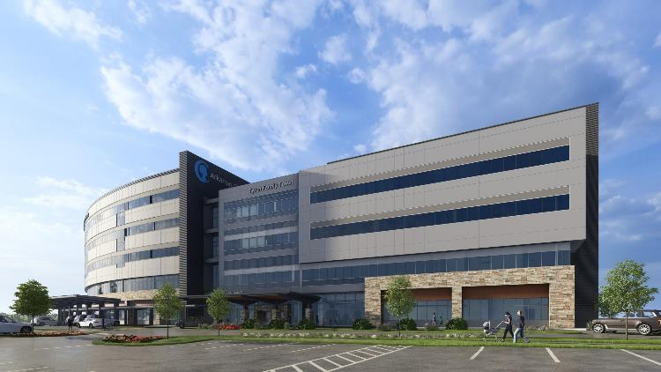
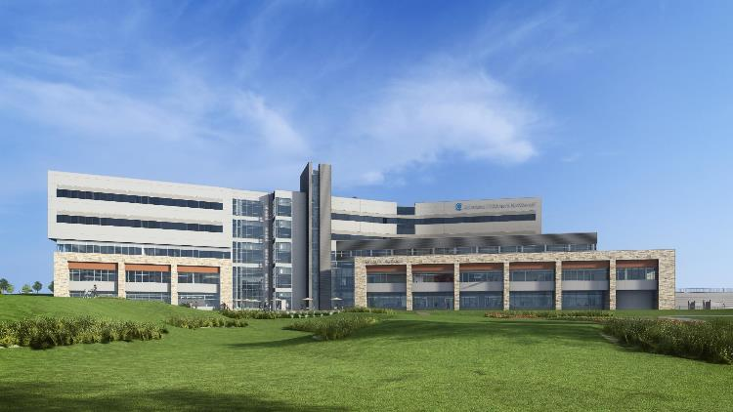

Slide 19
Partnerships and Child Health Equity

Slide 20
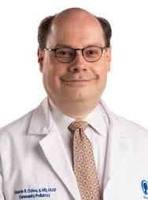
Eduardo R. Ochoa, Jr, MD
Vice Chair, Partnerships and Child Health Equity
Professor, Community Pediatrics
OchoaEduardoR@uams.edu

Slide 21
Diversity in Academic Medicine
Benefits
  Lived experience of diverse staff, trainees, faculty
  Recruitment
  Mentorship and sponsorship
  Reflection of the community served
  Community service, volunteerism

Slide 22
Health Equity
Treatment and outcomes of services
Reflection back to the community
  Dr. Elders: “You can’t be what you can’t see!”
Trust in the health system
Improved health of the community served

Slide 23
Child Health Equity Council
Membership (formed spring 2023)
  Amy Scurlock Mina Nguyen-Driver Ariel Berlinski Shipra Bansal
  Pam Royal Safia Nawaz Dala Zakaria Matt Malone
  Katherine Irby Carissa Rodriquez Hakeem Whittington-Brooks
  Jintong Wu Pratheepa Ravikumar Aixa Gonzalez Kelly Curran
  Rupal Bhakta Angela Chandler
  Ex-Officio: Renee Bornemeier Gwen White Carla Brown Eddie Ochoa
    Reps of Faculty Affairs, AR AAP IDEA, Housestaff DEI, Vice Chair

Slide 24
Partnerships and Child Health Equity
Partnerships with other cross-cutting areas
  Education
    Dr. Joycelyn Elders Child and Adolescent Health Equity Rounds
      Quarterly series, 3 presentations and 1 screening last year
      Next on Thursday: Dr. Tyler Rainer, CHOP: First do no harm, structural racism in behavioral health diagnosis
      Next dates: October 31st, 2025: January 30th, May 29th

Slide 25
Partnerships and Child Health Equity
Partnerships with other cross-cutting areas
  Education
    Dr. Joycelyn Elders Child and Adolescent Health Equity Rounds
      Quarterly series, 3 presentations and 1 screening last year
      Next on Thursday: Dr. Tyler Rainer, CHOP: First do no harm, structural racism in behavioral health diagnosis
      Next dates: October 31st, 2025: January 30th, May 29th

Slide 26
Partnerships and Child Health Equity
Partnerships with other cross-cutting areas
  Education
    Dr. Joycelyn Elders Child and Adolescent Health Equity Rounds
      Quarterly series, 3 presentations and 1 screening last year
      Next on Thursday: Dr. Tyler Rainer, CHOP: First do no harm, structural racism in behavioral health diagnosis
      Next dates: October 31st, 2025: January 30th, May 29th

Slide 27
Partnerships and Child Health Equity
Partnerships with other cross-cutting areas
  Education
    Dr. Joycelyn Elders Child and Adolescent Health Equity Rounds
      Quarterly series, 3 presentations and 1 screening last year
      Next on Thursday: Dr. Tyler Rainer, CHOP: First do no harm, structural racism in behavioral health diagnosis
      Next dates: October 31st, 2025: January 30th, May 29th

Slide 28
Partnerships and Health Equity
Recruitment-faculty, trainees, staff
Development and Learnings
  Faculty, staff, trainees
Work with UAMS to retool division
You!

Slide 29
Education

Slide 30
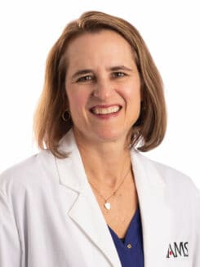
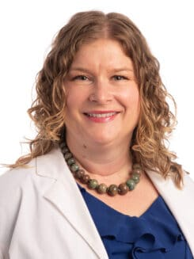
Jill Fussell, MD & Kelly Curran, MD
Vice Chairs
Education
Professor
Developmental- Behavioral Pediatrics
FussellJillJ@uams.edu
Associate Professor
Adolescent Medicine
KCurran@uams.edu

Slide 31
Fellowships
Pediatric Subspecialty Fellowships, ~ 65 fellows in 2024
Department of Pediatrics (48)
  Allery/Immunology (3)
  Cardiology (7)
  CVICU (2)
  Cardiac Advanced Imaging (1)
  Critical Care (8)
  Developmental/Behavioral (1)
  Emergency Medicine (9)
  Heme Onc (5)
  Neonatology (6)
  Pulmonary (3)
  Pediatric Hospital Medicine (2)
  Child Abuse (1)
  Endocrinology (new)
  Gastroenterology in ACGME application process
Other Department Pediatric Fellows –
  Anesthesia (2)
  Cardiac Anesthesia (1)
  Clinical Informatics (3)
  Otolarygology (1)
  Radiology (2)
  Surgery (2)
  Child/Adolescent Psychiatry (5)
  Psychology (1)

Slide 32
Academic Opportunities with Fellows
Core Curriculum
  ACGME Core
    ethics, patient safety, professionalism, wellbeing, fatigue mitigation
  ABP core
    critical literature review, proficiency in teaching, scholarly activities core knowledge
Mentorship, Scholarship Oversight Committees
QI, Research
Fellows’ Research Forum May 15-16, 2025

Slide 33
Fellows’ Scholarly Advancement Program
Launched July 2024
Volunteer participation, help fellows achieve higher level of academic competence
  Individual and group mentorship
  Develop a research project, specific aims page
  Develop career development plan tailored to the fellows’ career goals
  provide external advice and support from domain-specific Scholarly Advancement Committees*
    Clinical Research
    Basic and Translational Research
    Quality Improvement
    Outcomes/Clin Informatics/Health Disparities/Educational Research
* (Where you can get involved!)

Slide 34
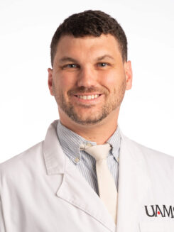
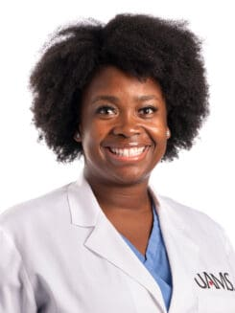
Medical Student Education
Jacob Filipek, MD
Hospital Medicine
Associate Clerkship Director
Carla Brown, MD
Neonatal Hospitalist
Associate Clerkship Director

Slide 35
Medical Student
Education Opportunities
Honors in Pediatrics: Goal if research mentor is to have a product that is presented or published
- Research project mentor
- Faculty shadowing opportunities
Junior Pediatrics Clerkship:
- Mentor group leader, meet 4x during a block or roughly every other week
- Team Based Learning Session Facilitator, TBLs are weekly every Friday (these are specialty specific week to week)
- Mini-PALS (simulation with different scenarios, Jeff Montgomery in Emergency Medicine is contact person)

Slide 36
Medical Student
Education Opportunities
Senior Students
- Pediatrics career advisor
Non-pediatrics specific but great opportunities to get students interested in peds:
- Practice of Medicine I and II preceptor (meet throughout the year)
- Mock residency interviews
- Medical school interviews
- Academic House Advisor (comes with 0.05-0.1 FTE and contact person is Becky Latch, interview required for this position)
“We’re always interested in if someone has a cool new curriculum idea or lecture series.” – J. Filipek

Slide 37
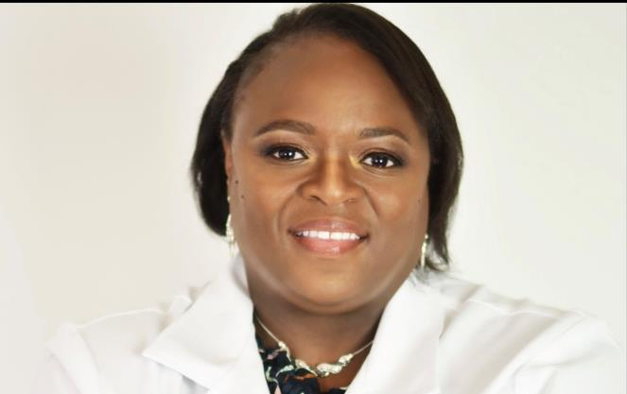
Oriaku A. Kas-Osoka, MD, MEd
Pediatric Residency Program Director
Associate Professor
Adolescent Medicine
Okasosoka@uams.edu

Slide 38
Pediatric Residency Program
96 Residents total: 75 Categorial Pediatric Residents, 19 Medicine/Pediatrics,
2 Child Neurology
3 Pediatric Chief Residents (4th Year)
4 Associate Program Directors
  Rachel Millner (Nephrology)
  Shruti Tewar (Behavior & Development)
  Paul Drake (Neurology)
  Richard Blaszak (Nephrology)
Several opportunities are available to engage with our residents:
  Clinical Experience: Residents rotate throughout ACH (and UAMS)
  “On the job” education from you is essential for a robust clinical experience

Slide 39
Pediatric Residency Program
Clinical Structure
  Thirteen 4-week blocks
  Potential Transition to X+Y or 4+1 Schedule in 2025-2026
    Separates out general pediatrics outpatient experience
    Allows for improved continuity of care in all areas
    Allows for increased access to subspecialty experiences early on
*NEW* ACGME Pediatric Residency Requirements
  Go into effect in 2025
  Additional Mental Health Rotation
  Allows for all programs to transition to X+Y scheduling
Faculty Newsletter
  Sent out monthly (beginning of every block)
  Has Tips & Tricks, Updates, Educational Pearls

Slide 40
Residency Opportunities
Didactic Education
  Attend (or moderate) Morning Report
  Weekdays at 8AM (Rachel Milner & Team)
  Teach at Resident Noon Conference/Academic Half-Day
  Curriculum Committee (Kas/Chiefs, works with Educational Champions)
  AHD every other week, Noon conference on off-week
  Board Review Fridays at 12, mixed into AHD
  Lecture at Grand Rounds/Peds Place every other Thursday (Jill Fussell/Kelly Curran)
Asynchronous Learning
  JEDI: online teaching platform (Jared Beavers)
Scholarship
  Research
  Quality Improvement
Engagement
  Numerous resident committees
    Recruitment Committee
    Curriculum Committee
    Coaching Committee
    Program Evaluation Committee
    Clinical Competency Committee
  Mentorship
    Project Support/Sponsorship

Slide 41
Specific Educational Opportunities
Residents and Medical Students in clinic and inpatient wards
JEDI – electronic resident teaching platform that houses lectures, slides, videos, quizzes, etc
Competitive Departmental grants for Educational Innovations
Specialty rounds, e.g. Schwartz Rounds, Grand Rounds, Health Equity Grand Rounds

Slide 42
Teaching Evaluations
Essential for Clinician Educators and helpful for Clinical Attendings in the Annual Review and P&T process
Evaluations: currently done through
  OASIS for Medical Students
  New Innovations for Residents and Fellows (How To)
Lecture Evaluations
  Currently being done through RedCap (Conference Cash+ for Residents)

Slide 43
2024 Pediatric Compensation Plan Overview

Slide 44
Current Compensation Committee
Ashley Ross, MD – Co-chair, Neonatology
Renee Bornemeier, MD – Co-Chair, Cardiology, ADFAD
Karen Farst, MD - ACH COS, TCAR
Rob Williams, MD – ACNW CMO, Ped Emergency Med
Robert Saylors, MD – ACNW COS, Heme-Onc
Bill Steinbach, MD – PIC, DOP Chair
Todd Maxson, MD – SIC, Peds Surgery
Pete Mourani, MD – ACRI President
Rick Barr, MD – ACCCAO
Tamara Perry, MD – Allergy Immunology
Theresa Wyrick, MD – Ortho
Steve Schexnayder, MD – Peds Critical Care
Sid Dassinger, MD – Peds Surgery
April Carpenter, APRN – APRN Director
Franscesca Miquel-Verges, MD – Neonatology
Tiffany Edwards – DOP Business Admin
Cindy Martin – ACH
Robin Dreisigacker – COM UAMS
Key Functions
Identify provider and physician work-force needs for replacement and growth
Develop strategy and model for physician compensation and assess impact on ACH and UAMS funds flow
Identify key performance metrics for physicians, providers and programs including non-clinical responsibilities
Make recommendations to CHEC* which makes the final determination
Notes:
CHEC = combination of UAMS and ACH leadership.
Finance Committee
CEO Cabinet at ACH

Slide 45
2018 and prior – lower base/incentive era
2016-2017
2018
2019
2020
2021
2022
2023
2024+
CHPC
Started work on compensation plan by faculty
COVID Pause
Incentives
< 70% clinical at 50th Percentile Non-Clinical
First Salary Changes
Quality Incentive
Subspecialties
Breastfeeding
Research Updates
COM Compensation Committee
Approved compensation plan for pediatric providers
50th Percentile Adjustments
<70% clinical new guidelines, SMART Goals
Quality Incentive

Slide 46
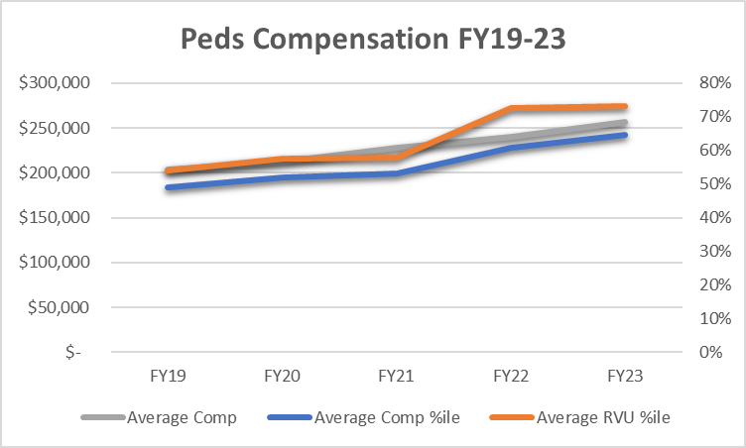
Accomplishments
 | Average Comp %ile | Average RVU %ile
FY19 | 49%ile | 54%ile
FY20 | 52%ile | 58%ile
FY21 | 53%ile | 58%ile
FY22 | 61%ile | 72%ile
FY23 | 65%ile | 73%ile

Slide 47
Grace Period for New Faculty
Example
  1-year grace period to not have productivity count toward salary change
    Faculty starts at 60th percentile July 2023
    Produces under 10% of goal end of June 2024
    No percentile change in October 2024, does moves to 2024 (new) tables if not hired on new tables
  During 2nd year on faculty, productivity “counts”
    Productivity July 2024 to June 2025 is >10% above expected
    Salary increases to 70th percentile October 2025

Slide 48
Annual Salary
Salary pegged to market level using total salary tables from pediatrics national specialty/subspecialty benchmarks for rank from the most recent year
Market competitive levels is defined to align percentile of performance to percentile of compensation

Slide 49
Salary Adjustments
Annual adjustments will utilize the approved benchmarks
  Individual or group performance
The safety corridor is 10% above and below the annual RVU benchmark
  There will not be a change in compensation for faculty that fall within the safety corridor
Compensation adjustments limited to 10 percentiles up or down per year

Slide 50
Why the need for decreases?
increases
+/- 10% Safety Corridor
80% 81% 82% 83% 84% 85% 86% 87% 88% 89% 90% 91% 92% 93% 94% 95% 96% 97% 98% 99% 100% 101% 102% 103% 104% 105% 106% 107% 108% 109% 110% 111% 112% 113% 114% 115% 116% 117% 118% 119% 120%
Output Continuum
Actual Points as a Percent of Expectation
reductions

Slide 51
Benchmarks
Specialty and Teaching Pediatrics – AAAP
Clinically Focused General Pediatrics – Sullivan Cotter
Surgical Services – MGMA and AAMC
Neurosurgery – NERVES
Radiology - SCORTCH

Slide 52

Increase in Productivity/Salary
RVU 2022-2023
45% | 50% | 55% | 60% | 65% | 70% | 75%
4,288 | 4,509 | 4,731 | 5,002 | 5,260 | 5,560 | 5,881
Faculty Example - Associate
RVU 2023-2024
Compensation: $209,273
Comp %tile: 55%tile
Target: 4,731
Actual: 5,882
Actual %tile: 75%tile
Outside 10% change in points
Increase
Limit to 10%tile change
New Comp %tile: 65%tile
New Comp: $230,205
New Target: 65%tile
New Target: 5,348
45% | 50% | 55% | 60% | 65% | 70% | 75%
4,378 | 4,621 | 4,860 | 5,073 | 5,348 | 5,640 | 5,935
Compensation 2022-2023
 | 45% | 50% | 55% | 60% | 65% | 70% | 75%
Assistant | $ 173,601 | $ 177,625 | $ 181,376 | $ 186,252 | $ 191,501 | $ 197,209 | $ 173,601
Associate | $ 200,000 | $ 203,447 | $ 209,273 | $ 212,915 | $ 218,624 | $ 225,843 | $ 200,000
Professor | $ 250,526 | $ 256,725 | $ 263,210 | $ 271,216 | $ 285,000 | $ 297,566 | $ 250,526
Compensation 2023-2024
 | 45% | 50% | 55% | 60% | 65% | 70% | 75%
Assistant | $ 182,621 | $ 186,429 | $ 191,600 | $ 196,424 | $ 201,433 | $ 207,071 | $ 213,780
Associate | $ 210,653 | $ 214,388 | $ 218,470 | $ 224,840 | $ 230,205 | $ 237,120 | $ 245,996
Professor | $ 257,398 | $ 264,931 | $ 270,880 | $ 279,926 | $ 290,128 | $ 301,673 | $ 314,803

Slide 53
Individual vs. Group Plan
Individual
Group
Consistent deployment, ability to influence productivity more directly
Compensation and productivity measured for each faculty
Individual 10% in productivity=change in compensation by no more than 10 %-tiles (up or down)
Diverse deployment, decreased control of volume
Productivity “pooled”
Group 10% increase/decrease productivity= change in compensation by no more than 10 %-tiles (up or down)
Notes:
Reference sub-sub specialist

Slide 54
Less than 70% Clinical
Compensation percentile for <70% Clinical is based on:
Evaluation of those goals and assessment of goal achievement will be made annually by a sub-committee of Compensation Committee that will include, AC CCAO, Pediatrician-in-Chief, Surgeon-in-Chief, ACH CMO, ACNW CMO, ACRI President, 2 UAMS Faculty Members, 1 Compensation Committee member.
Evaluation will result in a rating and associated base salary assignment
Special Note: to be paid above the 50th percentile for administrative goals will be dependent on AC achieving the metrics required to fund the AC employee incentive plan.
Compensation Percentile | Measures
Does not meet expectations (40th%ile salary) | < 50% of goals are achieved Option for immediate removal [from admin role], FTE adjustment, or corrective plan over next year.
Meets most expectations (50th%ile) | > 50% of goals are achieved i.e. an individual achieves 2 or 3 out of 4 goals If circumstance not completely under the control of the individual, this person should not be penalized with a drop by 10%tiles. They should be monitored closely the next year.
Meets all expectations (60th%ile) | 100% of goals and expectations are achieved.
Exceeds expectations (70th%ile) | Achieves all goals and exceeds expectations for > ½ of goals. Justified by exemplary performance.
Exceptional performance (75th%ile) | Achieves all goals and exceeds expectations for > ¾ of goals. There must be outcome documentation that warrants exceptional performance.

Slide 55




Components of Compensation Plan
Clinical
  Goal a percentage of total benchmark points
  Productivity targets based on prior year points
  All clinical activities except out of providers specialty/subspecialty
    GPC, ED extra shifts do not count towards point goal
  Group vs. individual targets
Academic
  Goal points are a percentage to benchmark points
  Section/Service Chief facilitates goals for each faculty
  Salary is based on overall clinical productivity
Administration
  For those <70% clinical, compensation based on SMART goals
    Compensation is based on performance along a sliding scale
  Each assignment is reviewed by the supervisor, Goals Committee
Externally Funded Research
  SMART goals, sliding scale based on performance.
  Incentives
Total Benchmark Points/Compensation

Slide 56
Academic Points/Time
Education
  Graduate medical education lectures
  M1/M2 teaching
  M3/M4 teaching
  Teaching of non-LIP students, staff
  Recognition of excellence in teaching
  Mentoring
  Other Teaching
Unfunded Research
  Endowment funded
  General Academic funds
  Intramural funded research
    ACRI internal grants
    UAMS internal grants
    TRI internal grants
Scholarly Activity: Scholarly activities can include the following:
  Publication in Peer Reviewed journal and books
  Presentation at Conference
  Abstracts
  Non-external funded research
  Academic Citizenship
Quality Improvement
  Eventual goal is to have meaningful quality initiatives in all areas and sections

Slide 57





SPECIFIC
MEASUREABLE
ATTAINABLE
RELEVANT
REALISTIC
TIME-BOUND
S
M
A
R
T
2024
G
O
A
L
S
Notes:
The DOP is striving to move into the top-tier of Pediatric Departments across the country.
This is achievable, but it will take the whole “village” to get us there.
The U of A system requires that faculty complete an Annual Performance Review
Part of this review is to assess what we accomplished in the previous year and what we are striving to accomplish in the coming year
Often the goals entered are nebulous, intangible, with no full way to measure the outcome
“I want to be a better doctor”. “I want to develop a nationally recognized program in…”
Though admirable, these lack an end-point, measurability, standard or timeline, and thereby will be prone to being derailed for more pressing matters.
re

Slide 58

SPECIFIC
Clearly defining the goal sets the boundaries and framework for your accomplishments.
Each Goal should be detailed and clearly defined
  Who will be involved?
  What do I want to accomplish?
  Where will this need to occur?
  When will I achieve this?
  Why is this important?

Slide 59

MEASUREABLE
Goals that may take a period of time to accomplish need planning as to the steps taken and actions needed to reach that goal.
You should be able to know when the goal has been reached.
How can you measure your progress?
How will you identify if you have been successful?

Slide 60

Set a goal that inspires you to move forward to make it happen, but not something that is just wishful thinking.
ATTAINABLE
Consider your current state - do you have the time, skills, resources to achieve this goal?
Is this goal within your reach?
What steps do you need to take to be successful?

Slide 61

Be sure this goal fits within the mission of my section or department, and that this goal makes sense for you at this time.
RELEVANT
Why is this goal something you need to do now?
What makes this the time to take this on?
Will it be worth the effort you will put into it?

Slide 62

TIME-BOUND
Anyone can set goals , but if there is not a timeline for accomplishment, they may get pushed to the side when more pressing things arise.
By when will you to accomplish this?
How often will you review your progress?
How will you hold yourself accountable?
Set a goal date.
2024

Slide 63
Practice Makes Perfect
REVISED
GOAL:
  Meet monthly regulatory standards for reporting within a hospital unit
PRIMARY METRIC:
  Monthly review of assessed parameters
STRETCH METRIC:
  Maintain Certification
GOAL:
  Decrease identified reporting errors
PRIMARY METRIC:
  Decrease reporting errors by 10%
STRETCH METRIC:
  Decrease reporting errors by 15%

Slide 64
Compensation Plan Location
Compensation Plan can be reviewed:
https://pedpoint.peds.ad.uams.edu/DOP/Shared%20Documents/Forms/AllItems.aspx?id=%2FDOP%2FShared%20Documents%2FComp%20Plan
Notes:
Add link to slide

Slide 65
Annual Performance Review

Slide 66
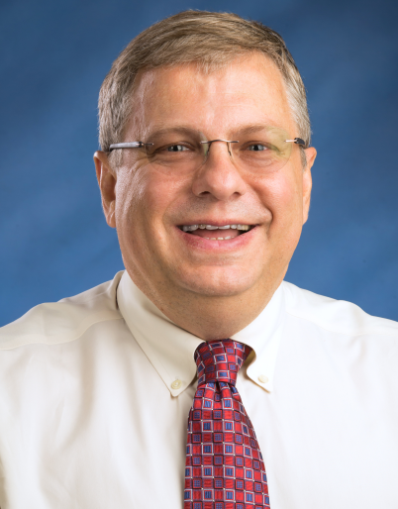
Steve Schexnayder, MD
Executive Vice Chair
Professor, Critical Care Medicine
SchexnayderSM@uams.edu

Slide 67
Annual Performance Review
New Faculty
  For your first year on faculty, the only required sections are goals in each effort area for the current academic year
Effort areas
  Clinical
  Educational
  Research and Scholarly Activities
  Administrative

Slide 68
Annual Performance Review
New Faculty
  Goals for the 2024-25 year in each category in SMART goal format
Next year
  Clinical RVUs and Percentile
  Educational Activities
  Research and Scholarly Activities
  Administrative / Committee Assignments
Due date Tuesday, Sept. 17

Slide 69
Annual Performance Review
After your submission, will be reviewed by your section chief
After chief review, will be reviewed by a vice chair as Dr. Steinbach’s surrogate
  Most by me
  Those with a significant research commitment by Dr. Varisco, Vice Chair for Research
Will ultimately be returned to your chief and you and will become part of your permanent employment file

Slide 70
Academic Points
Currently ACH provides 5-10% effort for academic effort for most clinical faculty
A multidisciplinary task force developed a tool toward award points for efforts across a broad range of categories four years ago to provide accountability for this time
Target for 5%= 115 points; 10% effort= 230 points
>95% of faculty hit this goal in FY23

Slide 71
Scholarly work
(outside of funded time)
 | POINT VALUE
Peer reviewed paper, first or senior author, impact factor >1.5 | 75
Peer reviewed paper, other author (not first or senior), impact factor >1.5 | 15
Peer reviewed paper, first or senior author, impact factor < 1.5 | 25
Peer reviewed paper, other author (not first or senior), impact factor < 1.5 | 10
Non-peer reviewed paper/local guideline/ ANGELS guideline, first or senior author | 25
Non-peer reviewed paper/local guideline/ ANGELS guideline, other author | 5
Non-peer reviewed paper/local guideline/ ANGELS guideline, first author, update | 15
Professional Society guideline, first or senior author | 75
Professionl Society guideline, other author, length | 25
Book chapter/manual, first or senior author, length >10 pages | 50
Book chapter/manual, other author, length >10 pages | 20
Book chapter/manual, first or senior author, length <10 pages | 25
Book chapter/manual, other author, length <10 pages | 10
Manuscript review for a journal (peer-review) | 10, Max 50 points total
Abstract reviewer for regional/national meeting | 10
Invited speaker at national/international conference | 35
Invited speaker at state conference | 25
Oral abstract presenter at regional or national meeting | 15
Abstract/poster presentation, first or senior author | 10
Abstract/poster presentation, other author | 5
Scholarly work (outside of protected/funded research time)
Peer reviewed paper, first or senior author, impact factor >1.5
Peer reviewed paper, other author (not first or senior), impact factor >1.5
Peer reviewed paper, first or senior author, impact factor < 1.5
Peer reviewed paper, other author (not first or senior), impact factor < 1.5
Non-peer reviewed paper/local guideline/ ANGELS guideline, first or senior author
Non-peer reviewed paper/local guideline/ ANGELS guideline, other author
Non-peer reviewed paper/local guideline/ ANGELS guideline, first author, update
Professional Society guideline, first or senior author
Professional Society guideline, other author, length
Book chapter/manual, first or senior author, length >10 pages
Book chapter/manual, other author, length >10 pages
Book chapter/manual, first or senior author, length <10 pages
Book chapter/manual, other author, length <10 pages
Manuscript review for a journal (peer-review)
Editorial board/journal editor
Invited speaker at national/international conference
Invited speaker at state conference
Oral abstract presenter at regional or national meeting
Abstract/poster presentation, first or senior author
Abstract/poster presentation, other author

Slide 72
Education/mentoring
Grand rounds/ Peds Place/invited grand rounds | 25
Student/Resident/Fellow lecture, new, per hour | 20
Student/Resident/Fellow lecture, updates, per hour | 10
Student/Resident/Fellow lecture, repeat presenation, per hour | 5
Student/resident team based exercise*, first presentation | 20
Student/resident team based exercise*, repeat presentation | 5
Ancillary (APRN/PA/RN/RT) lecture | 5
Parent/public presenation | 5
Morning report facilitator, per week | 5
Teaching participation in resident/fellow/faculty conferences incl. grand rounds | 1 point/hour, maximum 50 points
Journal club facilitator/mentor | 5
Student shadowing/mentoirng | 1 point/contact hour, maximum 10 points
Formal Mentoring - third year students, per group | 10
Mentor- resident/fellow advisor, per trainee | 10
Simulation work | 2 points per simulation hour

Slide 73
Administrative
Hospital committees | 15
University committees | 20
State/regional committee | 15
National/international committee | 35
QI projects/clinical pathway work, project lead | 15
QI projects/clinical pathway work, participant | 5
Medical informatics section leader (MISL) | 46

Slide 74
Citizenship
Resident/fellow interviews, without protected time | 10 per half-day/4 hours
Medical student interviews, or M4 mock residency interviews | 10 per half-day
Faculty/section meetings, med staff meetings, assorted (23 hrs/year) applied to all | 23
Leadership roles (without dedicated time/FTE support) | 15
Other academic role without dedicate time/FTE support | 15

Slide 75
Academic points for this year
Tracking tool for this year will be shared in the next month
You are not expected to track your “points” during your first year on faculty
Nevertheless, it is a good idea to pay attention to the the things that count for the coming years

Slide 76
Faculty Affairs

Slide 77
Renee Bornemeier, MD
Vice Chair, Faculty Affairs, DOP
Associate Dean, Faculty Affairs, COM
Director, Fetal Heart Center
Professor
501.364.2897
bornemeierreneea@uams.edu

Slide 78
Faculty Affairs
A branch of the DOP that seeks to serve its faculty.
Our mission is to ensure the successful matriculation and promotion of all Department of Pediatrics faculty.
These efforts are facilitated by the Office of Faculty Mentoring, Promotion and Tenure and the Office of Faculty Development.
We are interested in issues which are important to faculty.
We want to foster a positive work environment that not only allows us to provide the best care for our patients, but also promotes the well-being of our faculty.

Slide 79
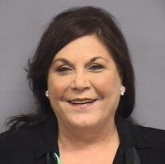
Joan Cranmer, PhD
Director, DOP Faculty Mentoring Program
Chair, DOP Promotion and Tenure Committee
Professor
501.247.1529
cranmerjoanm@uams.edu

Slide 80
Established & Successful FMP
For more than 25 years the DOP has conducted an extraordinarily successful, formal, Faculty Mentoring Program focused on guiding young faculty to achieve timely Promotion/Tenure while promoting well-being and work-life balance.
New faculty will have a personalized 3-member Mentoring Committee formed for them within 6 - 9 months of appointment.
The MC meets biannually and records template-guided minutes to guide progress for P/T and work-life balance.
In 2018 our established FMP was published in PEDIATRICS as “An Adaptable Pediatrics Faculty Mentoring Model”.

Slide 81
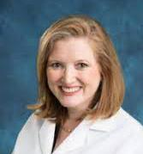
Amy Scurlock, MD
Director, Faculty Development
Professor, Allergy & Immunology
ScurlockAmyM@uams.edu

Slide 82
Faculty Development Opportunities
Faculty Development Lecture Series (1 hr CME Credit per Lecture)
  3rd Tuesday of each month, 12N-1PM, Zoom link in calendar
  Recent/Upcoming Speakers:
    Tuesday, 8/20: Dr. Josh Daily- “Unseen Influences: Why Doctors Make Irrational Decisions”
    Tuesday, 9/17: Dr. Rebecca Cantu- “Resident and Fellow Supervision and Progressive Autonomy”
    Tuesday, 10/15: Drs. Cranmer, Bornemeier, Scurlock- “DOP Faculty Mentoring Program”
    Tuesday, 11/19: Dr. Kat Neill, Interprofessional Education- “Building Effective Teams/Psychological Safety”
    Tuesday, 12/17: Dr. Becca Perin- “Integrating Advocacy into Clinical Practice”
    Tuesday, 1/21/2025: Dr. Joan Cranmer- “Preparing for Promotion and Tenure Review”
Medical Educators Grand Rounds and Workshop- Thursday, 9/19/2024
  Dr. Lisa Herrmann, Cincinnati Children’s Hospital- Grand Rounds at Noon- “Going for Gold: Best Practices in Medical Education Scholarship”
  Workshop: “Innovation and Scholarly Approaches in Medical Education” 9/19: 130-5PM, Betty Lowe Classroom
    More information and RSVP: https://forms.office.com/r/ZDk8PABpYX

Slide 83
Faculty Development
The COM and DOP offers several venues throughout the year for faculty development. Opportunities include everything from an advanced degree to courses on teaching the teacher, wellness, etc.
Office of Faculty Affairs is overseeing the on-campus activities. Other groups within UAMS have offerings as well (more to come in the Faculty Affairs portion of this meeting)
Please utilize these opportunities for your professional advancement.

Slide 84
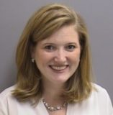
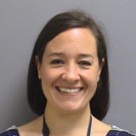
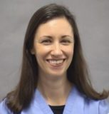
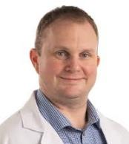
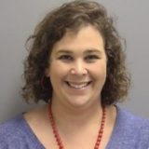
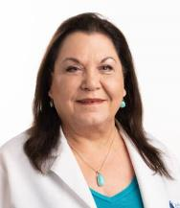
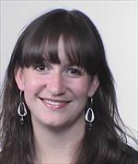
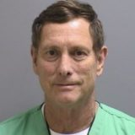
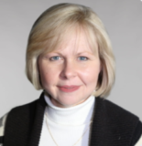
DOP Wellness Council
Chesca Miquel-Verges, MD
Katherine Irby, MD
Brendan Crawford, MD
Rebecca Latch, MD
Amy Scurlock, MD
Liza Murray, MD
Richard “Whit” Hall, MD
Renee Bornemeier, MD
Joan Cranmer, PhD

Slide 85

Jenny Kubacak
Administrative Coordinator
Office of Faculty Affairs
KubacakSJ@uams.edu

Slide 86
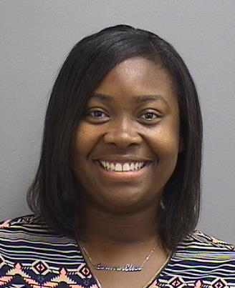
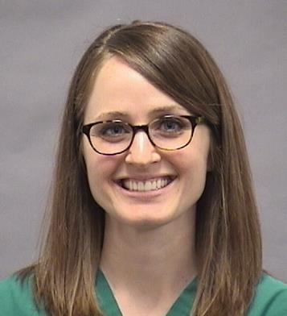
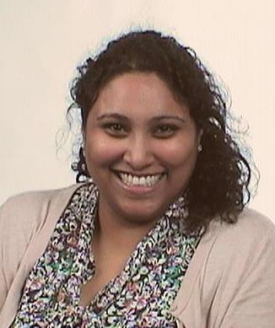
Social & Community Engagement Cmt
Carla Brown, MD: Chair
Departmental
Sub-Committee
Megan Baber, MD: Chair
Hospital Families
Sub-Committee
Renita Pushparajah Mak, MD: Chair
Community Engagement
Sub-Committee

Slide 87


Faculty Affairs/Departmental Events
12 Departmental Awards given annually
Advanced Rank Mentoring Forums held to listen & better serve faculty
DOP Museum of Discovery Fall Family Night event
WIMWAC : Mystery Mansion Escape Room Event
Faculty Affairs preserved eyesight during Total Eclipse with Glasses

Slide 88

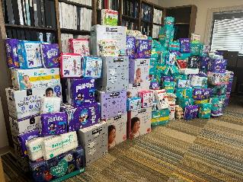

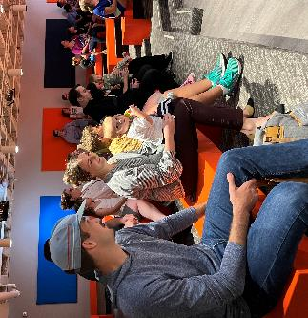
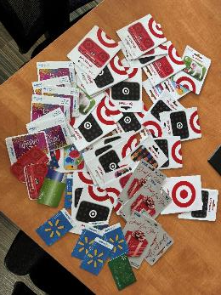
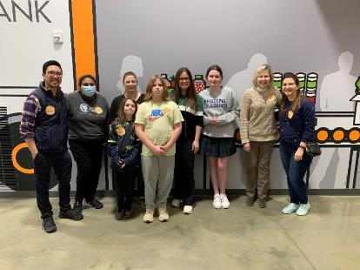

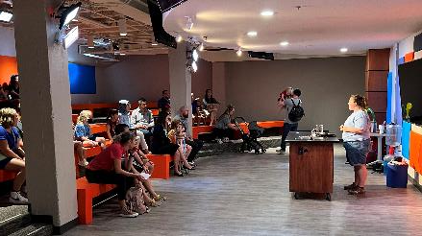
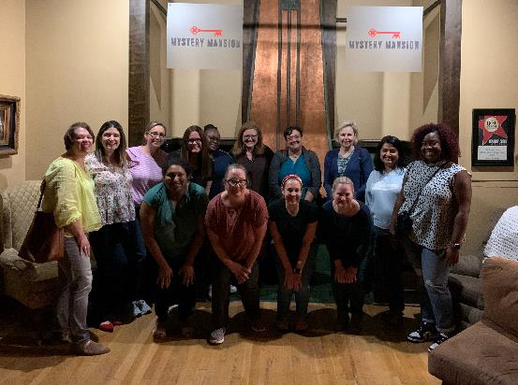

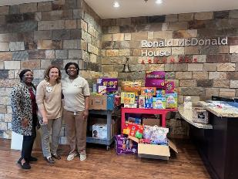

Slide 89
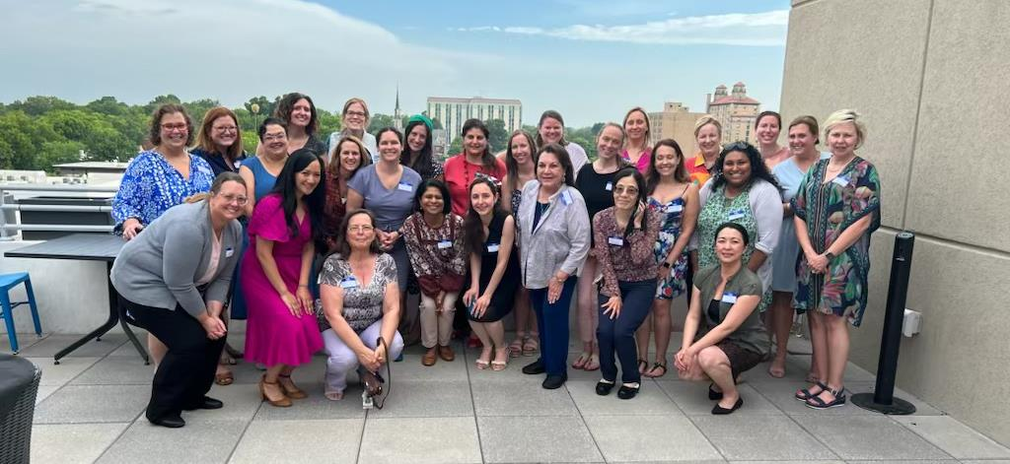
WIMWAC
Women In Medicine Working At Children’s

Slide 90
Professionalism
Standards for Professionalism exist on both campuses. Professionalism Issues raised:
Come through the Safety-tracker system (on AC Campus). On the AC Campuses we participate in the Professionalism Program developed by Vanderbilt known as PARS & CORS.
May be entered in i-Safe which is the reporting system on the UAMS Campus.

Slide 91



Executive Coaching

Slide 92
College of Medicine
Executive Coaching Program
The COM has invested in an Executive Coaching Program which is free of charge to faculty.
All coaches are internal and faculty of the College of Medicine
You may use the link below to access the Executive Coaching Program webpage on the UAMS website
Here you can learn more about the executive coaching program
An electronic form is available on the website if you would like to request coaching services
https://medicine.uams.edu/faculty/executive-coaching/

Slide 93
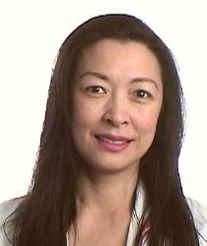
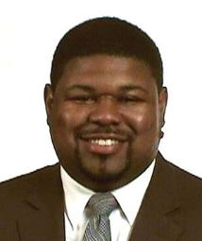
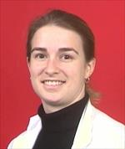
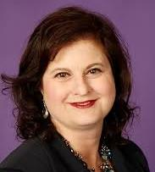

Meet OUR Team
Johnathan
Goree, MD
Renee Bornemeier, MD
(Director)
Molly
Meek, MD
Wendy
Ward, PhD
Destiny
Chau, MD
COM
Executive Coaches

Slide 94
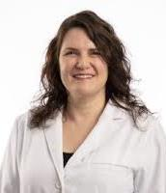
Faculty Wellness
Tracy Haselow, M.D., is an Associate Professor in the UAMS Department of Psychiatry and the Director of the UAMS Student, Resident, and Faculty Wellness Programs.

Slide 95
Wellness Resources
1. Psychiatric Services – Tracy Haselow, M.D.
Website: https://faculty.uams.edu/fw-program/
Telephone: 501-526-7105 – contact Cheryl Giblin
2. Counseling Services – Employee Assistance Program (EAP) Telephone: 501-686-2588; For after hour emergencies, call the 24/7 EAP number 800 542-6021 https://eap.uams.edu
3. Faculty may also access wellness support through Teledoc Health at the following website: https://www.teladoc.co
4. Get Healthy UAMS: https://gethealthy.uams.edu (for general overview of Wellness resources). They can also look at resources listed on the website: https://faculty.uams.edu/wellness/
The Get Healthy UAMS program led by Natalie Cannady which has created a number of initiatives including a lecture series on wellness, options at our gym, and better nutritional offerings. Our fitness center is a fantastic resource located on our campus and it is open to students, faculty and staff.
5. UAMS Culinary Medicine Program: Dr. Gina Drobena, Director. GADrobena@uams.edu
6. UAMS Mindfulness Program: Dr Pele Yu, Director FBYu@uams.edu
7. UAMS Pastoral Care is also available to faculty by calling 501-516-9120
8 . Faculty on AC campuses also have access to AC Pastoral Care at 501-364-1823 or email Brent Fairchild at fairchildbw@archildrens.org
9. Faculty on AC campuses also have access to WeCARE program which is part of the CANDOR program. This is a peer support program which you may access by contacting Amber Jones at 364-5724 or by emailing her at jonesal@archildrens.org

Slide 96
Department of Pediatrics
Administrative Leadership Team

Slide 97
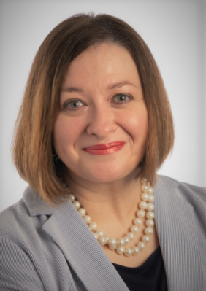
Tiffany Edwards
Assistant Dean for Child Health Administration
501.364.4037
edwardstiffanyf@uams.edu

Slide 98
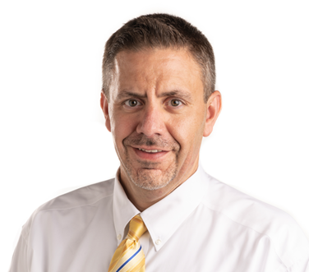

Jeremy Ruff
Associate Administrator
Practice Director, Inpatient
501.364.3082
JBRuff@uams.edu
April Carpenter
Director of Advanced Practice
501.364.3878
CarpenterAprilB@uams.edu

Slide 99



Mike Taggard
Director of Communications
501.364.1845
MTaggard@uams.edu
Afif Kamal
Director of Finance
Headstart Director
501.364.2578
AKamal@uams.edu
Mark Mosby
Senior Director of Research Administration
501.364.2972
MosbyMarkA@uams.edu

Slide 100



Mariah Camp
Assistant Administrator
Practice Director, Outpatient/Consult
479.725.6800
MJCamp@uams.edu
Brian Carpenter
Assistant Administrator
Practice Director, Behavioral Health
501.398.6173
BJCarpenter@uams.edu
Ryan Choate
Assistant Administrator
Practice Director, Primary Care
501.364.3685
ARChoate@uams.edu

Slide 101



Meghan Baser
Physician Recruiting/Onboarding Manager
501.364.3675
BaserMeghanC@uams.edu
Stacy Cornwell
Executive Assistant
501.364.5262
SLCornwell@uams.edu
Heather Winston
Arkansas Children’s Physician/Executive Recruiter
WinstonHS@archildrens.org

