Slide 1
UAMS Office Of Interprofessional Education

Slide 2
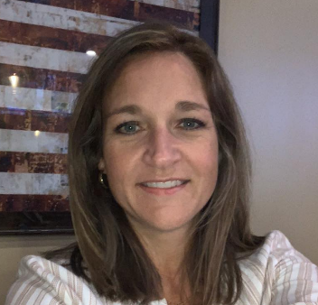
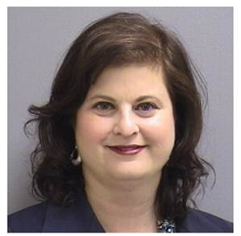
Office of Interprofessional Education
Kat Neill, PharmD, CCMS, FNAP
Associate Provost for Academics
Director of Interprofessional Administrative and Curricular Affairs
Wendy Ward, PhD, ABPP, FNAP, FAPA
Associate Provost for Faculty
Director of Interprofessional Faculty
Development

Slide 3
The Office of Interprofessional Education contributes to the curriculum development, scholarship productivity, research infrastructure, and collaborative practice environment across all five UAMS colleges and the graduate school. The office also coordinates an interprofessional curriculum that is a graduation requirement for all UAMS students.

Slide 4
Interprofessional Collaboration: Core Competency Domains
Roles
Communication
Values/Ethics
Teamwork
DIVERSE CONTEXTS
Education
Research
Clinical Practice

Slide 5
Patient
Care
Roles and Responsibilities
Values and Ethics
Clinical Practice
Population Health
Reduced
Cost
Students
&
Faculty
Communication
Teamwork
Research
Education
Provider Satisfaction
Notes:
Students and faculty can work together in research, education, and practice using the 4 core competencies of IPE (roles and responsibilities, values and ethics, communication, and teamwork) to impact the Quadruple Aim. It all begins with students and faculty working together to impact of healthcare.

Slide 6
All delivered in face-to-face, virtual, & online asynchronous formats

Slide 7
Faculty Development Opportunities
Training Formats
Workshops
-Facilitator Skills
-Simulation Education
-Taking Care of Yourself for Busy Professionals
Noon seminars
Online Modules
Faculty Movie Nights
Topics
Clinical collaboration skills
Research collaboration skills
Teaching skills needed for IP audiences
For more information: IPE Website: https://ipe.uams.edu/ Faculty Development: http://ipe.uams.edu/5-pillars-of-ipe/faculty-development/
Notes:
Education training - shadowing, inclusive environment; clinical training – topic, in room EHR documentation, climate change; professional wellness support – psychological safety, stress & burnout in the clinic
Cancer Survivors Day - 50/50
Health & Humanities Series - Something the Lord Made
Dental Health - Say Ahh!
Women's Issues - On the Basis of Sex
HPV Oral Health - Someone You Love
Alzheimers and Dementia - Still Alice
Food Insecurity - A Place at the Table
Opioid - Chasing the Dragon
Lifestyle Medicine - Code Blue
Team Sciences - Oceans 11 or Oceans 8

Slide 8
Facilitator
Master Facilitator
IPE FACILITATOR CERTIFICATION
Co-Lead Student Exposure Workshop
Co-Lead as Preceptor
Co-Lead a Discussion Group
Co-Lead a Simulation Event
Co-Lead a xxx
Audit a Student Exposure Workshop
Audit a 3-hr Clinic at 12th St Wellness Clinic
Audit a Discussion Group
Audit a Simulation Event
Audit a xxx
301 12th/North St Preceptor
301 Simulation
301 Exposure Workshop
301 Research Project Advisor
xxxxxxxxx
Review Training Material
Curriculum
Learner Handouts
FAQ
Facilitator Guide
Tips
Review Training Material
Curriculum
Learner Handouts
FAQ
Facilitator Guide
Tips
Review Training Material
Curriculum
Learner Handouts
FAQ
Facilitator Guide
Tips
Review Training Material
Curriculum
Learner Handouts
FAQ
Facilitator Guide
Tips
Review Training Material
Curriculum
Learner Handouts
FAQ
Facilitator Guide
Tips
201 Faculty Facilitation Workshop
101 Foundational Awareness Presentation
Notes:
The process is simple: just 3 steps (and you have already completed 2 of these steps!). The first step was the IPE 101 Foundational Awareness Presentation and you just complete the 201 Facilitation Workshop- you are on a roll! The next step is for you to be certified in a specific activity you are interested in. This could be Facilitating the Exposure Workshop for Students or precepting at the 12th or North Street Clinics. You could facilitate a movie or book discussion or lead a simulation. The possibilities are endless as you create more activities.
If you complete 1 of these tracks, you receive the “Facilitator” Certification. If you do 3 (any three that you like), you will receive the “Master Facilitator” Certification.
Grandfathering available

Slide 9
Attend Faculty Development Courses
For schedule: www.IPE.uams.edu OR Blackboard IPE Community

Slide 10
Co-curriculum Support
Core discipline
(didactic & experiential)
HLC defines co-curricular as: Learning activities, programs and experiences that reinforce the institution's mission and values and complement the formal curriculum
Interprofessional
Education
Co-
curriculum
Professional identity

Slide 11
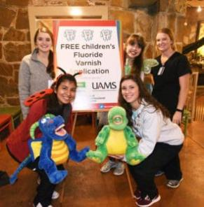
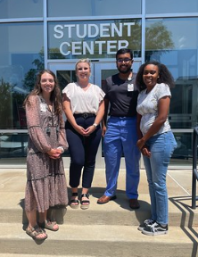
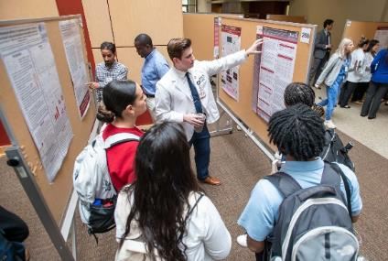
Co-curriculum Examples
Volunteerism
Leadership
Specialty training/education
12th Street Health and Wellness Center, North Street Clinic, community clinics, health fairs
Student Organizations, Special Interest Groups, Professional Organizations (local, state, national, international)
Campus events, seminars, trainings
Boo at the Zoo Health Fair
RSO/SIG
Student Research Day

Slide 12
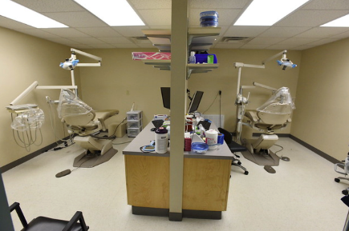
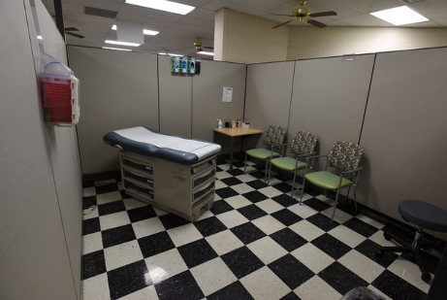
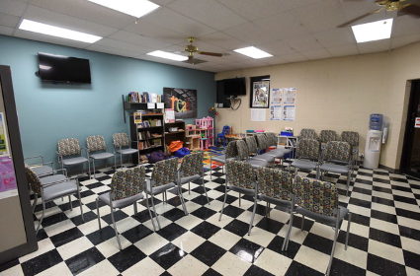
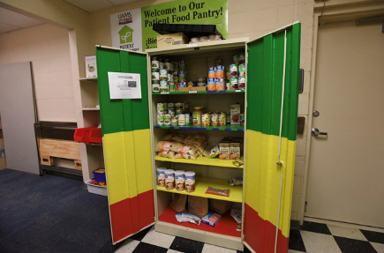
12th Street Health and Wellness Center

Slide 13
www.facebook.com/uamsipe
IPE@uams.edu
https://twitter.com/UAMSIPE
Thank you!
We’d love to hear from you!

Slide 14
UAMS Center for Faculty Excellence

Slide 15
UAMS Center for Faculty Excellence
Wendy L. Ward, PhD, ABPP, FNAP, FAPA
Associate Provost for Faculty
Director of Interprofessional Faculty Development
Office if Interprofessional Education
Emily Freeman, MHSA
Director of the Center for Faculty Excellence

Slide 16
Retirement Mentor Program**
Retirement Seminar Series**
Emeriti Faculty Support**
Onboarding/Orientation**@#
Walton Leadership@
Mentorship Skill Development**@
Promotion
Faculty Excellence Seminar Series**@#
Mentoring Program**@
Appointment
Sponsorship for Leadership Roles@
Academic Leadership Circle**@
Executive Coaching **@
Promotion
Center for Faculty Excellence: Faculty Development
Goals:
Promotion Success
Wellness
Retention
KEY
**Professional Fulfillment/Wellness
@DEI content
#Arts/Humanities
= Women’s Faculty
Development Caucus

Slide 17
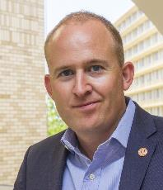
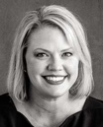
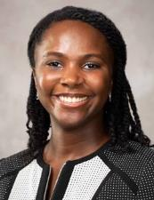
UAMS College of Medicine & Walton College Executive Education Year -long course with monthly workshops
Executive Healthcare Leadership Institute
Dr. Brent Williams
Associate Dean for
Executive Education and Outreach
Blythe Eggleston
Director, Executive Education
Shannon Heard
Associate Director, Executive Education

Slide 18
UAMS College of Medicine & Walton College Executive Education Target Audience: Faculty with an interest in Leadership Development specifically in the Healthcare Industry
Executive Healthcare Leadership Institute
Assessing your Leaderships Skills Now
Difficult Conversations and Feedback
Delegation and Empowerment
Strategic Planning &Thinking
Diversity, Equity & Inclusion in Academic Health Centers
Communication and Innovation
Meet with Local Leaders
Budgeting Basics and Organizational Finance
Business Plan Development
Executive Presence and Meaning Making

Slide 19
Center for Faculty Excellence: Faculty Affairs
Appointment
Data Management: Faculty appointment, Rank changes, Adjunct reappointment, and Departure
Promotion
Support P/T Committees
Packet creation and upload training workshops
Faculty Annual Evaluation
Exit Interviews and surveys
Departure or Emeriti transition
Professionalism
Indiv Interventions—IDPs, PIPs, Res Compliance
Policy
Creation/Revision/Dissemination/Interpretation
Departure
Audit of evaluation, training, and template
Faculty Mediation Service
Admin Council, AA Policyl, FacDev Council
Recognition
Institutional and College Awards
Collaboration
Asssoc Provosts, Deans, ICFC, Senate, RP, NW
Schwartz Rounds, IPE, PLE, Foundation, REOP, etc.
Faculty files online
Goals:
Retention
Promotion Success
Wellness
Context: Service

Slide 20
https://faculty.uams.edu

Slide 21
ClinicaI Informatics

Slide 22
Section of Clinical Informatics (SoCI) Department of Pediatrics UAMS School of Medicine
DOP Faculty Onboarding
August 28-29, 2024
Feliciano (Pele) Yu, Jr., MD, MSHI, MSPH, FAAP, FAMIA
Professor of Pediatrics, Biomedical Informatics and Public Health
Chief Medical Information Officer, Arkansas Children’s

Slide 23
What is our Purpose?
Clinical Informatics is the application of informatics and information technology to deliver healthcare services.
Applied to direct patient care
Informatics = Computer Science, Data, Analytics, AI
IT = EHR, Devices, HIT Advocacy, Standards
Deliver = bring value, engagement, connections
Healthcare = goal is to improve health
Services = process, activities, workflows
Health IT
Quality/Safety
Science

Slide 24
Informatics Services: What do we do?
EHR Optimization of Content and Clinical Decision Support
EHR Usability and Configuration Optimization
Software Development
Data Analytics and Knowledge Management
Research Informatics
Mentorship and Education

Slide 25
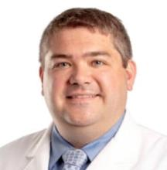
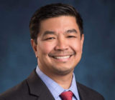
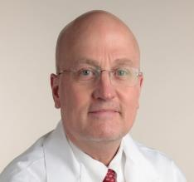
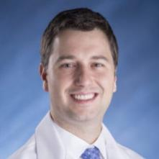
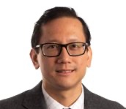
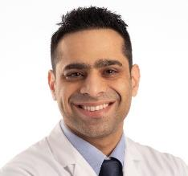
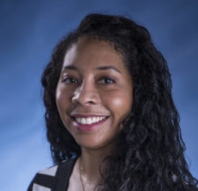
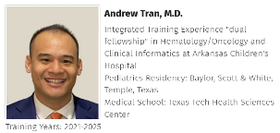
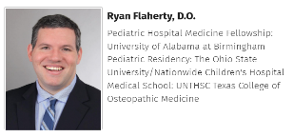
Clinical Informatics Service
BE
Pele Yu, MD, MS
VP/CMIO (AC)
Chief, SoCI (UAMS)
Jimmy Magee, MD
Associate MIO (ACH)
Professor (UAMS)
Whit Robben, MD
Assoc. Prof (UAMS)
Assist. MIO (AC)
Jared Beavers, MD
Assoc. Prof (UAMS)
Assist. MIO (AC)
BE
FELLOWS
Daniel Liu, MD
Assist. Professor
Research Informatics
Shafi Obeid, MD
Assist. Prof (UAMS)
Assist. MIO (AC)
Kandi Stallings-Archer, MD
Assoc. Prof (UAMS)
Assist. MIO (AC)

Slide 26
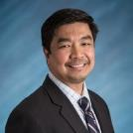
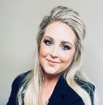
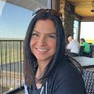
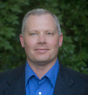
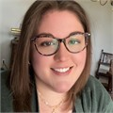
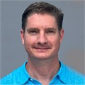
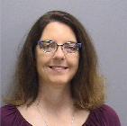
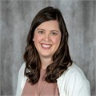
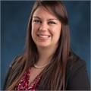
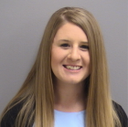
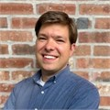
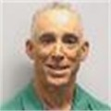
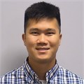
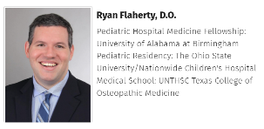
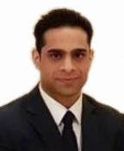
Research Informatics Core (RIC) Team Members
FELLOWS
Pele Yu, MD MS
Chief Medical Information Officer (AC)
Erin Hathorn, MS
Research Informatics Program Manager
(AC-Research Information Systems)
Zack bolt
ETL Developer
(AC-Population Health
and Analytics)
Tina Birdsong
System Analyst III
(AC-Research Information Systems)
Robbie Robinette
Senior Software Developer (AC-Research Information Systems)
Emily Erion
Compliance Manager
(AC)
Stuart Stough
Software Developer III (AC-Research Information Systems)
Julie (Nick)Fulmer
REDCap Informatics Program Manager
(AC-Research Information Systems)
Rachel Stevens
Principal Trainer
(AC-Research Information Systems)
Kimberly Voight
IS Administrator III
(AC-Research Information Systems)
Nicole Schrader
Cosmos Systems Analyst, Business Applications (AC)
Joe Matthews
System Analyst III
(AC-Research Information
Systems)
Desi Tuey
Software Developer III
(AC-Research Information Systems)
Aaron David
Information Security Engineer III
(AC- IT Security and Support)
Shafi Obeid, MD
Assist. Professor (Nov 23)
Daniel Liu, MD
Assist. Professor
Research Informatics

Slide 27
WHERE TO REQUEST RESEARCH INFORMATIC TOOLS AND RESOURCES
REDCAP Research Request
https://redcapwap.archildrens.org/redcap/surveys/?s=X3RWMLMACW
ACRI Resource List Dashboard
https://acriweb.archildrens.org/ResourceList/default
ASK RIC Sessions
Monday 12:00-1:00 (by appointment only)
Erin Hathorn, hathorne@archildrens.org
RIC Sessions Registration/Appointment Form
Users can attend the session to get answers/training on RIC tools or discuss research data requests.
https://compoint.peds.ad.uams.edu/ACRI/RIC
Erin Hathorn, MS
Research Informatics Program Manager (AC-Research Information Systems)
HathornE@archildrens.org

Slide 28
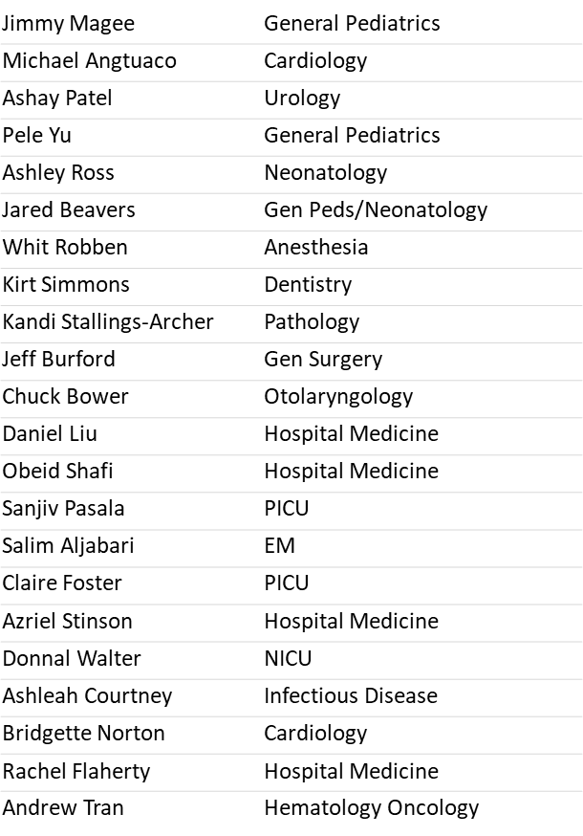
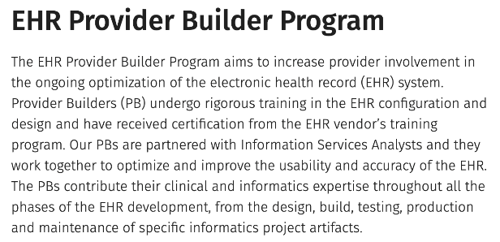
Physician Engagement in Informatics

Slide 29
Physician Engagement in Informatics

Slide 30
Learn more about us!
https://medicine.uams.edu/pediatrics/specialties/divisions/clinical-informatics/
Pele.Yu@archildrens.org
More questions?
FBYu@uams.edu

Slide 31
Medical Library Services

Slide 32
UAMS Library: Resources and Services
Lindsay Blake, MLIS, AHIP
Clinical Services coordinator

Slide 33
Objectives
At the conclusion of this activity, the participant will be able to:
Utilize library search, consultation, and article delivery services.
Navigate to and utilize basic clinical databases found on the library website.
Identify the range of resources available from the library website.
Identify reference management software for research and publication needs.

Slide 34
Education & Research Services
Notes:
MEDLINE through PubMed and OVID
Cochrane Databases (Ovid)
TRIP (Turning Research into Practice)
Clinical Key
Access Medicine

Slide 35
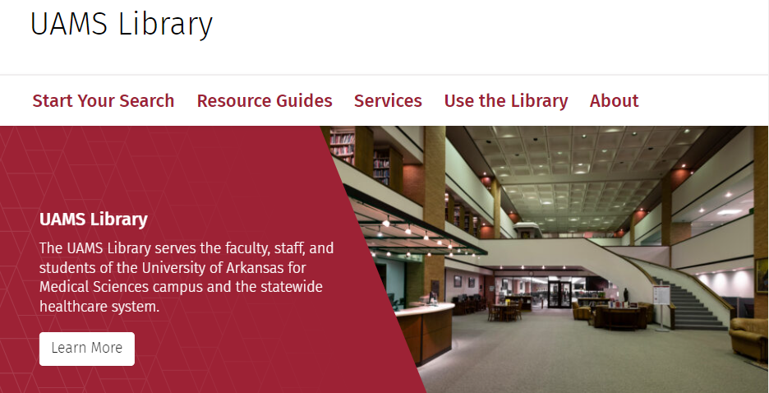
Notes:
MEDLINE through PubMed and OVID
Cochrane Databases (Ovid)
TRIP (Turning Research into Practice)
Clinical Key
Access Medicine

Slide 36
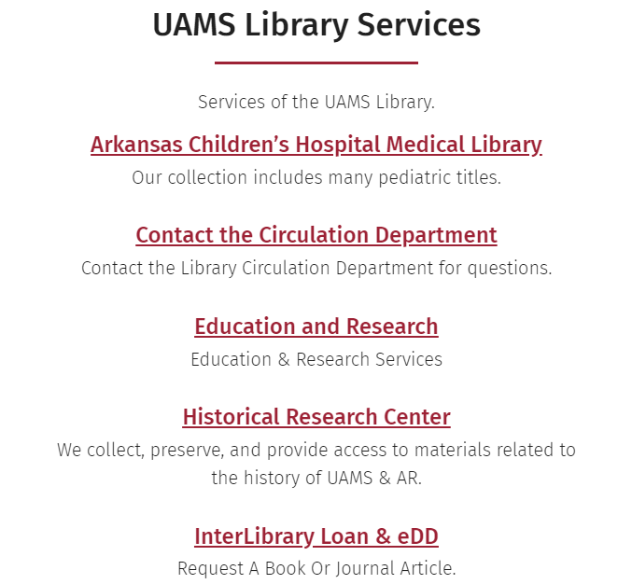
Notes:
MEDLINE through PubMed and OVID
Cochrane Databases (Ovid)
TRIP (Turning Research into Practice)
Clinical Key
Access Medicine

Slide 37
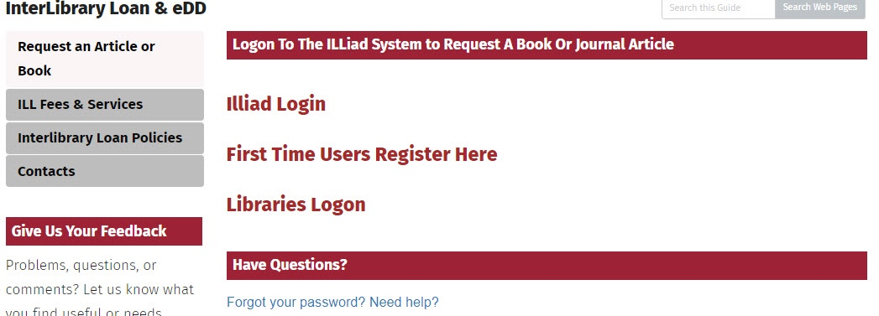
Interlibrary Loan

Slide 38
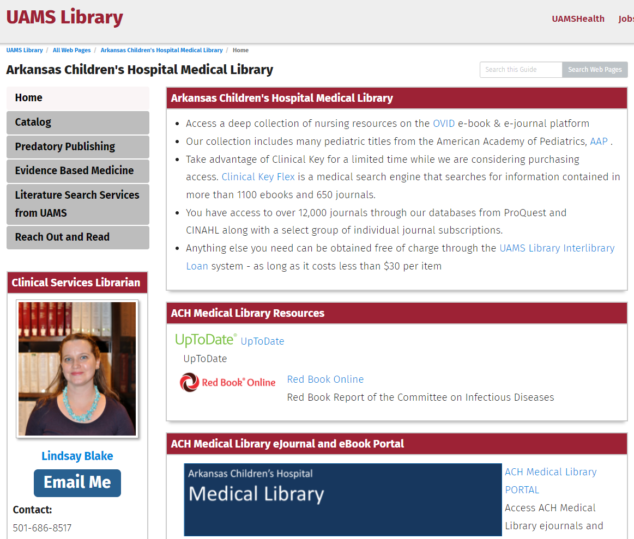
ACH Library Services

Slide 40
Literature Searching Services

Slide 41
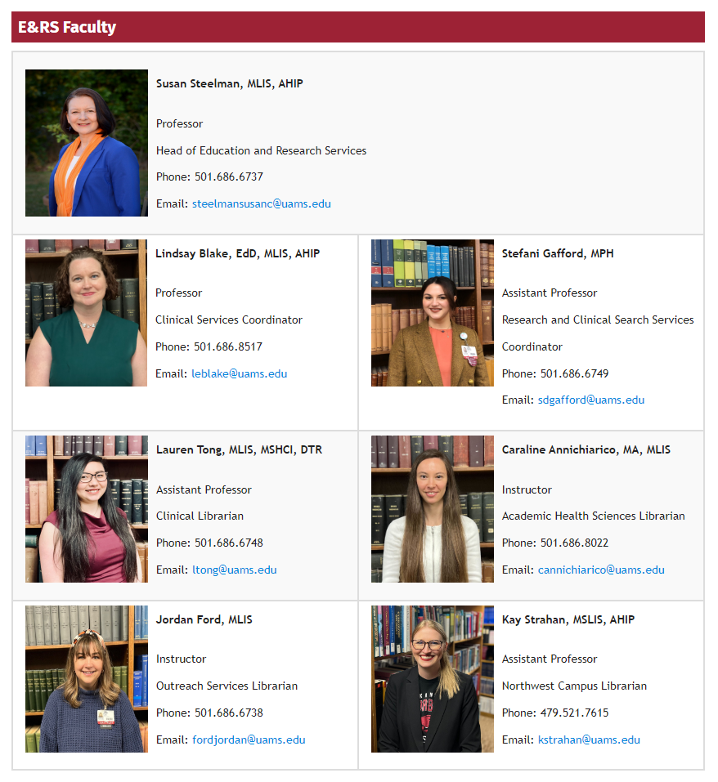
Education & Research Services Librarians
Notes:
MEDLINE through PubMed and OVID
Cochrane Databases (Ovid)
TRIP (Turning Research into Practice)
Clinical Key
Access Medicine

Slide 42
Research and Scholarly Activity Guide
Use of LibGuides software
3 Sections:
Presentation
Publication
Research
Break down each topic into easy to follow steps and with all the information needed to finish.
https://libguides.uams.edu/scholarlyactivityguide

Slide 43
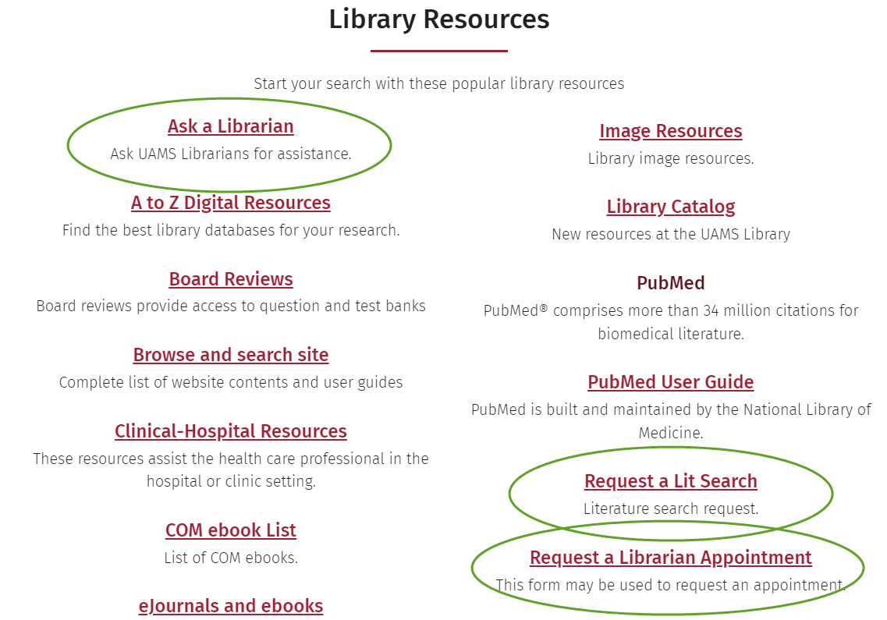

Slide 44
Literature Databases & Searching
Notes:
Library Point of Care Resources
UpToDate
First Consult
Micromedex and Lexi Comp
Essential Evidence Plus

Slide 45
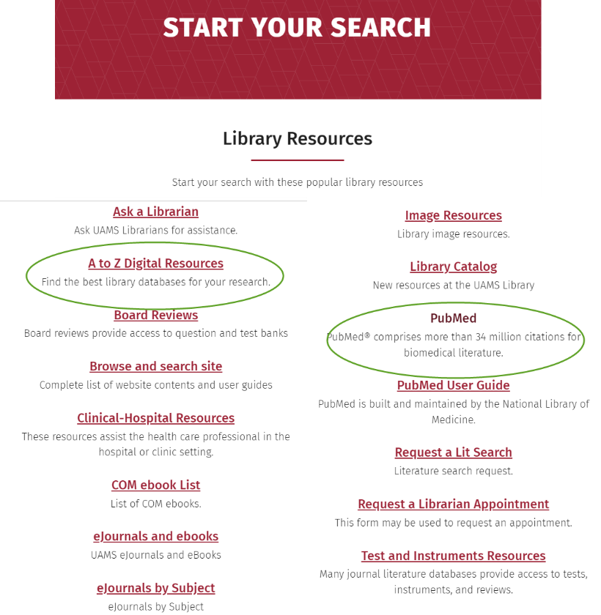

Slide 46
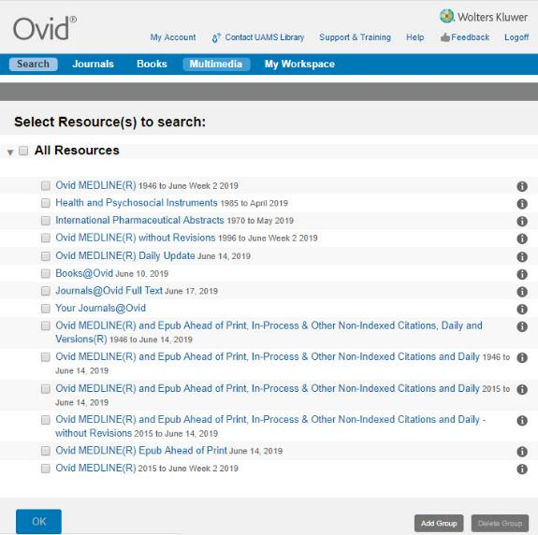
MEDLINE (PubMed and Ovid)
Notes:
MEDLINE through PubMed and OVID
Cochrane Databases (Ovid)
Clinical Key
Access Medicine

Slide 47
BASIC Searching Guidance
Write out your clinical question and break into PICO parts
Use keywords or phrases (in quotations)
i.e. “breast cancer”
Search each keyword or phrase individually
Combine your terms with AND, OR, NOT
Add any filters – language, gender, article type, etc
Review citations

Slide 48
Combine terms with AND to narrow your search
Combine terms with OR to broaden your search
Cesarean Section
C section
Caesarean
Cesarean Section
Neuraxial morphine
PONV
OR
OR
AND
AND
OR
AND

Slide 49
Neuraxial OR epidural OR spinal
PONV OR “postoperative nausea and vomiting” OR nausea OR vomiting
Cesarean Section OR c-section OR caesarean
Dexamethasone OR Decadron
These Boolean operators combined with keywords and phrases allow you to build more complicated searches
AND
AND
AND
AND

Slide 50
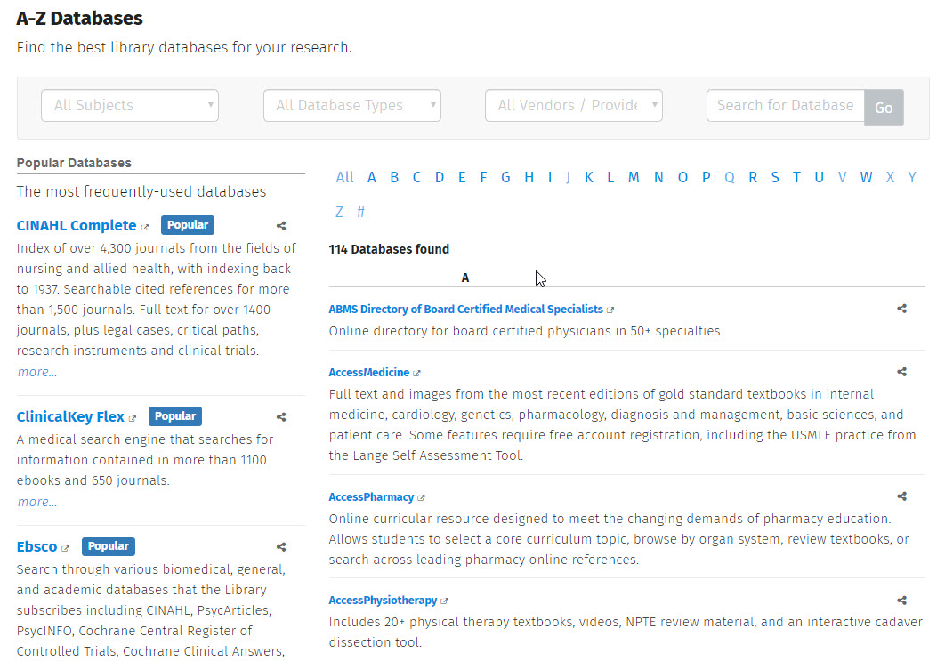
Additional Databases
Notes:
MEDLINE through PubMed and OVID
Cochrane Databases (Ovid)
Clinical Key
Access Medicine

Slide 51
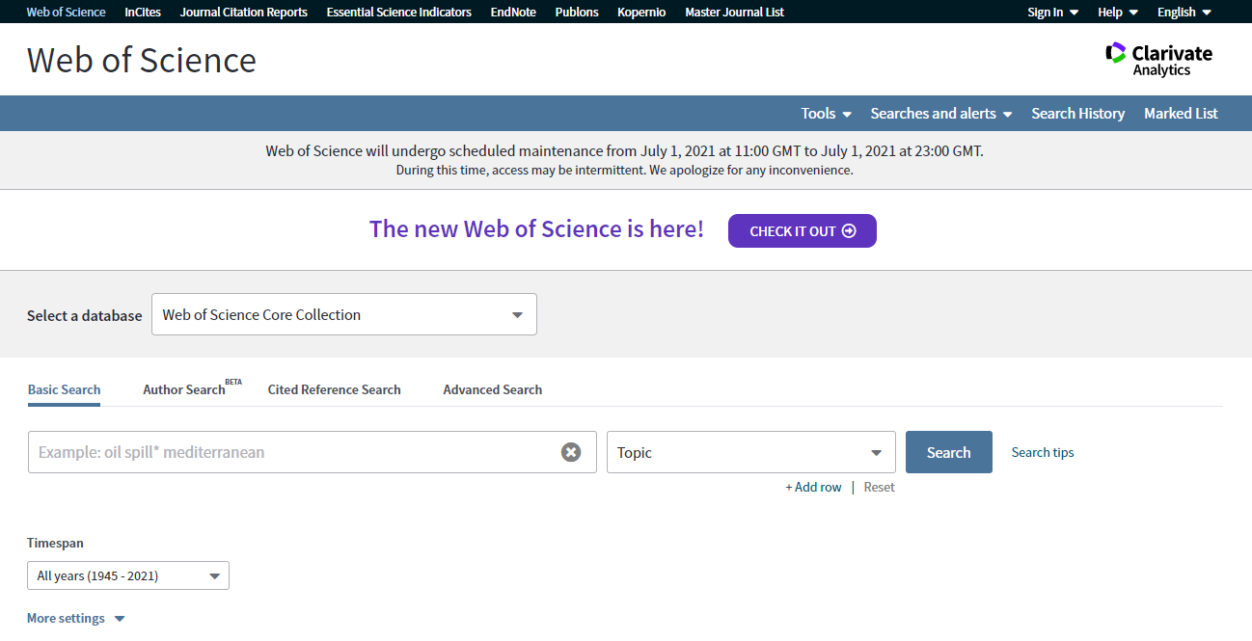

Slide 52
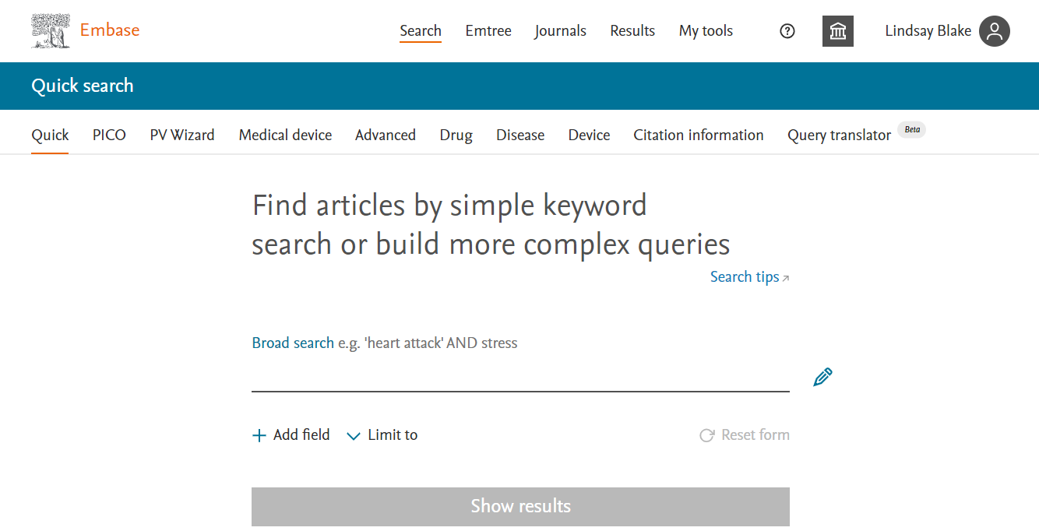

Slide 53
Point of Care Resources & E-Books
Notes:
Library Point of Care Resources
UpToDate
First Consult
Micromedex and Lexi Comp
Essential Evidence Plus

Slide 54
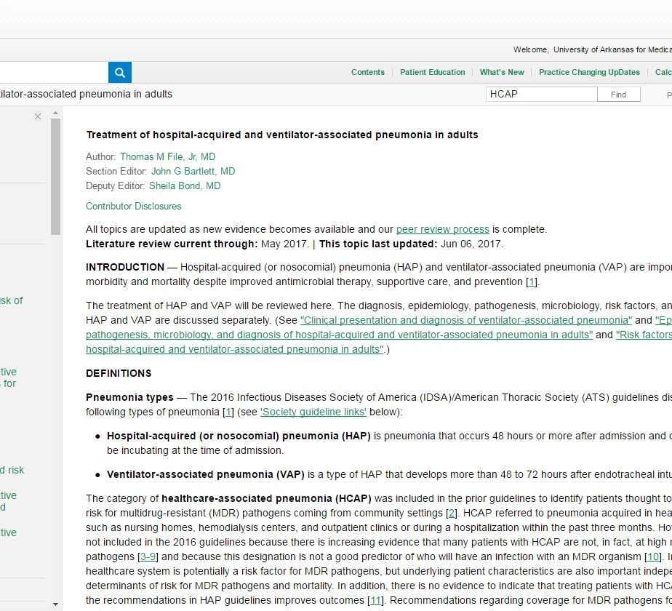
UpToDate
Notes:
Library Point of Care Resources
UpToDate
First Consult
Micromedex and Lexi Comp
Essential Evidence Plus

Slide 55
Drug Resources: Micromedex
Notes:
Library Point of Care Resources
UpToDate
First Consult
Micromedex and Lexi Comp
Essential Evidence Plus

Slide 56
Drug Resources: Lexi-Comp
Notes:
Library Point of Care Resources
UpToDate
First Consult
Micromedex and Lexi Comp
Essential Evidence Plus

Slide 57
Additional Databases
Notes:
MEDLINE through PubMed and OVID
Cochrane Databases (Ovid)
Clinical Key
Access Medicine

Slide 58
ClinicalKey & AccessMedicine
Notes:
MEDLINE through PubMed and OVID
Cochrane Databases (Ovid)
Clinical Key
Access Medicine

Slide 59
RefWorks – Reference Management Software
Notes:
MEDLINE through PubMed and OVID
Cochrane Databases (Ovid)
TRIP (Turning Research into Practice)
Clinical Key
Access Medicine

Slide 60
Notes:
MEDLINE through PubMed and OVID
Cochrane Databases (Ovid)
TRIP (Turning Research into Practice)
Clinical Key
Access Medicine

Slide 62
Refworks

Slide 63
Notes:
Across the top
ADD – Upload document, Import References, Create a new reference
FOLDER – Assign to a folder or create a folder and assign
SHARE – Share folder, export references, copy shared references
CITATION – Create bibliography, quick cite, citations style editor
TRASH – Remove from folder or delete
TAGS – search for existing tags or create new ones (can also do this on individual citations)
SETTINGS – Find duplicates, tools (web button, Word/google program link), bulk edit
SEARCH – Search references
Across the left side
ALL REFERENCES – references for this project
SEARCH DATABASES – basic search in PubMed, can search for other databases
LAST IMPORTED –
SHARING –
MY FOLDERS – create folders here to use for different papers
TAGS –
DELETED -

Slide 65
Quality Improvement and MOC

Slide 66
People Who Can Help
Bridget Norton, MD, MBA
Rebecca Cantu, MD, MPH
Doreen Tooch
Chief Quality & Safety Officer
MOC Portfolio Manager
MOC Portfolio Administrator

Slide 67
Quality Improvement
Quick Tips

Slide 68
Quality Assurance and Performance Improvement (QAPI)
Should be focused on improving health outcomes and preventing/reducing medical errors and safety events.
Should be data-driven and demonstrate a need for improvement. Maintaining previous success is important but should not be used for QAPI goals
Should not be viewed as “extra” work. The QAPI goals should align with work that is already being done to achieve the goals of both your section and the ACH system. The associated projects may also be used for MOC credit, individual SMART goals, and submission for the quality component of the compensation plan..
Should usually have between 2-4 goals, depending on size and/or scope of services.
Should be continuously maintained. Interventions should be added/changed as needed, and data should be updated regularly. This is not a once per year activity.
Are monitored and reported in the Achieve It platform

Slide 69
Clinical Pathways
An evidence-based, multidisciplinary, task-oriented & time-sequenced plan to guide medical decision-making in the care of patients with a specific clinical problem.
Pathways translate guidelines and the latest literature into local practice, but can also reflect commonly accepted care standards when evidence is lacking.
Pathways have been demonstrated to improve clinical outcomes, and reduce unnecessary variation
Integrated directly into Epic through a 3rd party software called Curbside
Resources for pathway development can be found on the intranet on the pathways department page including: charter, guide for creating metrics, as well as team leader and member expectations
Contact person: Emily Rader, Director of Clinical Effectiveness & Outcomes raderek@archildrens.org

Slide 70
Improvement U
Project-based course to learn fundaments of QI and data
Assigned project mentor to help you along the way
Currently a hybrid model
Online modules in ACU (Continuing Education [ACCME, ACPE, & ANCC] credit available)
Four 2-hour classroom sessions for hands-on application of concepts
New classes kick off every other month
Great for QAPIs, strategic goals, and leader development
American Board of Pediatrics Maintenance of Certification Part 4 credit

Slide 71
Maintenance of Certification

Slide 72
MOC Part 4
Collaborative/multi-location QI projects
QI projects initiated in the workplace
Web-based improvement activities
QI published articles, posters, and podium presentations
Institutional QI leadership
Personal improvement project
Residency & Fellowship ACGME programs

Slide 73
ACH Recognized as Portfolio Sponsor for ABP MOC Program
As a Portfolio Sponsor:
MOC credit can be awarded for:
–ACH evaluates its own QI projects using ABP standards for Maintenance of Certification (MOC Part 4)
–Projects meeting this standard become part of the ACH/UAMS MOC portfolio
–Physicians participating in portfolio projects will receive MOC Part 4 credit
–There is ZERO cost to the physician to submit a project to the ACH portfolio
-Project leader of a portfolio project
–Meeting meaningful participation in a portfolio project

Slide 74
QI Work is Publishable!

Slide 75
MOC Part 2
New Pathways:
Resuscitation certificates - upload for points
Diversity/Equity/Inclusion - self-claim for points
Visit your Diplomate page at ABP.org

Slide 76
ABP MOC Requirements
100 points per 5-year cycle
50 points Part 2
50 points Part 4
If you exceed your Part 4 requirement, you can rollover up to 25 points to your next MOC cycle!
Be sure to submit all physician-led QI work to the ACH/UAMS Portfolio for credit!

Slide 77
Checking boxes...
Lead QI Project --> Submit for ABP MOC Part 4 points
Give Grand Rounds on project --> Submit for ABP MOC Part 2 points
Add podium presentation to CV --> counts toward peer-reviewed presentation
Submit work to a national journal --> peer-reviewed publication
Add this all
to your
Promotion & Tenure packet!

Slide 78
ACH/UAMS MOC Portfolio Program

