Slide 1
Pediatric Onboarding Day 2
August 29, 2024

Slide 2
Arkansas Children’s Leadership

Slide 3


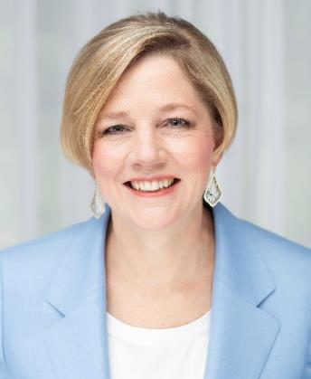
Marcy Doderer, FACHE
President and CEO of Arkansas Children’s
501.364.8000
dodererml@archildrens.org

Slide 4
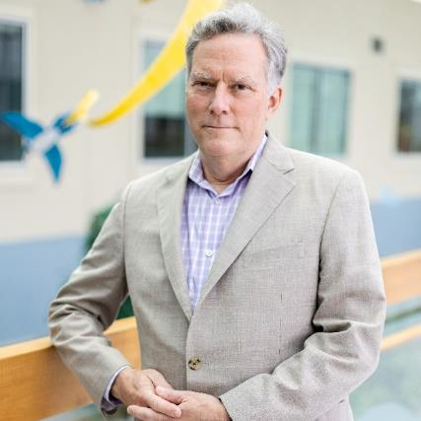
Rick Barr, MD, MBA
Executive Vice President
Chief Clinical and Academic Officer
Professor
501.364.3124
barrfe@archildrens.org

Slide 5
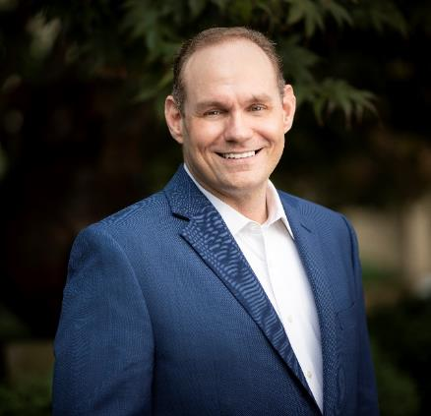
Jamie Wiggins, Ph.D (c), MBA, RN
Executive Vice President
Chief Operating Officer
501.364.8000
Cell: 415.314.1673
wigginsjl@archildrens.org

Slide 6
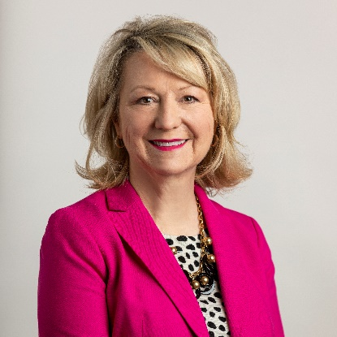
Gena Wingfield
Executive Vice President
Chief Financial Officer
WingfieldGG@archildrens.org

Slide 7

Fred Scarborough, CFRE
Executive Vice President
Chief Communications Officer and Development Officer
scarboroughf@archildrens.org

Slide 8
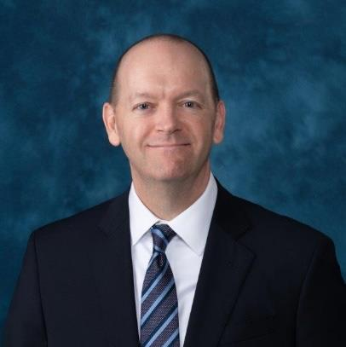
Brent Thompson,JD
Executive Vice President
Chief Legal Officer
ThompsonBL@archildrens.org

Slide 9
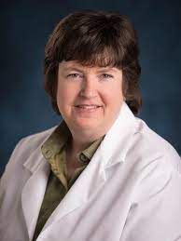
Karen Farst, MD
Senior Vice President
Chief Medical Officer
FarstKJ@archildrens.org

Slide 10
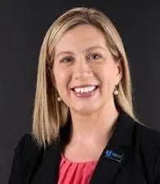
Heather Cherry, DNP, RN, NE-BC
Senior Vice President
Chief Nursing Officer, Arkansas Children’s
CherryH@archildrens.org

Slide 11
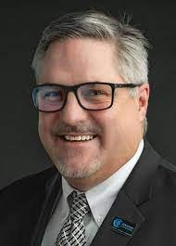
Jason Williams, Psy.D
Senior Vice President
Chief Mental & Behavioral Health Officer
WilliamsJ6@archildrens.org

Slide 12
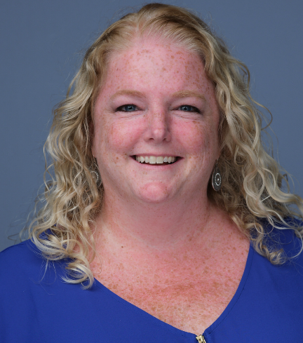
Bridget Norton, MD, MBA, CPHQ, CPPS
Senior Vice President
Chief Quality and Safety Officer, Arkansas Children’s
nortonbm@archildrens.org

Slide 13
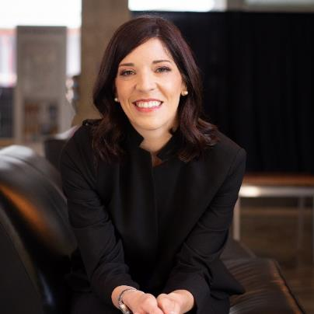
Ashlie Hilbun, EdD, FACHE, CFRE
Senior Vice President
Chief Strategy Officer
hilbunaj@archildrens.org

Slide 14
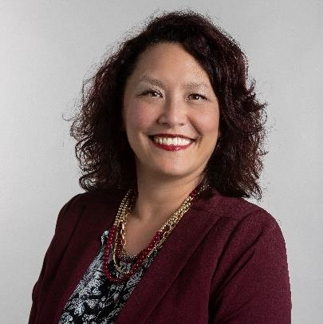
Crystal Kohanke, MS, PHR, SHRM-CP, ACC
Senior Vice President
Chief People Officer
KohankeCH@archildrens.org

Slide 15
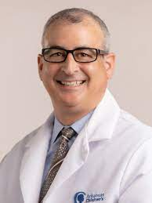
Pete Mourani, MD
Senior Vice President
President, ACRI
mouranip@archildrens.org

Slide 16
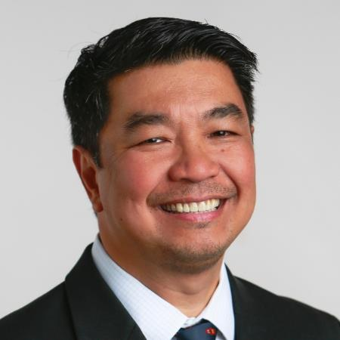
Pele Yu, MD
Chief Medical Information Officer
yuFB@archildrens.org

Slide 17
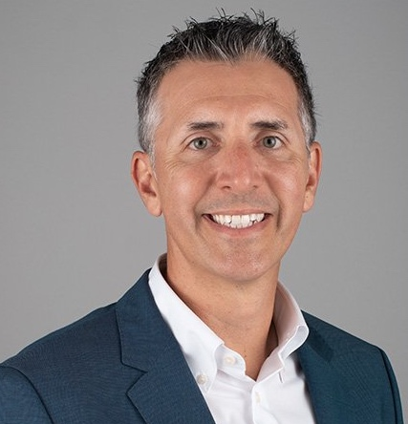
Ryan Solomon, JD, MPS
Senior Vice President
Hospital Operations
SolomonJR@archildrens.org

Slide 18
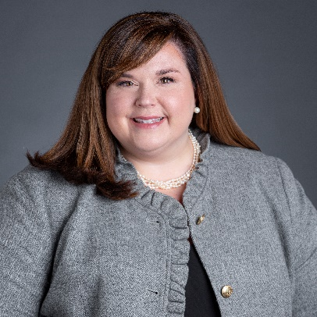
Erin Parker
Senior Vice President
Chief Information Officer
ParkerEE@archildrens.org

Slide 19
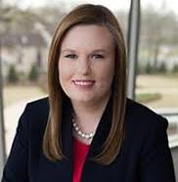
Enid Olvey, CFRE
Senior Vice President
President, Arkansas Children’s Foundation
OlveyEC@archildrens.org

Slide 20

Todd Maxson, MD
Surgeon–In-Chief
Professor, Surgery
RTMaxson@uams.edu

Slide 21
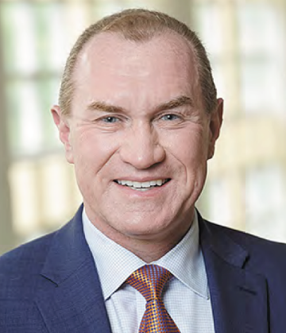
William J. “Bill” Steinbach, MD
Pediatrician-in-Chief, Arkansas Children’s
Professor & Chair, Department of Pediatrics
WSteinbach@uams.edu

Slide 22
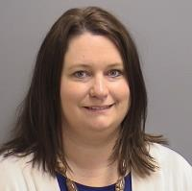
Cindy Martin
Vice President, AC Practice Plan
501.364.4037
martincl@archildrens.org

Slide 23
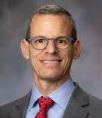
Rustin Morse, MD
Senior Vice President
Chief Administrator ACNW
MorseR@archildrens.org

Slide 24
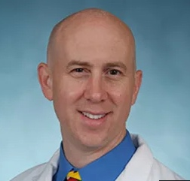
Rob Williams, MD
Chief Medical Officer
ACNW

Slide 25
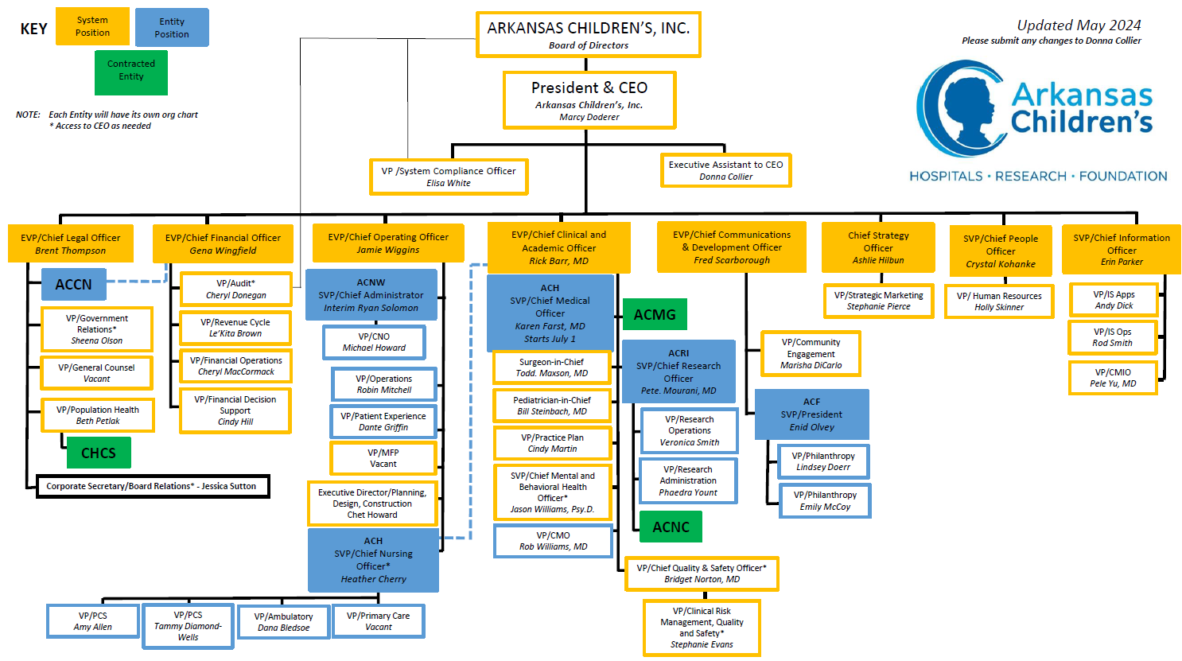

Slide 26
Medical Staff Services
(LIPs = physicians and APPs
Credentialing (Compliance and Quality/Safety)
  Initial
  Ongoing
Medical Executive Committee (meets monthly)
  Elected reps from surgical and medical service lines
  Officers (Secretary-Vice Chief-Chief of Staff)
  Med Staff Committees
    Credentialing
    Professionalism
    Health
    CPE
Provider Leadership Training
Oversees Maintenance of Certification projects for AAP/ABP
Lots, lots more……
FPPE
  Focused Professional Practice Evaluation
  Follows initial credentialing (once)
OPPE
  Ongoing Professional Practice Evaluation
  Every cycle of re-credentialing (currently 2 years)

Slide 27
Communication about issues pertaining to Medical Staff
Email
  Direct
  Newsletter
Service/section meetings
Faculty meetings
Chief meetings
Medical Staff meetings

Slide 28
Research

Slide 29
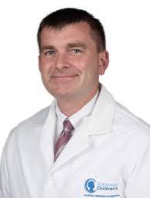
Brian Varisco, MD
Vice Chair, Research
Professor, Critical Care
BVarisco@uams.edu

Slide 30
ACRI Resources for Researchers archildrens.org/research

Slide 31
ACRI Faculty Leadership Structure
ACRI President
Peter Mourani
Director of Laboratory Research
Brian Varisco
Director of Clinical Translational Research
TBD
Director of Population Health Research
Paul Darden
Director of Research Informatics
Fred Prior
Director of Research Faculty Development
TBD
Director of ACNC
Mario Ferruzzi
ACRI VP Operations
Veronica Smith
ACRI VP Finance
Phaedra Yount
Associate Director of Laboratory Research
Craig Porter
Associate Director of Clinical Translational Research
Michael Bishop
Existing positions
New positions

Slide 32
Research Facilities
Research Institute Building
The Arkansas Children’s Research Institute Building is the headquarters for all research on the campuses of Arkansas Children’s
Notes:
The four-story Research Institute Building on the Arkansas Children’s Hospital campus is the central location of ACRI administrative offices and houses researcher offices, conference space, state-of-the-art laboratories, and ACRI’s animal facility.
ACRI’s animal facility is accredited by the Association for Assessment and Accreditation of Laboratory Animal Care. AAALAC accreditation is important because it demonstrates quality, promotes scientific validity, demonstrates accountability, and stimulates continuous improvement.

Slide 33
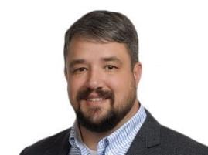
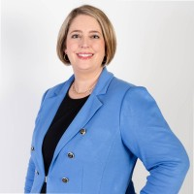
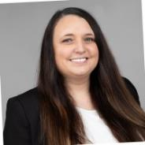
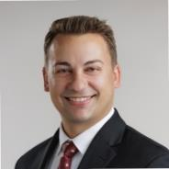
Facilities: ACRI
196,000 sq. ft.
  Vivarium
  Dry Lab
  Wet Lab
  ACNC
~250 staff
FY23-$37.9M Federal
FY24-about $45M
Clinical Research Team
  Megan Gorski, Dalton Janssen
PCRU
  Jason Ketcher
NCOR Building
  Fall 2025
  50,000 sq. feet.
  $50M grant from state
  Jami Jones

Slide 34
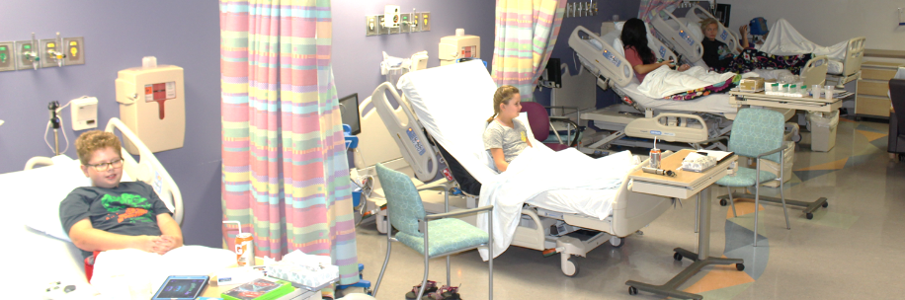
Research Facilities
Pediatric Clinical Research Unit
3600 ft² unit
4 semi-private beds
2 private rooms
Kitchen
Specimen processing lab (additional space in Sturgis with BSC hood)
Conference room
Adjacent Research Pharmacy
Notes:
Clinical trial research is a vital part of health care today.
Many researchers conduct their clinical trials at ACRI’s Pediatric Clinical Research Unit. The PCRU is located on the second floor of the Main Hospital Building at ACH. This unit is centrally located and provides space for clinical trials and ensures that research participants are a part from acutely ill hospitalized patients.
ACRI offers a staff of qualified nurse research coordinators to assist investigators in the PCRU as well as on-site Research.

Slide 35
ACRI Support Areas
Research Support
Animal Operations
Administrative Support
Biostatistics Support
Arkansas
Reproductive Health Monitoring System
Clinical Research Operations
Research Cores
Mentorship and Intramural Funding
Space and Facilities
Pre-Award Services
Post-Award Services
Compliance and Legal Support

Slide 36


Research Informatics Core (RIC)
Unified Healthcare Data request process for Research
Access to Research Informatics tools such as RAiA Desktop, Accruals to Clinical Trials (ACT) Network, TriNetX, N3C, Epic Cosmos, among others
Research Informatics Consultation and Training services (Ask RIC Sessions)
Electronic Health Record (EHR) associated research and clinical trials
Research Informatics grant development and support
More info:
Pele Yu, MD, MS, Director
  501-364-8104 pele.yu@archildrens.org
Erin Hathorn, MS, RIC Program Manager
  501-364-2651 hathorne@archildrens.org
Notes:
Julie Nick- REDCap administrator
Robbie Robinette- Research Information Systems (CTMS/Project Tracking)
Judy Allen – Research EPIC analyst

Slide 37
Biostatistics Core
Provides comprehensive assistance with study design, data analysis, and statistical results interpretation
The core is staffed by two doctoral level statisticians and one master’s level statistician/epidemiologist
DOP is developing a workflow for faculty and fellows to access support.
More info: Beverly J. Spray, PhD,
SprayBJ@archildrens.org
phone (501-364-3184).
Notes:
Julie Nick- REDCap administrator
Robbie Robinette- Research Information Systems (CTMS/Project Tracking)
Judy Allen – Research EPIC analyst

Slide 38
ACRI Intramural Award Programs
ACRI offers intramural competitive grant programs for its research community
Programs assist and encourage researchers of all levels of experience
Each program has specific research goals, eligibility requirements, and funding support
Program descriptions and RFA links to all programs are found at https://www.archildrens.org/research/resources-for-researchers/intramural-grant-overview
  For more info, contact Anne McMains, 501-364-5143 mcmainsam@archildrens.org
Notes:
ACRI offers intramural competitive grant programs for its research community. The grant programs assist and encourage researchers of all levels of experience from beginning researchers to experienced researchers. Each program has specific research goals, eligibility requirements, and funding support.

Slide 39
Biostatistical Core Request Process
Non-funded requests are submitted through a RedCap Database
Requests reviewed by committee or VC Research
Elements such as data type, size, tests anticipated, time requested now required

Slide 40
Marion B. Lyon New Scientist Award
Promotes the career development of young investigators who are initiating independent research careers, but have not yet received NIH funding
Each year, three awards in the amount of $75,000 (up to two years) are available on a competitive basis
Provided through a generous gift from the late Frank Lyon, Jr.
Notes:
A generous gift from a private donor endows the Marion B. Lyon New Scientist Development Program.
The award promotes the career development of young investigators who are initiating independent research careers, but have not yet received NIH funding.
Each year, two awards in the amount of $75,000 (up to two years) are available on a competitive basis.

Slide 41
ACRI/ABI Grant Programs
Team Science Research Grants: encourages exploratory and developmental research fostering new collaborations and scientific directions
ACRI/ABI Postgraduate Research Grants:
support investigator-initiated research by trainees conducting child health research
ACRI/ABI Nursing and Allied Health Research Grants: support investigator-initiated research directed by nurses and
allied health professionals.
Notes:
Arkansas Children’s is one of five member organizations of the Arkansas Biosciences Institute (ABI), created as the major research component of the Tobacco Settlement Proceeds Act of 2000. ABI research focuses on agriculture and basic and clinical scientific research that will lead to health improvement, especially in the area of tobacco-related diseases. To comply with the enabling legislation, ACRI established the ACRI/ABI Competitive Research Grant Program to provide support to a wide range of ACRI researchers among various award categories.
ACRI/ABI Investigator-Initiated Research Grants
The ACRI/ABI Investigator-Initiated Research grant program encourages exploratory/developmental research by providing support for the early and conceptual stages of project development. Grant applications must focus upon novel, original research that is directly relevant to the development and/or health of infants, children, or adolescents. The two-year awards are a maximum of $75,000 total ($37,500 per year).
ACRI/ABI Postgraduate Research Grants
The ACRI/ABI Postgraduate grant program supports investigator-initiated, hypothesis-driven research directed by trainees conducting pediatric research. Grant applications must focus upon research that is directly relevant to the development and/or health of infants, children, or adolescents. Eligible candidates include those with MD, PhD, MD/PhD, PharmD, or PharmD/PhD degree who have completed their first year of postgraduate training by the award date. All trainees must apply with a faculty mentor(s) and scholarly oversight committee. The two-year awards are a maximum of $30,000 total ($15,000 per year); successful awardees will have the opportunity to apply for an additional $20,000, 12-month, administrative supplement at the end of year 2.
ACRI/ABI Nursing and Allied Health Research Grants
The Nursing and Allied Health Research Award intramural grant mechanism supports investigator-initiated, hypothesis-driven or goal-directed (in the case of qualitative studies) research directed by nurses and allied health professionals who are full time employees of an institution in the Arkansas Children’s Health System. Eligible candidates include those with a terminal professional degree required for their discipline. If the applicant is pursuing a graduate degree, that applicant must include a detailed mentoring plan and a mentoring statement by an ACH staff member. Awards are a maximum of $5,000 for up to two years.

Slide 42
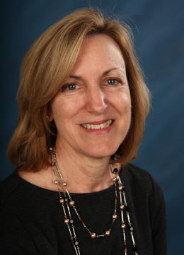
Center for Childhood Obesity Research
(CCOP)
NIH-funded Center of Biomedical Research Excellence
Focus of the Center:
  To better understand the origins of pediatric obesity, as well as the behavioral and environmental contributors; and
  To develop interventions designed to prevent and treat, and ultimately reduce, childhood obesity and its associated complications
Creates mentoring pathways for researchers whose work is focused on pediatric obesity (research project leaders and pilot projects)
Research Cores established
  Metabolism and Bioenergetics Core
  Biostatistics Core
  Community Engagement Core
Judy Weber, PhD, RD
CCOP Director
501-364-5113 weberjudithl@uams.edu
Notes:
ACRI has received two prestigious NIH awards to fund Centers of Biological Research Excellence (or COBRE) awards, grants that create world-class research environments for young faculty who are identified as the next generation of excellence in research.
In 2016, our first COBRE award, for $9.4 million, created a center for the study of childhood obesity. Led by Dr. Judy Weber, the multidisciplinary Center for Childhood Obesity Prevention strengthens ACRI’s obesity research capacity and creates mentoring pathways for emerging scientists whose work is focused on pediatric obesity. The Center also serves as an anchor for the development of a comprehensive pediatric obesity program in the Arkansas Children’s Health System statewide. The focus of the CCOP is to better understand the origins of pediatric obesity, as well as the behavioral and environmental contributors, and to develop interventions designed to prevent and treat, and ultimately reduce, childhood obesity and its associated complications.
In 2021, the center has been funded, for $11.5 million, for its second 5-year cycle.
New discoveries and knowledge produced through the work of the CCOP and partners throughout the state are continually being translated into novel programs, interventions, and treatments necessary to make our children not only better today but healthier tomorrow.

Slide 43
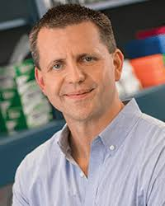
Center for Translational Pediatric Research
(CTPR)
NIH-funded Center of Biomedical Research Excellence
The mission of the center is to use proteogenomic approaches to identify epigenomic mechanisms and therapeutic targets in diseases, including cancer, impacting or translatable to the pediatric population
Creates mentoring pathways for researchers whose work is focused on utilizing systems biology approaches (research project leaders and pilot projects)
Research Cores established
  Administrative Core
  Proteogenomics Core
Alan Tackett, PhD
CTPR Director
501-686-6181
ajtackett@uams.edu
Notes:
In 2017, ACRI received its second COBRE award, for $11.5 million, to establish the Center for Translational Pediatric Research (CTPR).
Led by Alan Tackett, PhD, this center seeks to investigate how pediatric diseases develop from a systems biology and mechanistic approach, with the ultimate goal of identifying the intersections of disease and development, which will produce targets for therapeutic intervention and the development of new treatments for children. Systems biology is an integrated approach examining all events within cells, tissues, and organisms that lead to a particular outcome.
By applying a systems biology approach to the study of pediatric diseases, the center hopes to expand existing knowledge of pediatric disease development and contribute to new therapeutic targets.
The long-term goal of the CTPR is to build an innovative, multi-disciplinary pediatric research center that utilizes cutting-edge systems biology technologies and state-of-the-art translational research to study pediatric diseases.

Slide 44
COBRE Pilot Projects
Each COBRE provides funding for pilot project for junior scientists with matching research interests
Competitive 1-year awards with access to COBRE resources
Develops potential future COBRE research project leaders
Contact the COBRE PIs for more information
Notes:
Both COBREs at ACRI offer competitive Pilot Awards to junior scientists whose research interests closely match the focus of the COBRE.
These are typically one-year awards with access to COBRE resources. The programs help develop potential future COBRE research project leaders.
Contact the COBRE of interest for more information.
The Pilot Study Program of the Childhood Obesity Prevention (CCOP) Pilot Study Program awards $75,000/year for pilot study funding for research proposals that fit with the theme of the Center. Two to four awards may be issued in a year. Interested individuals should email Jami Jones (JLJones@uams.edu) for eligibility and additional information.
The Pilot Project Program of the Center for Translational Pediatric Research (CTPR) awards $75,000/year in direct costs to a junior scientist whose research interests closely match the focus of the CTPR. Two awards are issued every year. Interested individuals should email Dr. Alan Tackett (AJTackett@uams.edu) to ensure the proposed research fits with the mission of the CTPR.

Slide 45
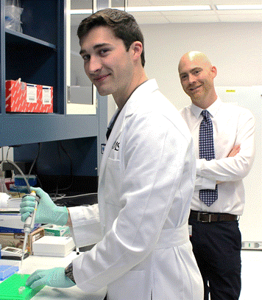
Summer Science Program
Summer Science Program
Each summer ~20 college students spend 8 weeks participating in research projects involving children’s health
Interested in serving as a mentor?
[Undergrads, Med or Grad students, Residents, Fellows]
Complete our survey at https://redcapwap.archildrens.org/redcap/surveys/?s=DL9D4D7N8W
Notes:
The Summer Science Program at Arkansas Children's Hospital, a program co-sponsored by the UAMS Department of Pediatrics and the Arkansas Children’s Research Institute, gives outstanding sophomore-, junior-, and senior-level college students the experience of a career in academic medicine—in both the clinical and the research aspects. The students spend 8 weeks during their summer shadowing physicians, attending rounds and clinics, and touring different hospital units, as well as participating in a mentored research project involving children’s health. Since the program began in 1992, over 300 students have participated in the program.

Slide 46
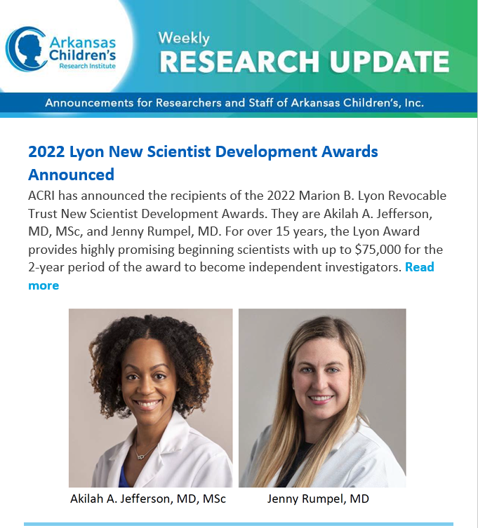
Weekly Research Update
ACRI’s weekly email of news,
events, training, and
funding opportunities
  To subscribe or submit news
  send your request to ResearchUpdate@archildrens.org
Notes:
ACRI notifies its researchers and research staff of pressing news, meetings, training sessions, funding opportunities, and other urgent announcements through a weekly email, Weekly Research Update.

Slide 47
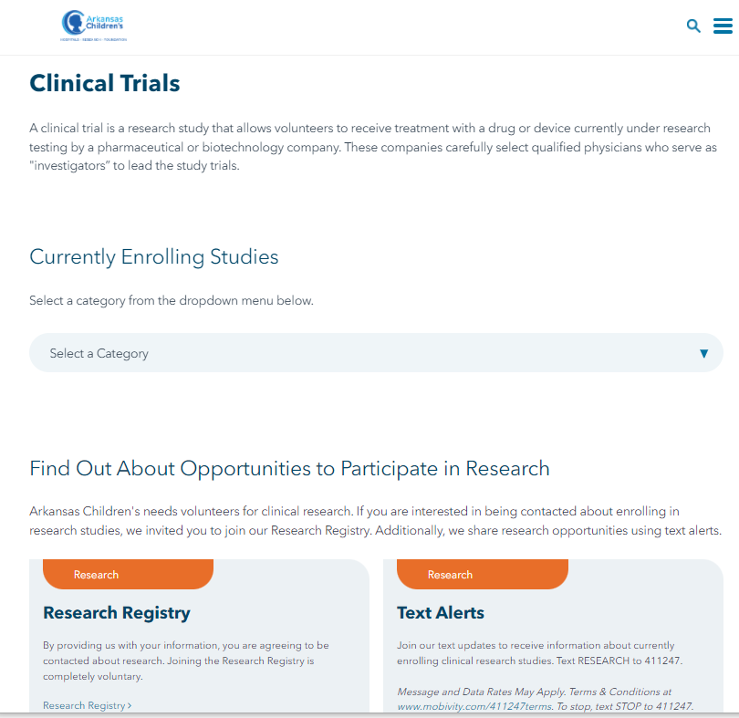
Currently Enrolling Studies
Many of our currently enrolling studies
are posted at
archildrens.org/clinicaltrials
IRB approval is required for posting of studies on the website.
Contact Phaedra Yount for assistance with drafting website content and posting studies on the website yountpa@archildrens.org
Notes:
We encourage investigators to post all research studies on the clinical trials page.

Slide 48

Learn More About Resources Available
Visit Our Resources for Researchers Site
https://www.archildrens.org/research/resources-for-researchers
or Call 501-364-7373
Download the Guidebook!
Notes:
If you would like to learn more about research at Arkansas Children’s, please visit our website.
In addition to details of our research programs, profiles of our researchers, and news about research accomplishments, you will find a directory of ACRI Administrative Staff.
The site also provides resources for those conducting or planning to conduct research at Arkansas Children’s.

Slide 49
Overview
July 1, 2019 – ACGME-accredited UAMS Clinical Informatics Fellowship Program
January 1, 2020 – Established Clinical Informatics Division, Department of Pediatrics, UAMS
Primary appointment
      Ashley Antipolo – Adolescent Medicine (CI Board certified 2021)
      Daniel Liu – Hospitalist Medicine (CI Board eligible)
      Jimmy Magee – General Pediatrics (CI Board certified 2019)
      Joe Thompson – General Pediatrics
      Feliciano (Pele) Yu, Jr. – General Pediatrics (Board certified 2013)
Affiliated Faculty
      Jared Beavers – Neonatology (CI Board eligible)
      Whit Robben – Anesthesia (CI Board eligible)
      Kandi Stallings-Archer – Pathology (Board Certified 2019)
      Donnal Walter – Neonatology (Board Certified 2013)
July 1, 2020 – Inaugural CI fellows
July 1, 2021 – Established AC Hospital Service for Clinical Informatics
October 1, 2021 – Established Research Informatics Core (ACRI)

Slide 50
What is our Purpose?
Clinical Informatics is the application of informatics and information technology to deliver healthcare services.
  Applied to direct patient care
  Informatics = Computer Science, Data, Analytics, AI
  IT = EHR, Devices, HIT Advocacy, Standards
  Deliver = bring value, engagement, connections
  Healthcare = goal is to improve health
  Services = process, activities, workflows
Health IT
Quality/Safety
Science

Slide 51
Informatics Services: What do we do?
EHR Optimization of Content and Clinical Decision Support
EHR Usability and Configuration Optimization
Software Development
Data Analytics and Knowledge Management
Research Informatics
Mentorship and Education

Slide 52
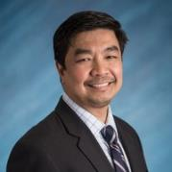
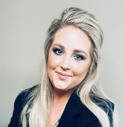
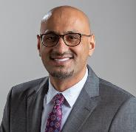
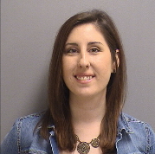
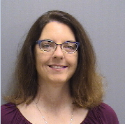
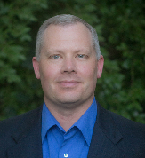
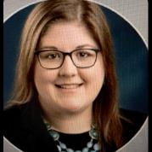
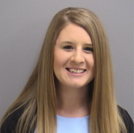
Research Informatics Core (RIC) Team Members
Pele Yu, MD MS
Chief Medical Information Officer (AC)
Erin Hathorn, MS
Research Informatics Program Manager (ACRI)
Ahmed Abu Halimeh, PhD
Research Informatics, Consultant
Judy Allen BSN, RN, CPN
Epic Application Analyst & Principal Trainer (AC)
Julie Nick
REDCap Informatics Program Manager
(ACRI)
Robbie Robinette
Senior Software Developer, Research Information Systems (ACRI)
Emily Erion
Human Research Protections Program Director (ACRI)
Nicole Schrader
Cosmos Systems Analyst, Systems Development (AC)

Slide 53








Research Informatics Tools at Arkansas Childrens
Slicer Dicer
Cosmos
Research Module

Slide 54

Ask RIC! Sessions
Every Monday 12:00 PM-1:00 PM (by appointment only)
https://compoint.peds.ad.uams.edu/ACRI/RIC
  RIC Sessions Registration/Appointment Form
  Users can attend the session to get answers/training on RIC tools or discuss research data requests.
Chelsea (Erin) Hathorn, MS
Research Informatics Program Manager (ACRI)
HathornE@archildrens.org

Slide 55
Research
These were from Jessica regarding UAMS resources

Slide 56
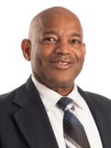
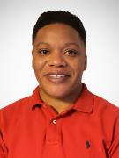
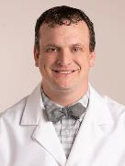
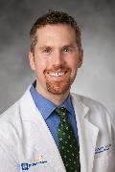
DoP Research Office
Brian Varisco
  ACRI Building, R3040
  BVarisco@uams.edu
  501-364-7512
Josh Kennedy
  Vice Chair Basic/Translational Research
  KennedyJoshuaL@uams.edu
Matt Kelley (Starting Feb 1)
  Vice Chair Clinical Research
Mark Mosby
  Senior Director, Research Administration
  MosbyMarkA@uams.edu
Antonia Conley
  Senior Grants Administrator

Slide 57
Innovative Teaching Methods for Fellows
Fellows Research Curriculum
  2 year cycle
  ~20 topics
  Mixed in with clinical core curriculum 2nd and 4th Mondays at Noon
ACH Research Seminar Series
  3rd Mondays at Noon
Fellow Scholarly Development Program
  Optional
  Bi-annual meetings with committee with deliverables
  Spec-aims focused
  Monthly meetings with VC Research
    1st Mondays at noon
  $5K award for final year possible

Slide 58
Supporting Grant Submissions
ACRI submits all grants for DoP faculty in which >=50% of work done at ACH or satelites
6-9 months before deadline, submit intake
Option for Grant Writer Support
Grant Review Panels
  ACRI
  TRI
  Bioventures
  Others OK too
Grant Writer Support
  List of screened providers with expertise listed
  Others not on list OK
  External awards only
  Limited ACRI-support
  1-2 month lead time
  0.1% total award if no grant review
  0.2% total award if reviewed
  One round of support per FY

Slide 59
Supporting Grant Submissions
ACRI submits all grants for DoP faculty in which >=50% of work done at ACH or satelites
6-9 months before deadline, submit intake
Option for Grant Writer Support
Grant Review Panels
  ACRI
  TRI
  Bioventures
  Others OK too
Grant Writer Support
  List of screened providers with expertise listed
  Others not on list OK
  External awards only
  Limited ACRI-support
  1-2 month lead time
  0.1% total award if no grant review
  0.2% total award if reviewed
  One round of support per FY

Slide 60
ACRI Facilities
Arkansas Children’s Research Institute (ACRI) was created to provide a research environment on the ACH campus to meet the needs of the UAMS faculty.
In addition to traditional research labs and animal facility, ACRI maintains a Pediatric Clinical Research Unit and the Research Pharmacy in the main ACH hospital building.

Slide 61
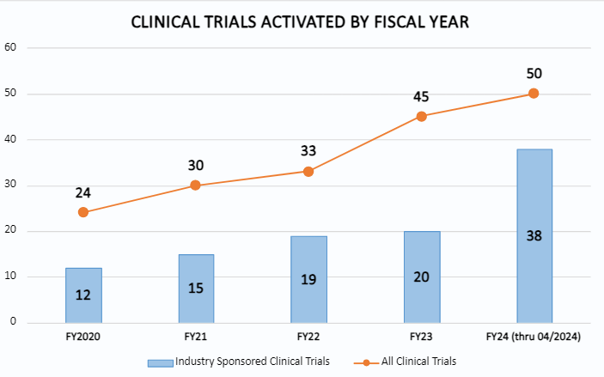
Research Impact
Support presentation at national and international meetings
  eFunds, Chair Funds
Turn abstracts into papers
  Biostats, research in progress meetings, writing support
Research communications
  Committees, Panels, Review papers
Participate in Clinical Trials

Slide 62
ACRI Biostatistics Core
Two PhD statisticians
An additional Master’s level statistician available by contract
One database manager
The team provides biostatistics support for Arkansas Children’s researchers
Research Design
Grant Planning
Statistical Analyses
Bioinformatics Analyses
Education
Database Support

Slide 63
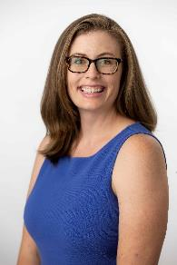

The LINK:
Leveraging Implementation and eNgagement for Knowledge Impact
MISSION: The Link accelerates the implementation and impact of Evidence-Based Interventions (EBIs) to improve the health of all Arkansas children by connecting communities and science.
SERVICES: Implementation Science and Community Engagement across all study and translational phases.
  Focus on pediatric health
  Direct support options (e.g., trained staff available for buy-out to conduct study activities)
  Intentional approaches to be relevant to even basic science researchers
  Free grant development support and fee-for-service structure upon funding

Slide 64

Research Support Services
Research Coordinator Pool: Nurses assist investigators with pre-site visits, IRB submissions, and day-to-day operations of their clinical studies. The costs associated with these services are direct expenses to the specific clinical study
Study Recruiting Support: Social media posting, community event advertising, Research Participant Database
Megan Gorski

Slide 65
Research Support Services
Clinical Trial Support: Research contract review and budget negotiation; research pricing for hospital services; quality assurance and regulatory compliance support
Grant Proposal Preparation Support: Assistance with editing grant proposals and scientific manuscripts, grant budget development support, assembly of application and completion of forms

Slide 66
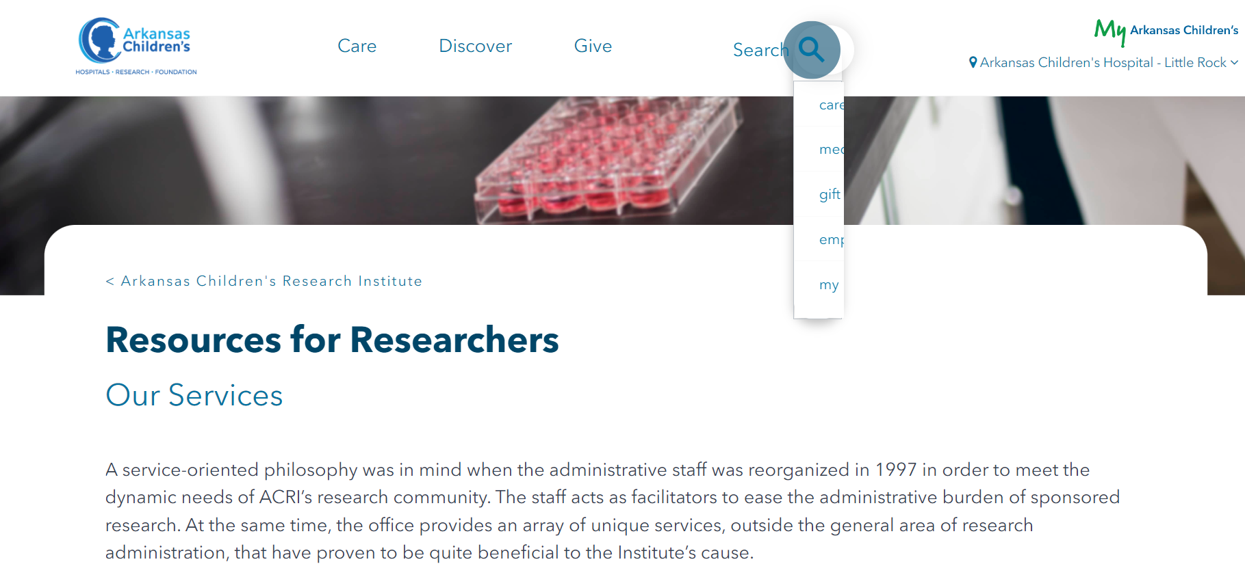

Slide 67
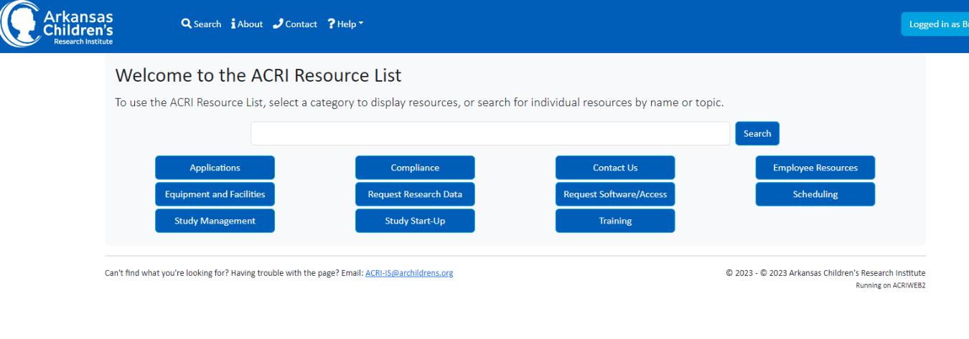
ACRI Resource List and Software Center
acriweb.archildrens.org/ResourceList

Slide 68

HELP!!! Just Call 47373
Don’t know who to call for help?
Simply call ACRI’s main office and our staff will be happy to direct your call to the appropriate staff member.
http://www.archildrens.org/research/about-acri/contact-us

Slide 69
Translational Research Institute (TRI)
Translational Research Institute (TRI)
Laura James, M.D.
Director
Mission
Develop new knowledge and novel approaches that will measurably address the complex health challenges of rural and underrepresented populations

Slide 70
TRI Resources & Services
Biostatistics | Research Services & Support | Community & Stake- holder Engagement | Informatics | General Info
Animal Studies | Clinical Trials Innovation Unit | Community Engagement Consultation | Biomedical Informatics (general) | Implementation Science Consult
Human Studies | ARResearch.org | Community Review Board | AR-CRIS | Research Forum
 | Medicare Coverage Analysis | Equipment Library | AR-CDR | Mock Study Section
 | Budget Development & Negotiations |  | Biomedical Informatics Consult
 | IRB Protocol Assistance |  | Honest Broker
 | DSMB |  | LimeSurvey
 | Regulatory (IRB) |  | PROFILES
 | Research Nurses & Coordinators |  | REDcap
 | Research Space |  | TriNetX Access
 | Specimen Processing

Slide 71
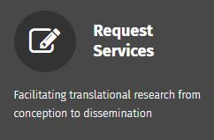

Got Research?
TRI Us!
Got Research?
TRI Us!
Submit your TRI service requests through an online form at:
TRI.uams.edu

Slide 72
Intramural Grant Programs
http://www.archildrens.org/research/resources-for-researchers/intramural-grant-overview
Research.uams.edu/grants_funding/intramural-funding

Slide 73
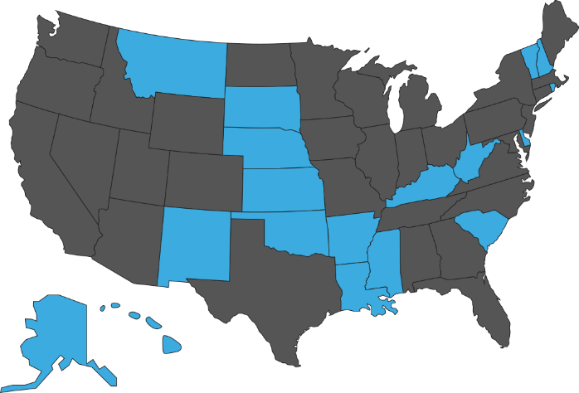

IDeA States Pediatric Clinical Trials Network
Initiated in September 2016
Current Composition:
  18 awardee sites (blue states)
    Support site level capacity building
    Perform clinical trials
  1 Data Coordinating and Operations Center

Slide 74


Slide 75

Resources
www.archildrens.org/research
  Get added to the ACRI newsletter: pyountPA@archildrens.org
TRI: TRI.uams.edu
  http://tri.uams.edu/research-ebook/
UAMS College of Medicine
  Office of Research | UAMS College of Medicine
UAMS Research & Innovation
  UAMS Research and Innovation
ISPCTN: ideapedtrials.uams.edu
  Email me to get on newsletter jsnowden@uams.edu

