Slide 1
Transjugular Intrahepatic Portosystemic Shunt (TIPS)
Background, indications, procedure, and outcomes for

Slide 2
Anatomy review

Slide 3
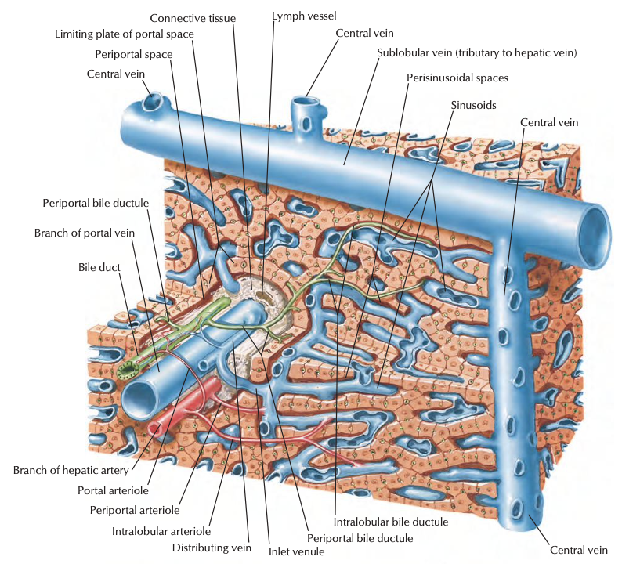
Netter

Slide 4
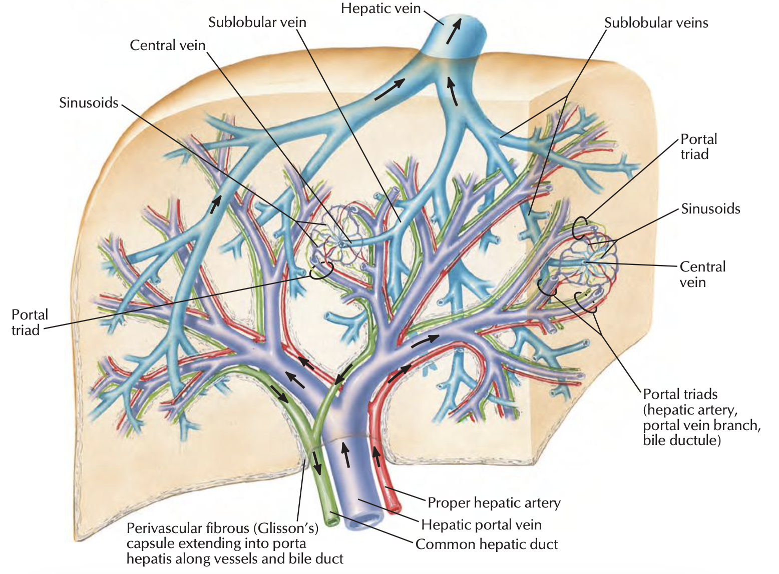
Netter

Slide 5
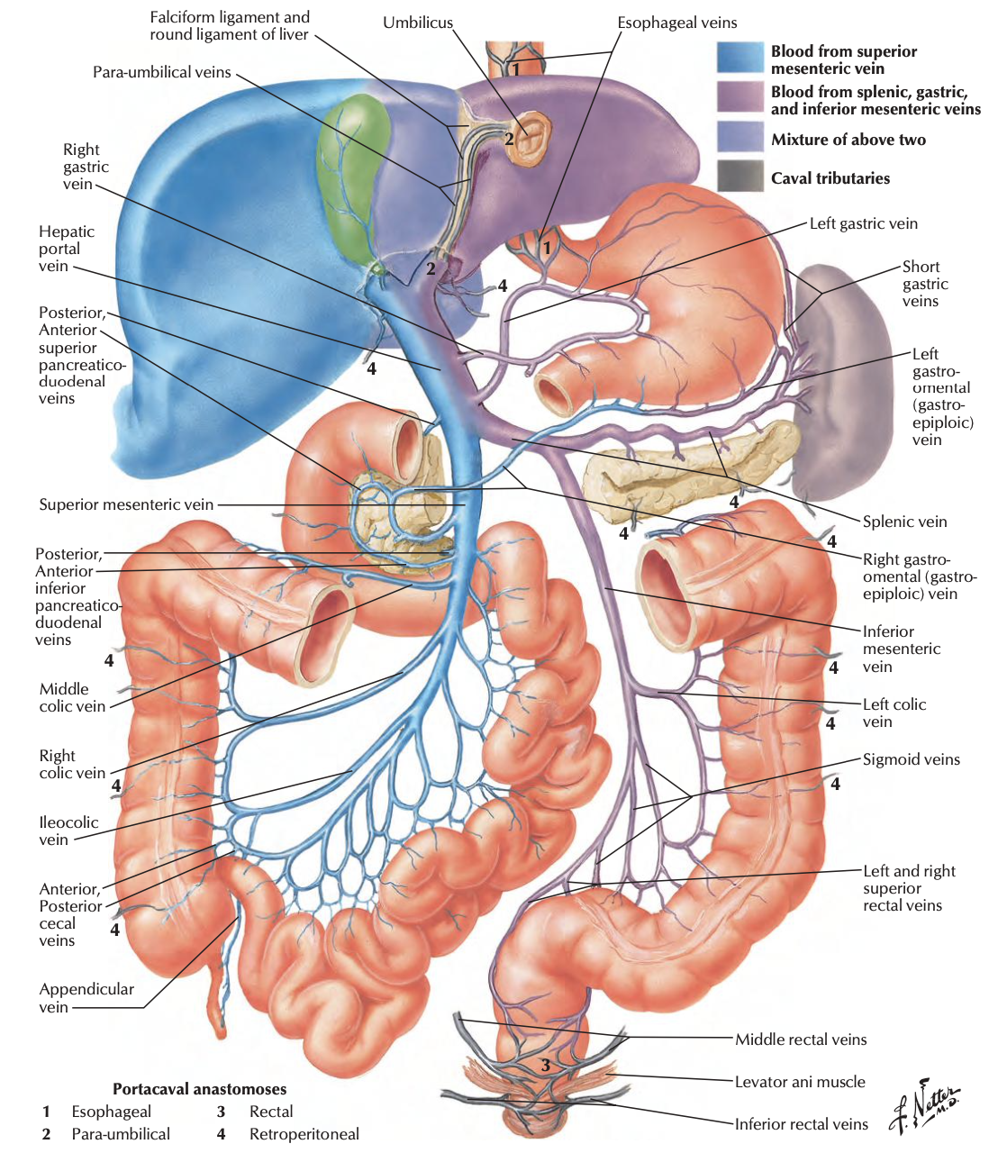

Slide 6
TIPS background

Slide 7
Portal HTN is an endpoint of liver disease
Chronic liver disease results in approximately 38,000 deaths a year, making it the 12th leading cause of mortality in the United States (CDC).
“Progressive liver disease results in portal hypertension…”
  “Cirrhosis is the most common cause, accounting for 90% of cases.”
  “Worsening portal hypertension leads to refractory ascites, hepatic encephalopathy, hepatic hydrothorax, hepatorenal syndrome, and variceal hemorrhage.”
IR playbook
Notes:
“Approximately 58% of patients with cirrhosis develop ascites within a decade of diagnosis and usually have a PSG of >12 mmHg”
“Initial management of ascites involves treating the underlying liver disease, sodium restriction, and the use of oral diuretics such as spironolactone and furosemide.”
“With worsening disease, patients may become resistant to or intolerant of diuretic therapy (>400 mg/day spironolactone or 160 mg/day furosemide), at which point serial large-­ volume paracenteses (LVP) are required…”
“Esophageal variceal hemorrhage occurs in approximately 25–40% of patients with cirrhosis, with each episode carrying an approximate 30% mortality risk ”
1) CDCData [Internet]. [cited 2017 Feb 3]. Available from: https://www.cdc.gov/nchs/data/nvsr/nvsr65/nvsr65_04.pdf.

Slide 8
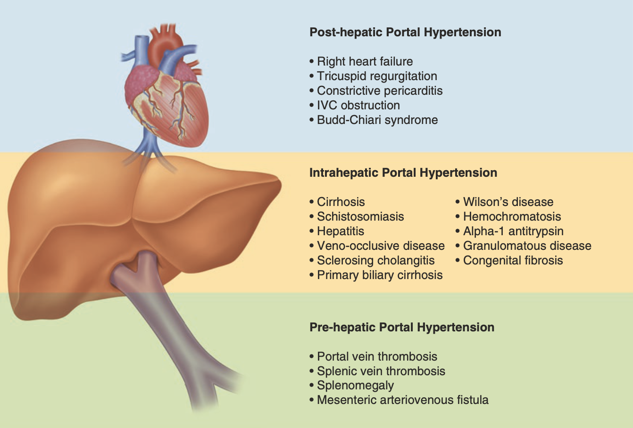
IR playbook
Notes:
Classifications of portal hypertension

Slide 9
A normal PG is 0–5 mmHg
Portosystemic gradient (PG)
Wedged hepatic vein pressure
Free hepatic vein pressure
=
-
Notes:
*Wedged hepatic vein pressure indicates the pressure of the hepatic vein with balloon occlusion of the hepatic vein outflow into IVC; it closely approximates sinusoidal pressure; much like pulmonary capillary wedge pressure

Slide 10
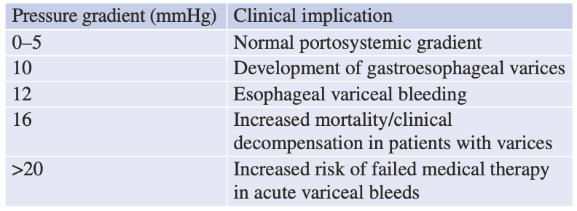
IR playbook

Slide 11
TIPS indications

Slide 12
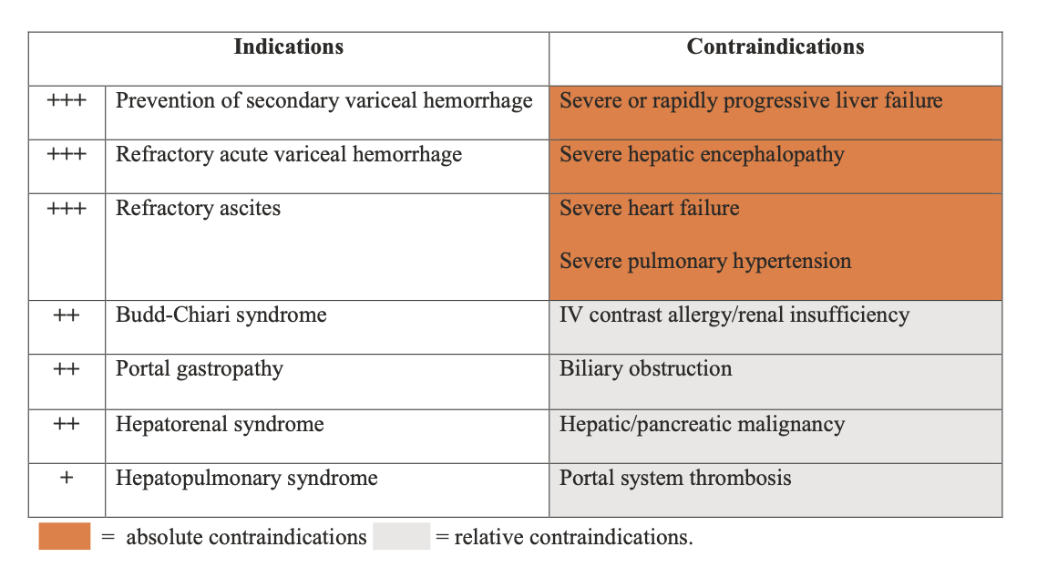
*Mean pulmonary artery pressure >45 mmHg
IR playbook
Notes:
+++ indicates greater strength of evidence

Slide 13
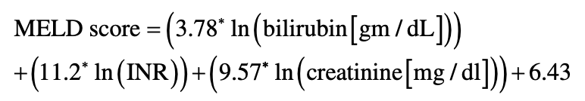
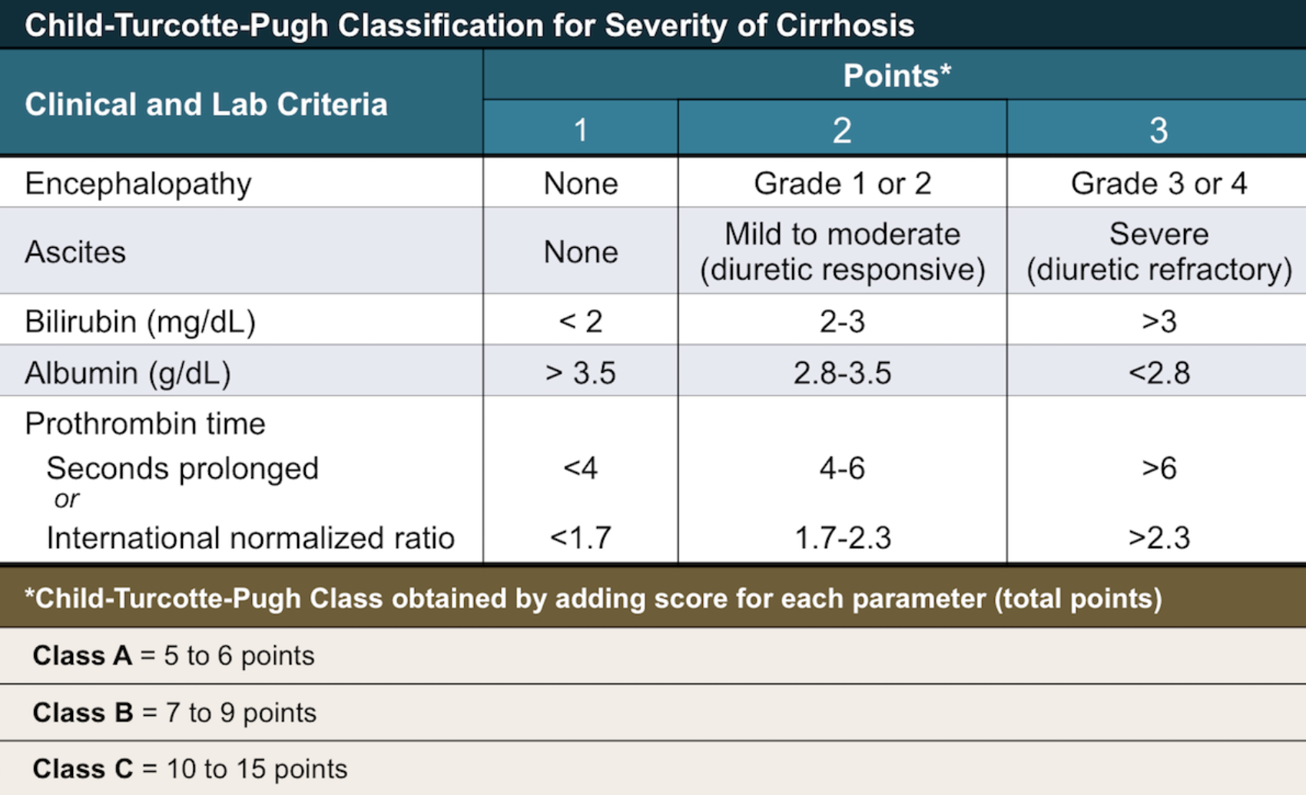
IR playbook
MELD >25
CTP>12
“Associated with increased risk of mortality following TIPS.”
Hepatitis C Online
“Compensated cirrhosis”
“Decompensated cirrhosis”
“Decompensated cirrhosis”
Notes:
MELD>25 has 72% mortality rate at 6 months post-procedure

Slide 14
TIPS referral

Slide 15
TIPS referral requires multidisciplinary collaboration
Internal medicine, GI, hepatology, and interventional radiology are all involved in the pre-procedural evaluation for TIPS
TIPS is most useful in the following cases:
  Refractory bleeding from esophageal varices
  Ascites refractory to LVP

Slide 16
TIPS pre-, peri-, & post-procedure

Slide 17
TIPS workup includes labs and axial imaging
CBC
BMP
LFTs
Coagulation panel
Axial imaging

Slide 18
TIPS is a percutaneous procedure
Caval access is obtained, typically from right IJV to SVC to IVC
10 Fr vascular sheath is used to measure IVC pressure
5 Fr curved diagnostic catheter is used to select a hepatic vein
Wedged venography is performed to map shunting path
TIPS needle and sheath are advanced through hepatic parenchyma towards portal vein
A guidewire is passed into the portal vein; splenic and portal venography is performed
Intrahepatic tract and balloon is dilated to 8 mm and measured for PTFE graft selection
Repeat pressure measurements and venography are performed
Residual varices are identified and embolized

Slide 19
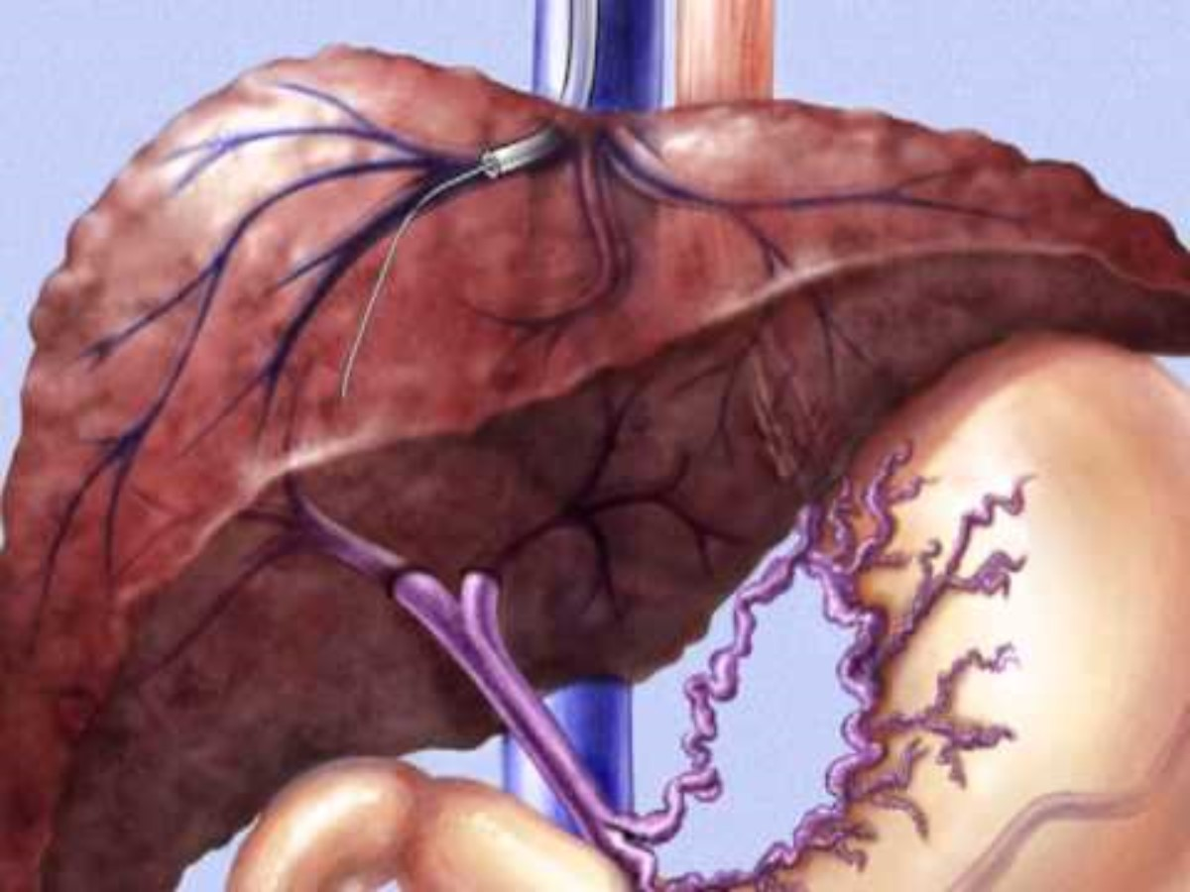

Slide 20
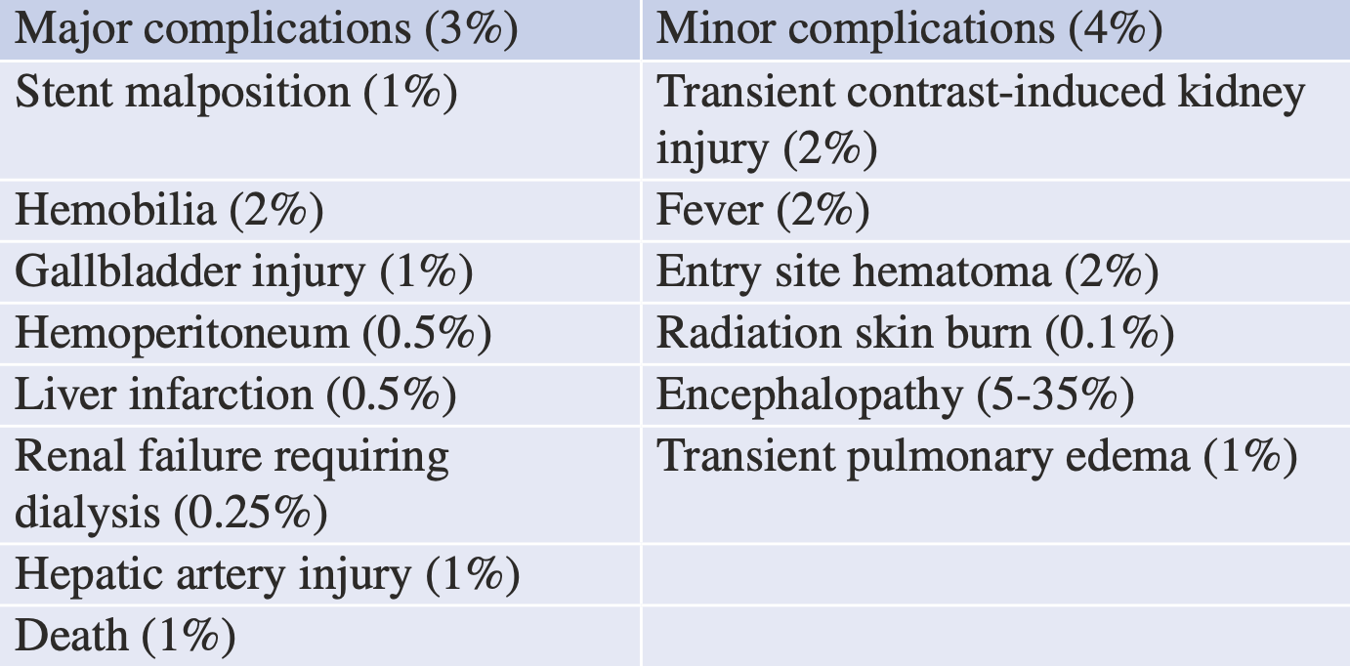
TIPS can have severe side effects
IR playbook

Slide 21
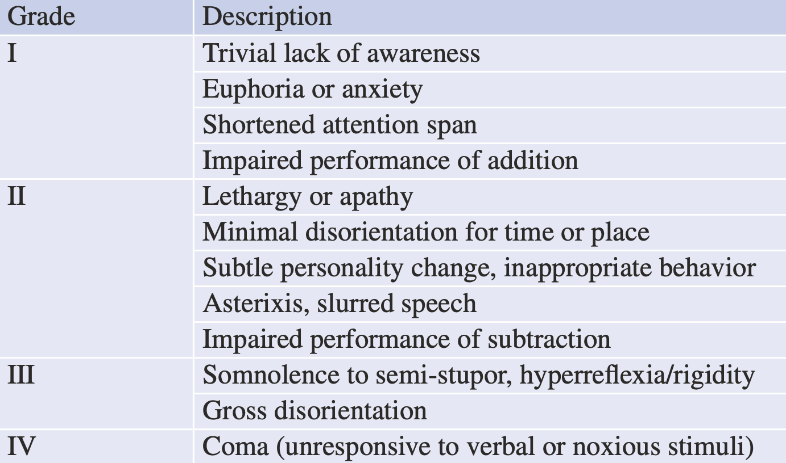
Hepatic encephalopathy occurs in 5-35% patients
IR playbook
Notes:
West-Haven criteria

Slide 22
TIPS outcomes

Slide 23
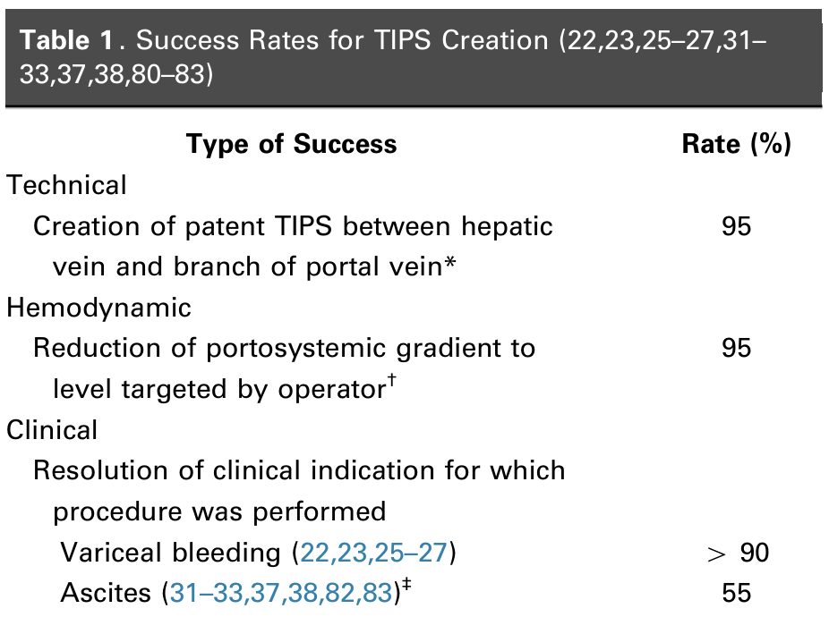
JVIR
Notes:
Clinical success is measured by “event-free survival”

Slide 24
TIPS is neither an instant fix nor permanent alteration
Overnight post-procedure monitoring is common
Clinic follow-up commonly occurs at 1, 3, 6, 12 months, then biannually thereafter
TIPS can be revised by stent downsizing or intentional thrombosis in the context of TIPS induced hepatic encephalopathy

Slide 25
TIPS case

Slide 26
TIPS + paracentesis can be beneficial for patients
H&P:
Decompensated cirrhosis, refractory ascites, varices
Procedure: TIPS, paracentesis
Brief op note:
Paracentesis drained 3275 ml
Successful TIPS creation between the middle hepatic vein and right portal vein
  Pre-TIPS pressures: portal pressure 28, right atrium pressure 16
  Post-TIPS pressures: portal pressure 24, right atrium pressure 19
Post-procedure instruction:
Monitor in PACU for a minimum of 1 hour until vital signs are stable, patient is AAOx3, and able to safely ambulate without assistance. Patient okay to return to floor after 1 hour
Right internal jugular access sites with woggles x 2 and dressings in place. IR will remove

Slide 27
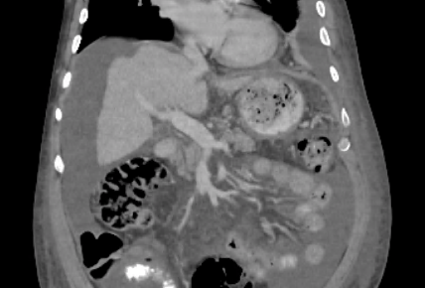
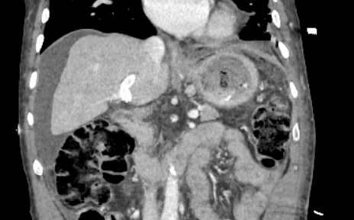

Slide 28
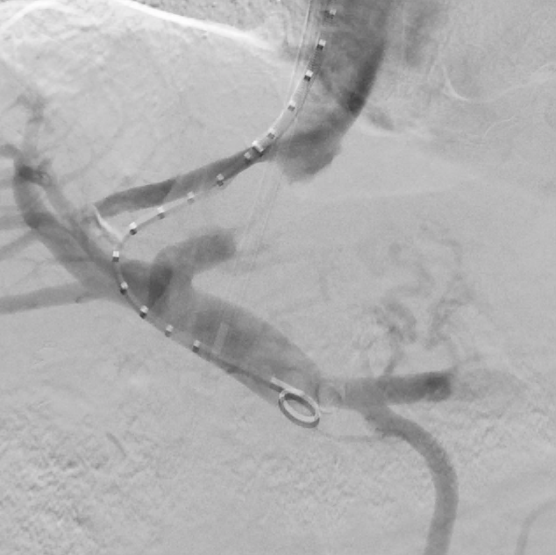
Hepatic v.
Portal v.

Slide 29
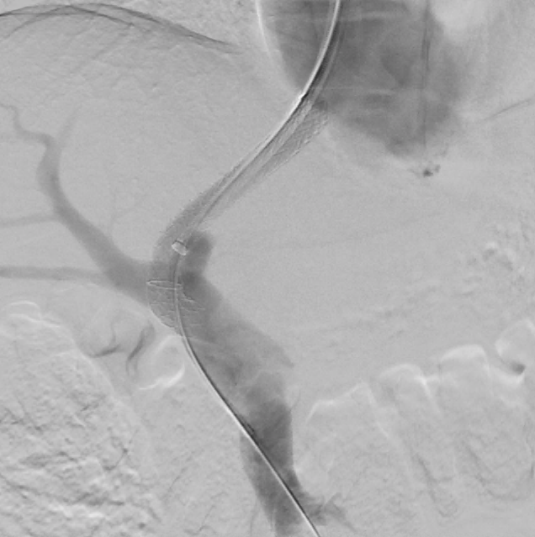
Hepatic encephalopathy is an indication for revision
Revision

Slide 30
References
Netter’s Atlas 6th Edition
IR playbook
Song et. al. 2018
Dariushnia et. al. 2016
IR playbook
Hepatitis C online

